Slide 1
Independent Evaluation of Bank Group Support to Health Financing Seminar with Expert Group for Aid Studies Sweden
Pia Schneider, PhD
Lead Evaluator Social Sectors
Independent Evaluation Group - IEG
Stockholm, November 7, 2014

Slide 2
Outline
Overview on Health Finance and Methods
6 Key Findings
2 Main Recommendations

Slide 3
Overview

Slide 4
WB’s share of Global Development Assistance to Health has decreased from 20% in 1998 to 6% in 2013

Slide 5
A Snapshot of Health Financing 188 Bank Operations in 68 Countries FY03-12 Of which, 35 Operations in 20 Fragile States

Slide 6
A Shifting Portfolio of Bank Interventions

Slide 7
Main Health Financing Activities Supported by World Bank
Revenues Public Sources
Level of health budget
Subsidies
Fiscal targeting
Information
Payroll taxes
Expenditure management
Paying health care providers
Revenues Private Sources
Purchasing
Level of user fees paid by patients
Risk Pooling
Tobacco taxes

Slide 8
Effectiveness of World Bank Group Support to Health Financing?
Revenue Collection for Health
Risk and Fund Pooling
Purchasing Health Care
Factors of success?
Equity in Service Use and Financing
Financial Protection
Efficiency

Slide 9
Methods – Triangulate Different Data Sources
Project Data
Country Case Studies
Impact Evaluations
Interviews
WBG Analytics
IEG Project Assessments

Slide 10
6 Key Findings

Slide 11
Finding (1): Bank Support Helped Raise or Protect Public Revenues for Health
Limited Support to Tobacco Tax in MICs
Government commitment needed to sustain higher budget level over time

Slide 12
Finding (2): More People Covered In Risk Pools and Equity in Pooling Improved
Bank support mainly in MICs helped:
Improved payroll tax collection and transfers
Improved equity in pooling where enrollment subsidized
Improved targeted budget transfers to health programs

Slide 13
Finding (3): Governance Obstacles to Pro-Poor Spending
Good governance systems influence implementation of health sector budgets and coverage.
Governance reasons why spending not pro-poor:
Budget management and planning
Technical capacity in government and health insurance
Information about benefits, beneficiaries and finances
Targeting leakages
Tied up investments and high reserves

Slide 14
Finding (4): Limited Attention to User Fees
Limited Bank support:
Only 15% of HF projects support fee reduction
Limited evidence of improved financial protection / utilization
Missing analysis about fiscal implications
Insufficient preparation of providers for increased demand

Slide 15
Findings (5): Purchasing Reforms Affect Utilization Several Concerns Remain
MICs: Insurance payment reforms (DRGs/Capitation)
LICs: Paying Providers by Number of Services
Improved data on service delivery
Increased service use
Concerns:
Demand-side barriers: Do the poor seek care?
Salary top-ups for health workers
Administrative costs
Financial sustainability
Institutional reforms for providers to react to incentives

Slide 16
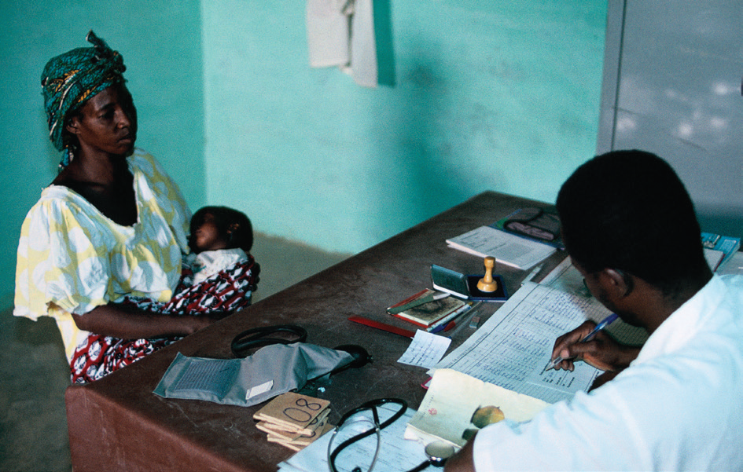
Finding (6): Utilization Not Improved in Some Cases, Despite Increased Pooling
Substantial improvements in some countries
Reasons why Utilization not Improved:
Information about benefits covered
Limited benefit package
Affordability
Service provision

Slide 17
Factors In Successful Bank Group Support
Collaboration
Analytical Work
Government Commitment
Integrating Health Financing
M&E in Projects

Slide 18
Challenges to Evaluation
Knowledge Work
By socio-economic groups
Project Results Framework

Slide 19
2 Main Recommendations

Slide 20
Integrate Health Financing With Broader Public Finance Context
Efficient and equitable revenue instruments (tax and non-tax) for health
Revenue and expenditure management to ensure revenues positively affect provision
Broader institutional reforms may be needed to support sustainability

Slide 21
Support Government Commitment and Build Capacity to Inform Financing Priorities
Standardized monitoring of health expenditures in governments:
National Health Accounts, Benefit Incidence Analysis
Analysis of targeting effectiveness
Fiscal and equity analysis of financing changes

Slide 22
To Sum it Up: 4 Main Messages
Bank support has helped raise or protect public revenues for health, and increased pooling.
This support did not always lead to pro-poor spending, improved utilization and financial protection.
Purchasing reforms are likely not sustained unless they are embedded in overall health financing and the broader public finance context.
Collaborate to draw from comparative advantages, to establish institutions and to support capacity building.

Slide 23
http://ieg.worldbankgroup.org/evaluations/wbg-support-health-financing
Independent Evaluation Group
Address Line 1
Address Line 1
City ABC
State DEFG

