Slide 1


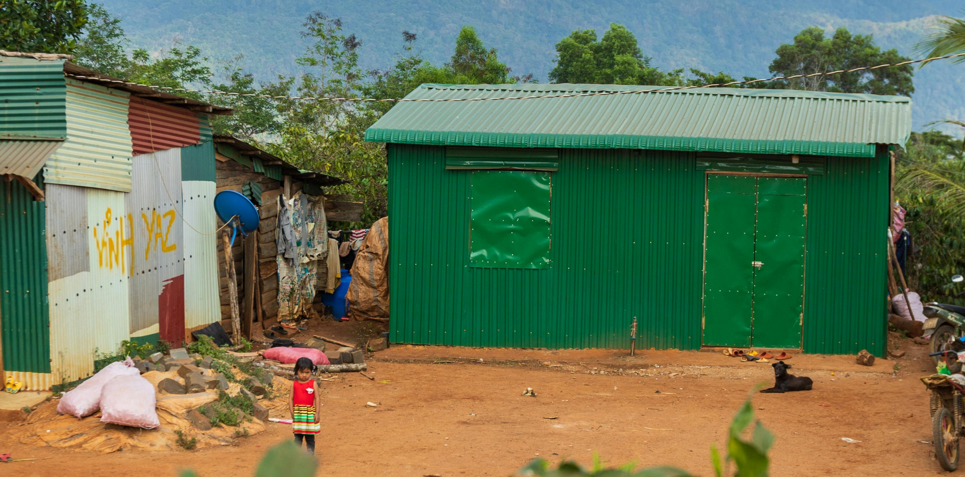
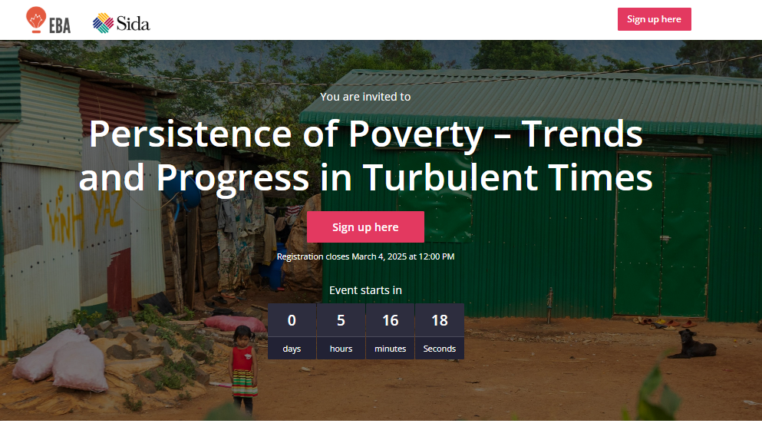
You are welcome to
Persistence of Poverty – Trends and Progress in Turbulent Times

Slide 2




POVERTY, PROSPERITY,
AND PLANET REPORT
2024

Slide 3
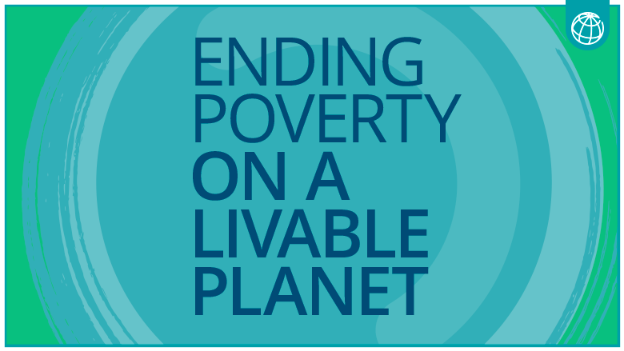
The World Bank has set a clear mission:

Slide 4
Global poverty reduction and improvements in shared prosperity have stalled
Progress

Slide 5
Extreme Poverty reduction has been significant, but recently the pace has slowed to a near halt
Poverty rate
Millions of poor
Source: pip.worldbank.org; horizontal dotted line shows 3% or 3% of global population in 2030.

Slide 6
At a higher poverty line ($6.85), almost half of the global population is poor and the number of people living in poverty remains unchanged since 1990
Poverty rate
Millions of poor
Source: pip.worldbank.org; horizontal dotted line shows 3% or 3% of global population in 2030.

Slide 7
The stagnation in poverty reduction reflects various factors
Slowdown in economic growth (even before the pandemic)
A concentration of the poor in slow-growth settings
The scarring impacts of the pandemic and high inflation
The increase in conflict and fragility

Slide 8
Poverty rates are still above pre-pandemic levels in Low-income countries
Poverty at $2.15
Poverty at $6.85
Source: pip.worldbank.org.

Slide 9
the regional composition of poverty has changed over time
Millions of poor (less than $2.15 per day)
Source: pip.worldbank.org.

Slide 10
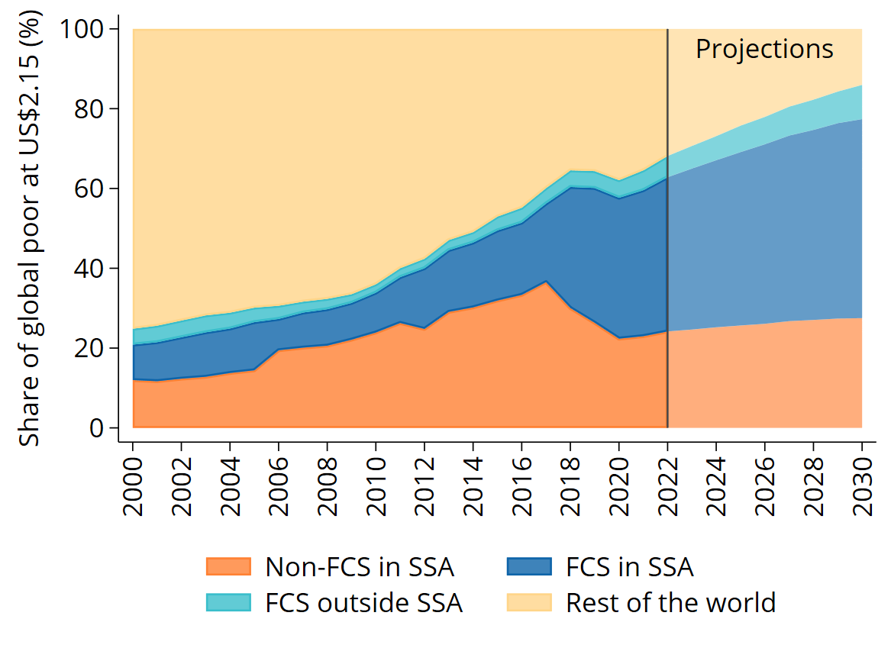
Looking ahead, poverty will be increasingly concentrated IN SSA and FCS countries
Share of extreme poor in Sub-Saharan Africa and FCS
Share of extreme poor in Sub-Saharan Africa and IDA
Source: pip.worldbank.org.
Notes: FCS = Fragile and conflict affected situations; IDA = International Development Association; SSA = Sub-Saharan Africa. Countries in FCS and IDA are defined following the World Bank classifications for each year until 2022, and keeping the definition fixed in 2022 for the years after.

Slide 11
At current levels of economic growth, poverty will not be eradicated for decades
Millions of poor (less than $2.15 per day)
Source: World Bank calculations, pip.worldbank.org; horizontal dotted line shows 3% or 3% of global population in 2030.

Slide 12
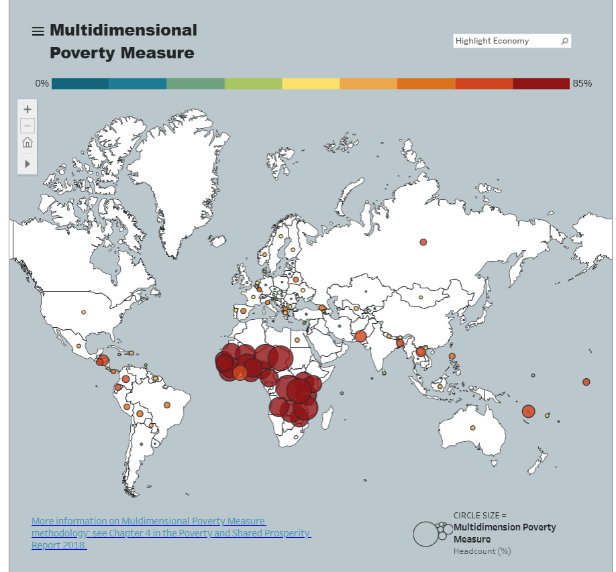
Poverty is multidimensional and goes beyond income
Data from the World Bank’s multidimensional poverty measure (MPM) suggests a modest decrease in the multidimensional poverty rate from 14.4% from circa 2018 to 13.4% in 2021

Slide 13
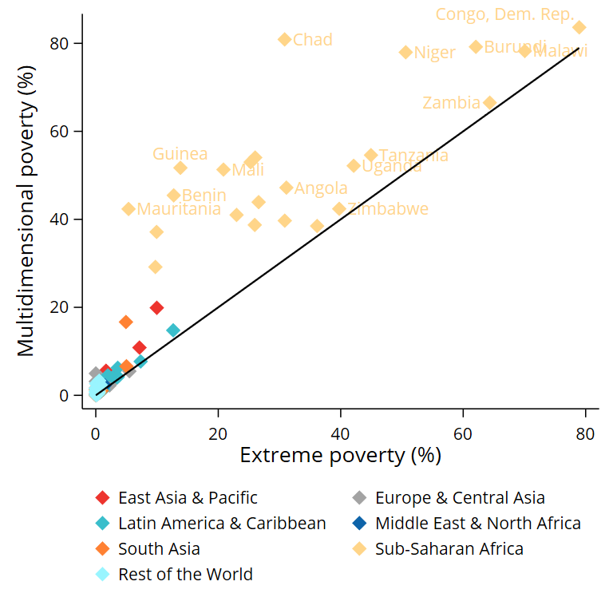
multidimensional poverty rates are often considerably higher than monetary poverty rates, Especially in Sub-Saharan Africa
Multidimensional poverty (MPM) vs monetary poverty ($2.15)

Slide 14
Country innovations: A complexity approach to understanding multidimensional poverty
Poverty Space
A visual representation that maps out the structural relationships between various dimensions of poverty. It helps us see how different aspects of deprivation are interconnected.
Poverty Centrality
A measure that assigns an importance score to each dimension within the network. This score reflects the prominence of each indicator and its potential as a strategic intervention point.
Two new measures based on network science to analyze multidimensional poverty:
Source: Stojkoski, Viktor; Lopez-Calva, Luis F.; Bolch, Kimberly; Fernandez, Almudena. 2024. Development Acupuncture: The Network Structure of Multidimensional Poverty and Its Implications. Policy Research Working Paper; 10882. World Bank,.
Notes:
These measures are applied to data from 67 developing countries using the Global Multidimensional Poverty Index (MPI).
We map the interconnected structure of multidimensional poverty and track changes over time.
Using network science highlights key "nodes" where targeted interventions could have a larger impact on reducing overall poverty.

Slide 15
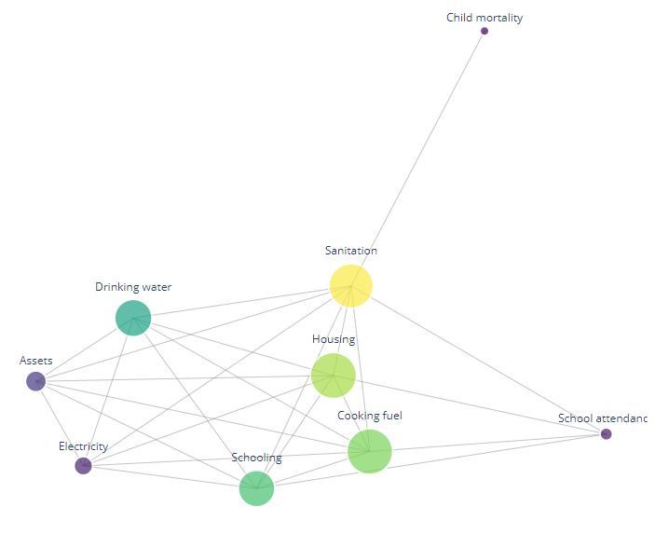
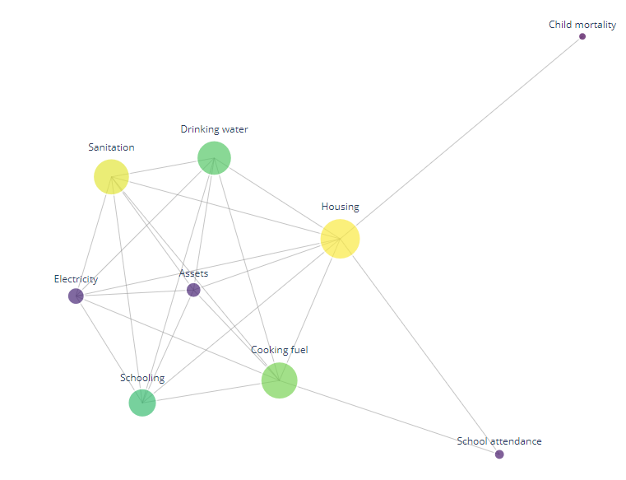
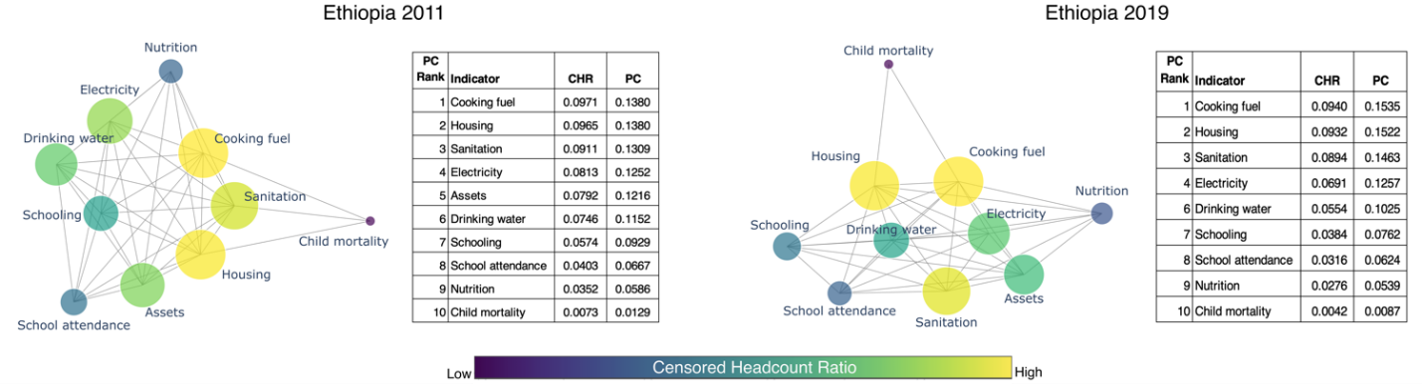
Development as acupuncture: How are different dimensions of well-being interlinked & how do they co-evolve over time?
The nodes represent poverty indicators, whereas the edges between two poverty indicators highlight a significant structural dependency. The size of the nodes is proportional to its poverty centrality.
Colombia 2010
Colombia 2016
Source: Stojkoski, Viktor; Lopez-Calva, Luis F.; Bolch, Kimberly; Fernandez, Almudena. 2024. Development Acupuncture: The Network Structure of Multidimensional Poverty and Its Implications. Policy Research Working Paper; 10882. World Bank,.
Notes:
Colombia:
While deprivations in each dimensions improve over time (all indicators, except for drinking water), the structure remains very similar. Housing remains most central indicator in both years. Child mortality remains least central indicator. The centrality of all indicators stays the same over the two years (with exception of assets and electricity which switch places).

Slide 16
A new indicator: understanding vulnerability from a multidimensional perspective
No access to
water
A person is at risk from
climate hazards if...
Exposed to climate hazards
Vulnerable to experience losses
No access to
electricity
AND
Physically vulnerable
Low access to
services and markets
Flood
Low income
Drought
No access to social protection
Extreme heat
Unable to cope
No access to
financial instruments
Cyclones
Low education level

Slide 17
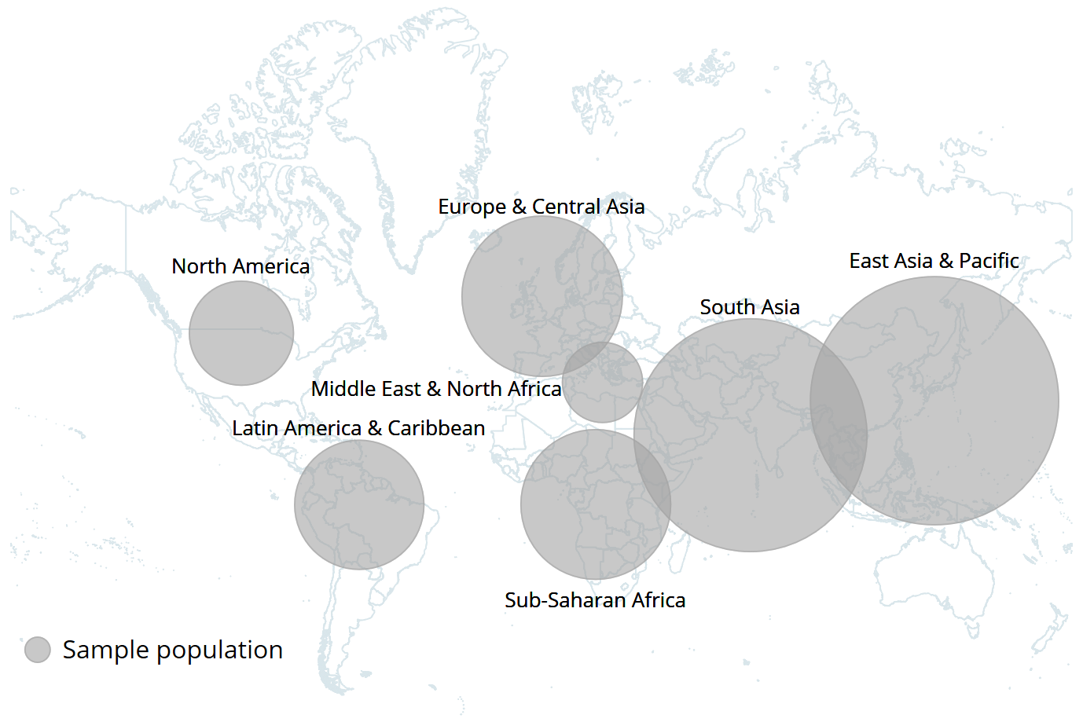
one in five people are at risk of experiencing welfare losses due to an extreme weather event from which they will struggle to recover
Source: World Bank Scorecard indicator: the percentage of people at high risk of climate-related hazards globally, https://scorecard.worldbank.org/en/scorecard/home.

Slide 18
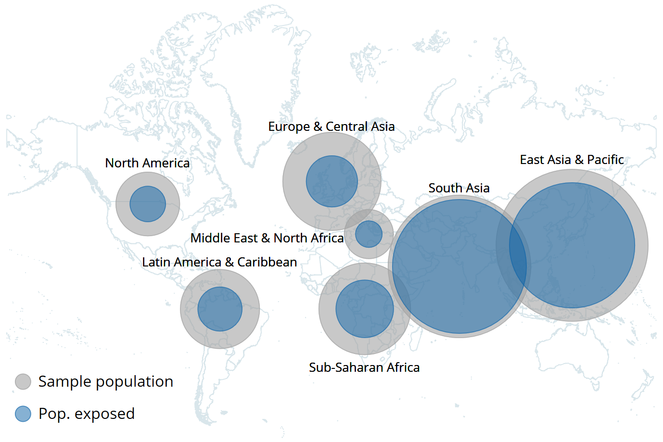
one in five people are at risk of experiencing welfare losses due to an extreme weather event from which they will struggle to recover
Source: World Bank Scorecard indicator: the percentage of people at high risk of climate-related hazards globally, https://scorecard.worldbank.org/en/scorecard/home.

Slide 19
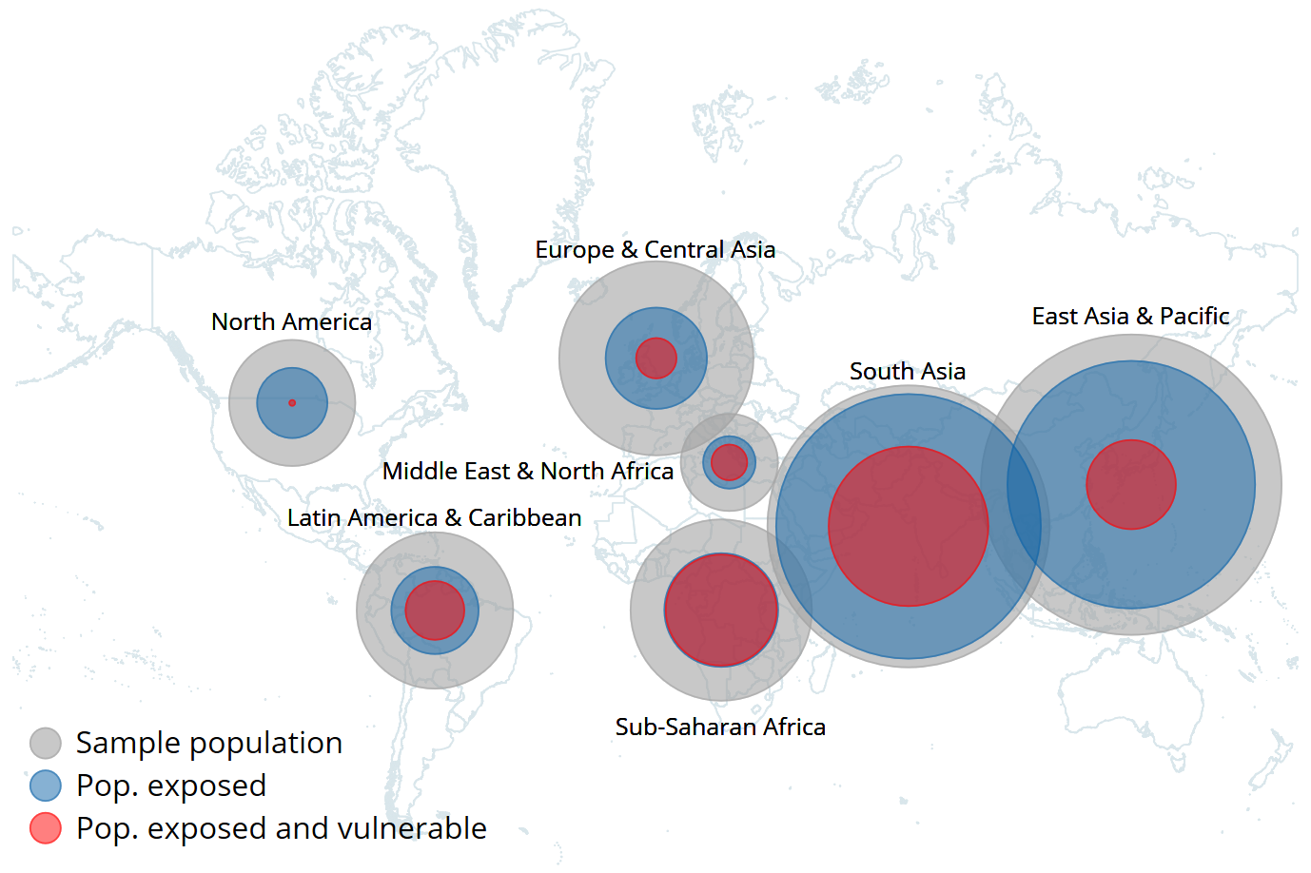
one in five people are at risk of experiencing welfare losses due to an extreme weather event from which they will struggle to recover
Source: World Bank Scorecard indicator: the percentage of people at high risk of climate-related hazards globally, https://scorecard.worldbank.org/en/scorecard/home.

Slide 20
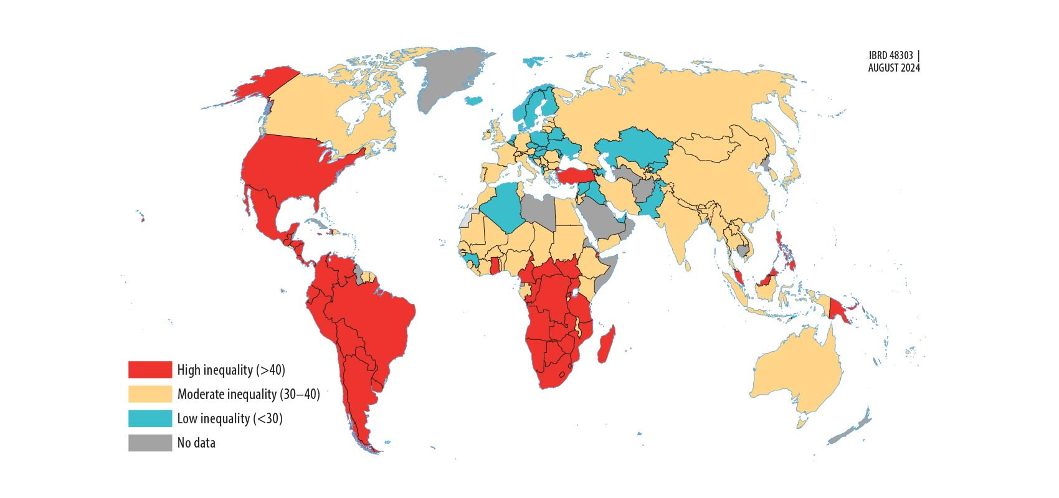
The number of economies with high inequality has fallen, but remains high in Latin America and sub-Saharan Africa
Source: pip.worldbank.org.

Slide 21
Eradicating poverty and boosting shared prosperity on a livable planet requires managing trade-offs
Pathways

Slide 22
Progress on the three interlinked goals requires faster and inclusive growth and protecting people from extreme weather events
Growing incomes for the poor
Better-functioning labor markets
Investments in the productive capacity of people
Structural conditions that enable socioeconomic mobility
Protecting people from extreme weather events (and other shocks)
Lowering vulnerability by enhancing risk management
Preventing the escalation of future climate hazards by accelerating transformations to reduce the emissions intensiveness of growth

Slide 23



policy makers must prioritize and make difficult choices
TRADE-OFFS
between growing incomes and lowering emissions​
CONSTRAINTS
to scale up synergistic policies
(e.g., cut air pollution)
TRANSITION COSTS
and how to manage them varies by
context

Slide 24
Actions need to consider where the poor live and where emissions come from
Extreme poor in 2024
GHG emissions in 2022
GHG emissions in 2050
(current policies)

Slide 25
Advancing on eradication of extreme poverty does not come at a big cost for the planet
Additional emissions from poverty reduction

Slide 26
Doing what matters where it matters the most
Priorities

Slide 27
Priorities to advance on the interlinked goals
Prioritize mitigation while managing transition costs
Prioritize income growth that reduces vulnerability, and pursue synergies (such as cutting air pollution)
Prioritize poverty eradication by fostering investment in human, physical, and financial capital

Slide 28
Advancing on these interlinked global challenges requires a solid foundation of evidence
Foundational efforts to strengthen national statistical systems
Innovative approaches to collect data and for modeling
More investment is needed to produce reliable, granular, and timely data.
Bringing a multidimensional lens to poverty, shared prosperity, and the livable planet.

Slide 29
Urgent and coordinated global action is essential to meet these interlinked goals
The financing gap for sustainable development is growing, which hinders lower-income countries’ ability to invest across multiple objectives.
This constrained environment creates an urgent need to focus and prioritize the actions that will have the highest return for development and that can allow the world to make significant progress.
It calls for fundamental changes in how countries approach their national development strategies and their contribution to global public goods.

Slide 30

Coming soon!
April 2025: Next bi-annual update on global poverty
In addition to updating global estimates with the latest household surveys (twice per year), this special update will feature updated international poverty lines (new!)
April
2025
Notes:
India data was released over the summer and the new PPP were published in May 2024.
3PR mentions that for 2011, India’s extreme poverty rate is cut in half (22.9 to 13.4) when switching from URP to MMRP.
At the time of writing, the 3PR did not incorporate two relevant sets of information due to its concurrent publication: i) 2022/23 Household Consumption and Expenditure Survey (HCES) for India and ii) the 2021 purchasing power parities (PPPs).
The report’s key conclusions remain robust, including the increasing concentration of extreme poverty in SSA and fragile countries.
Our teams are expected to conclude the analytical evaluation of this information by the global poverty update of Spring Meetings 2025.

Slide 31
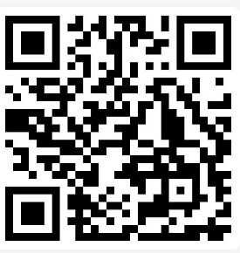
POVERTY, PROSPERITY,
AND PLANET REPORT
2024
Thank you!
www.worldbank.org/3pr

Slide 32
Persistence of Poverty – Trends and Progress in Turbulent Times

