Slide 1

Sweden’s Financing of UN Funds and Programmes: Analyzing the Past, Looking to the Future
Stephen Browne & Thomas G. Weiss
Stockholm, 30 November 2017

Slide 2
UN Funds & Programmes: Chronology
ITU
1865/1945
UPU
1874/1945
UNESCWA
1973
WFP
1963
ILO
1919/1945
UNFPA
1969
UNCTAD
1964
ITC 1964
FAO
1945
UNECA
1958
UNEP
1972
ICAO
1945
Specialized agencies
UNESCO
1945
UNESCAP
1949
HABITAT
1978
WB/IMF
1946
Special Fund
1959
UNAIDS
1996
WHO
1948
UNECLAC
1948
UNDP
1965
UNICEF
1946
UNODC
1997
GATT
1948
EPTA
1950
WMO
1951
UNECE
1947
UN
Women
2010
IAEA
1957
UNHCR
1950
IMO
1958
WIPO
1970
IFAD
1977
UNIDO
1985
UNWTO
2003

Slide 3
The UN Development System
Security Council
General Assembly
Economic and Social Council
Funds and Programmes
Regional Commissions
Specialized
Agencies
WORLD BANK
GROUP
UN Secretariat
UNDP (UNCDF)
UNICEF
WFP
UNFPA
UNCTAD
ITC
UNEP
UN-HABITAT
UNAIDS
UNOPS
UN-DESA
UNODC
UN Women
UN ECA
UN ECE
UN ECLAC
UN ESCAP
UN ESCWA
ILO
FAO
UNESCO
WHO
UNIDO
IFAD
UNWTO
ICAO
IMO
ITU
UPU
WMO
WIPO
IAEA
UNHCR
UNRWA
UN training and research organizations
UN functional commissions
Regional and country field system (1,000+ offices)
Many regional locations; between 5 and 20 separate UN offices per country

Slide 4
Organizational Challenges of UN (Development) Multilateralism
Expansion by adding new organizations, but with…
No overall strategic plan or guidance, leading to…
Unbalanced core resource allocations but also…
Inconsistent and inaccurate funding data
Dispersed system of independent organizations which are…
Patronized by individual member-states leading to…
A: For donors as principals, rapid increases in non-core funding, accompanied by…
Excessive concentration on quick results, burdensome reporting, but…
B: For programme countries as principals, no objective assessment of organizational performance and relevance and…
No commitment to value-for-money

Slide 5
Development Context
UN a declining ODA force facing further funding cuts, yet…
…High expectations because of 2015-2030 agenda which, however…
…Does not mention human rights (Myanmar, Sri Lanka…)
Graduation of many programme countries to middle-income status, but…
Several countries suffering chronic conflict and fragility, which demand…
A more joined up UN system which doesn’t exist

Slide 6
Reform Context
Ten years of limited action
DaO blueprint (2006) not fully implemented
UN system too compartmentalized
Problem of the firewall
No strong UNDS head
Member-states resistant to change

Slide 7
Main Challenges of UN Funding
Decrease in core, increase in non-core resources
Inaccurate and ambiguous funding data

Slide 8
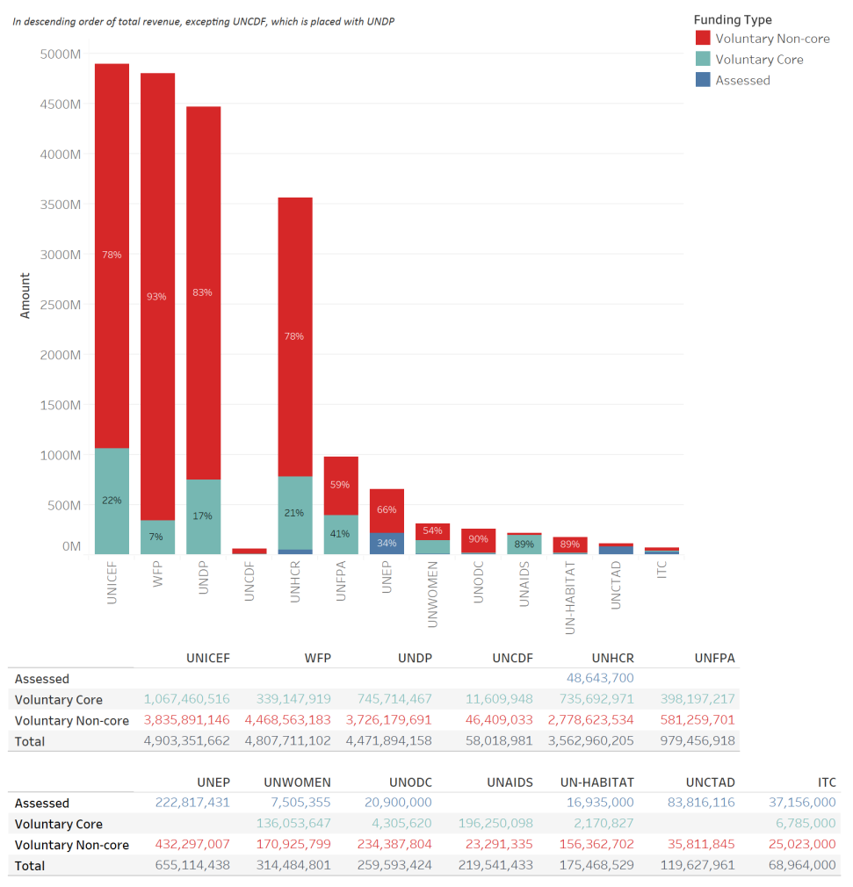
UN Funds & Programmes: Core/Non-core

Slide 9
Types of Funding Source (Simplified)
 |  | Number of Contributors | Overheads | Coverage (Programming Agenda) | Eligible Programme Countries | Reporting | Evaluation
Core funding | Assessed (Least Earmarked) | Full membership | - | Entire organizational mandate (agreed corporate strategy) | Unrestricted | Annual report of organization | Standard
 | Voluntary Core | Individual donors | - | Entire organizational mandate (agreed corporate strategy) | Unrestricted | Annual report of organization (normally) | Standard
Non-core funding | Soft Voluntary Non-core | Individual donors Clusters of donors (pooling) | 5-8% 7-8% | Part of organizational mandate Part of organizational mandate | Countries selected by UN Countries selected by UN | Individual reports for donors Collective report to donors | Standard or customized Agreed with donors (collective)
 | Hard Voluntary Non-core | Individual donors | 5-8% (donor-determined) | Donor-interest priority | Countries selected by donors | Individual reports customized by donor | Standard or donor-driven
 | Restricted Voluntary Non-core (Most Earmarked) | Individual programme countries | 5%+ | Perceived national interests and ownership | Contributor’s country | Jointly determined by organization and donor | Jointly determined

Slide 10
Challenges of UN Funding: UNDP Today

Slide 11
Advantages of Core: Development
Supports organizations in their strategic planning, research, advocacy, norms
Provides flexibility when needs change
Facilitates forward planning
Provides leverage, including to attract private sector funding for innovation
Jump-starts activities and provides seed money
Can reimburse funds advanced for unforeseen purchases
Reduces transaction costs: direct (time/energy of limited staff) and indirect (competition, waste, salaries of locals, etc.)
Addresses unpopular or silent or long-running crises
Subsidizes experiments that carry risk
Supports prevention, which is harder to sell

Slide 12
Advantages of Core: Humanitarian
Fills gaps when appeals fall short
Improves emergency responses
Helps leverage earmarked funding
Tides over the period emergency to development gap

Slide 13
Challenges of UN Non-core Funding: Development
Bilateralization: diversion and dilution of core mandates
Transformation of UN organizations from donors to implementers
Competition for funds healthy competition (?), but further atomization of the system: follow the money not mandate
Emphasis on short-term results, not longer-term change
Emphasis on narrow technical rather than broad developmental concerns
Donor driven = not aligned to programme country priorities
Diversion of staff resources: excessive time for donor wooing, reporting
Declining commitment to core mandates, especially norms, standards
Subsidization by core of non-core
Declining overhead charges (race to bottom)

Slide 14
Challenges of UN Non-core Funding: Humanitarian
Unbalanced allocations of funding, more rigidity
Underfunding of longer-term crises
Underfunding of permanent infrastructure: staff, offices etc
Underfunding of reserves for new crises

Slide 15
Mitigating Factors
In general, more earmarking = less management control
However, more control can be achieved by managements through:
A strong, coherent corporate strategy
Clear results orientation
Unified programme budgeting (core plus non-core)
Use of thematic trust funds
Pooling of donors, joint programming (MPTF model)
Narrower, more focused development mandate
Willingness to refuse funding offers, request higher overheads

Slide 16
Solutions?
Appoint a strategic head of UNDS
Pool all development and humanitarian funding
Make UNDP the sole UNDS coordinator
Realign all organization mandates to eliminate duplication
Ensure all programmes are joint
Fully incorporate human rights into development/humanitarian
Not going to happen?

Slide 17
Nine Recommendations (Do-able)
Sweden should:
Sponsor a new Independent International Commission on UN Funding (IICUNF)
Press for clearer, more uniform definitions and nomenclature for the various UN funding categories
Request that all UN organizations to improve their messaging around the importance of core funding
Prioritize its non-core support to UN funds and programmes which, in its judgment, are the most effective in articulating clear and credible corporate strategies
Lead discussions on more predictable financing of essential normative activities
Press for standard ways of measuring and justifying overhead costs
Increase its contributions to pooled and core funding for humanitarian relief
Withdraw its non-core funding from UNDP encouraging it to emphasize its original central funding and coordination role within the UNDS rather than its role as an operational competitor within the system
Consider withdrawing funding from its favored enclaves in individual UN organizations

