Slide 1


MULTILATERAL FUNDING: KEY FACTS AND TRENDS
Financing the UN Funds and Programmes: is Sweden
being taken for a ride?
Stockholm, November 30th 2017

Slide 2
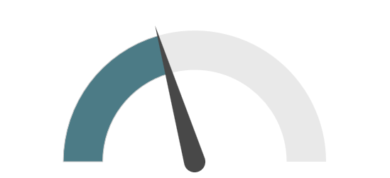
OECD work on multilateral development finance :
a system-wide view:
about 2/5 of ODA goes to and through multilateral organisations
Where does this money go?
Who are the largest contributors?
Where are multilateral outflows directed to?
How is the architecture of multilateral organisations evolving over time?
How are providers’ funding practices affecting the performance of multilateral organisations?
How can providers best spend their ODA money to support multilateral organisations deliver effectively?

Slide 3
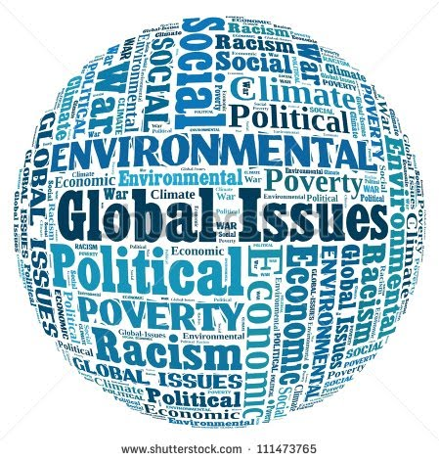
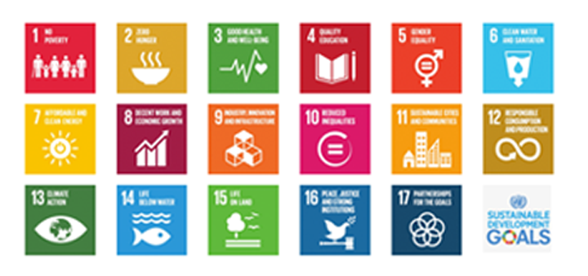
Multilateral organisations have historically played a key role to reduce poverty worldwide and promote a more equal world
In the era of the 2030 Agenda, their role could be even more important :
Politically-neutral conveners of global partnerships,
Vehicles for upstream pooling of resources,
Facilitators for multi-stakeholder cross-border operations, and
Setters of global standards and norms.

Slide 4
Are current financing trends supporting multilateralism?

Slide 5
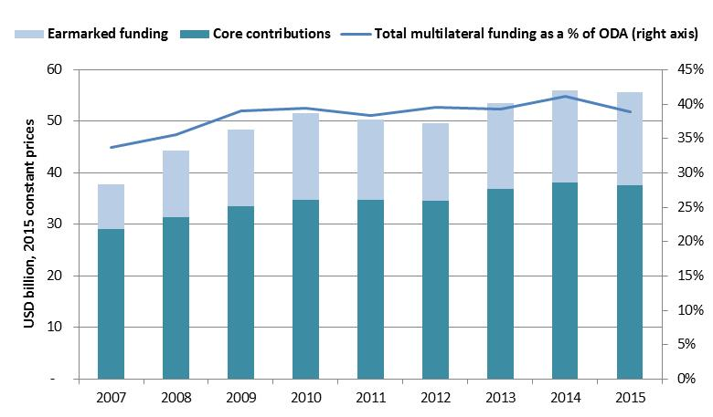
FACT #1: Funding to multilateral organisations is decreasing slightly
After consecutive increases in 2013 and 2014, in 2015 multilateral funding (USD 55.7 billion) has decreased (-0.5%) and represents now a slightly smaller share of ODA (39%, from 41% in 2014).
Source: OECD-DAC, gross disbursements, constant prices, USD billion (2015)

Slide 6
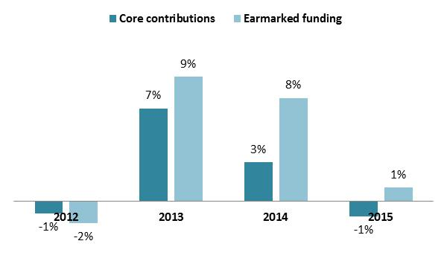
Fact #2: Funding is increasingly tied to specific projects and purposes
Only earmarked funding increased in 2015 (+1%) to be offset by the decrease in core resources (-1.2%);
Over time, earmarked funding increased much faster than core resources, doubling since 2007 and now represents an increasing share of multilateral funding (33% in 2015, up from 23% in 2007).
Source: OECD-DAC, gross disbursements, constant prices, USD billion (2015)

Slide 7
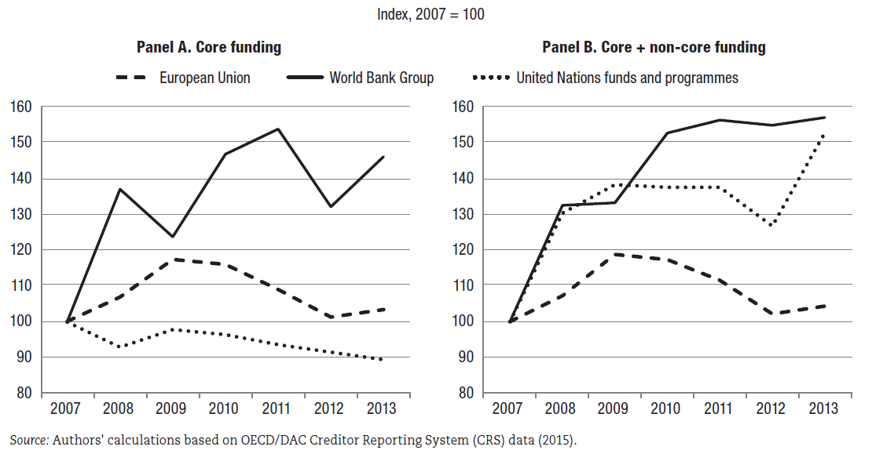
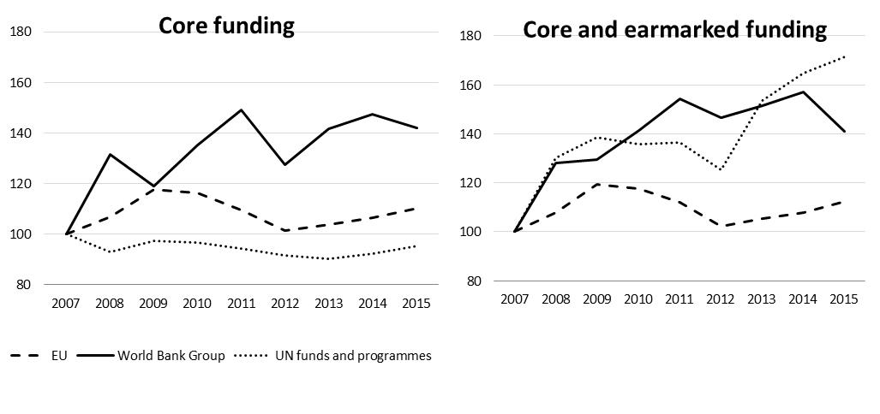
UN funds and programmes are particularly reliant on earmarked funding
A need for more core resources and “better” earmarked funding

Slide 8
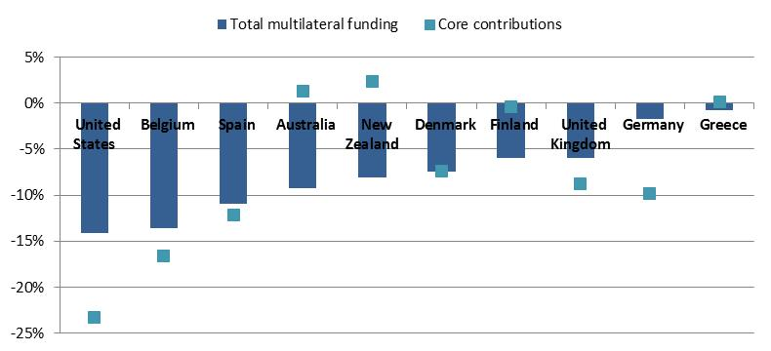
Fact #3: Large decreases in multilateral funding – mainly in core resources - by some large providers
Percentage changes between 2014 and 2015
Source: OECD-DAC, gross disbursements, constant prices, USD billion (2015)

Slide 9
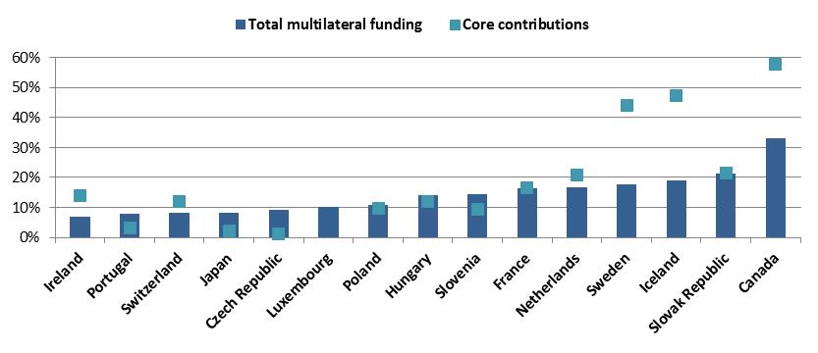
…but also some increases
Percentage changes between 2014 and 2015
Source: OECD-DAC, gross disbursements, constant prices, USD billion (2015)

Slide 10
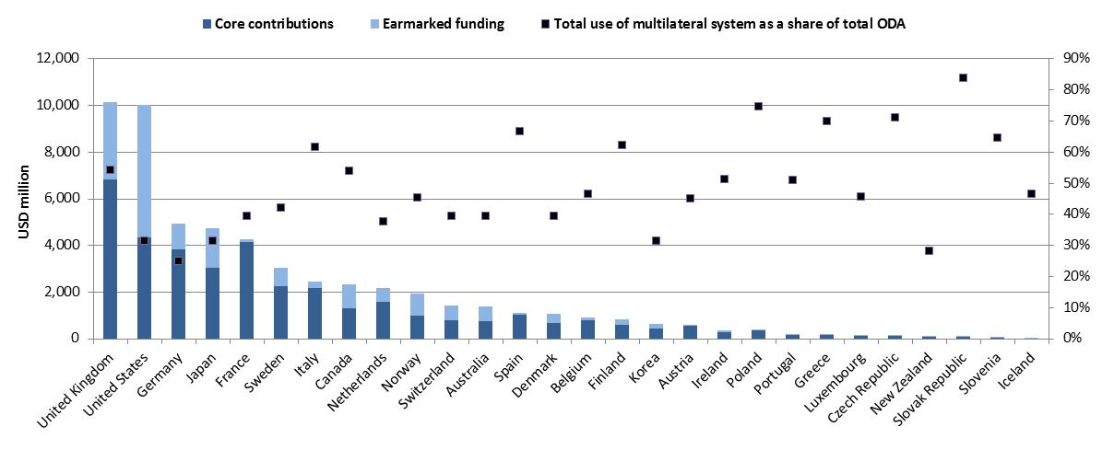
Donors engage with multilateral organisations to different degrees and in different ways
Source: OECD-DAC, gross disbursements, constant prices, USD billion (2015)
Notes:
This graph shows the heterogeneity across DAC members :
in volume terms (as illustrated by the bars in the chart): the sum of core and non-core contributions in 2015 ranged between USD 10.2 billion (UK) and USD 18 million (Iceland). The second largest multilateral donor was US (USD 10 billion), followed by Germany (USD 4.9 billion), Japan (USD 4.7 billion), and France (USD 4.3 billion). Sweden is the sixth largest at USD 3 billion.
In relative terms (as illustrated by the little squares in the chart): the use of the multilateral aid system as a share of gross ODA ranges from 84% of Slovak Republic to 25% of Germany. For Sweden it is 42%.
When EU contributions are excluded, the United Kingdom becomes the largest provider in relative terms, followed by Italy, Canada, Finland and Austria.

Slide 11
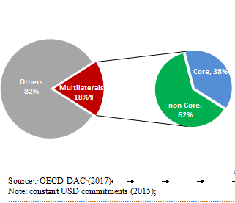
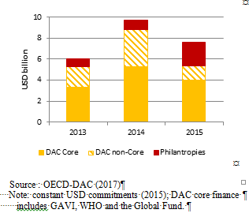
Fact #4: Growing sources of financing beyond sovereign states and DAC providers
Private sources, including foundations;
Non-DAC providers;
Other multilateral organisations (such as vertical funds, EUI, etc)
Philanthropic support to multilateral organisations
2013-15
Philanthropic and DAC support
for health - 2013-2015

Slide 12
Fact #4: Growing role of non-DAC providers
Considerable increase in funding to “ODA-eligible” multilateral organisations from 7 large non-DAC providers (+51% in 2009-13) – but still small compared to DAC members’ multilateral funding (USD 1.2 billion compared to USD 59 billion in 2013).
Set up of new multilateral institutions: the New Bank (“BRICS bank”) and multilateral funds and initiatives under the leadership of China, such as the Asia Infrastructure Investment Bank.

Slide 13
Going forward
Evidence-based discussion on the quality of overall financing to multilaterals (core + earmarked) that could deliver pragmatic solutions (i.e. WHO pilot);
Implications of a universal development agenda and contribution to Global Public Goods – capturing the normative role of multilaterals via TOSSD;
New funding models and instruments for sustainably leveraging additional resources;
Implications of “graduation” criteria and transition phases;
Systemic complementarity and coherence

Slide 14
Thank you
Find out more at: http://www.oecd.org/dac/aid-architecture/multilateralaid.htm
Notes:
The report will of course be available on line, as the web remains a key communications/dissemination tool for us.
But in the past the webpages have not been so easy to navigate.. Therefore, we have been working to improve the quality of the webpages on multilateral aid. New webpages are currently available
We will also have dynamic charts going live at the same time as the launch of the Report in July.

Slide 15
Backup-slides

Slide 16
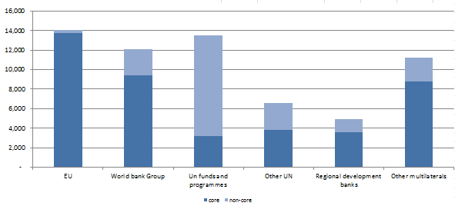
Funding across groups of multilateral organisations
Three clusters of multilaterals receive the bulk of funding;
Each has a different composition of resources
Core and non-core funding in 2015
USD million
Notes:
Total multilateral funding continues to be mainly concentrated in:
the European Union (21% of total core and non-core flows),
the World Bank Group (22%) and
the United Nations funds and programmes (20%).
The composition and pattern of flows towards multilateral organisations differs significantly:
EU: minimal reliance on non-core and no overall upwards trend of funding (funding fell in 2010-12, rebounded in 2013 yet remaining below its 2009 peak of USD 14.2 billion in real terms);
WBG: large importance of non-core; both core and non-core have grown over time;
UN funds and programmes: large and growing reliance on non-core (non-core resources represented 58% of total funding in 2007 versus 76% of all funding in 2013); growth in total funding to UN funds and programmes since 2007 has mainly been due to increases in non-core funding as the core-base has progressively eroded.
Multilateral flows to developing countries (both multilateral outflows originated by core resources and earmarked funds) are predominantly focussed on LDCs but this focus is diminishing over time. However on the positive side the recent replenishments (IDA, AfDB) have shown increased future allocations to fragile states.

Slide 17
Decision-making: some examples
Notes:
Here’s a snapshot of how decision making varies across DAC members…
Some have a very concentrated model, like Australia, other more pluralistic, like Spain
No model is better than the other a priori, but make sure you have enough coherence and that you don’t approach the same organisation through several different interfaces – this is confusing for multilaterals

Slide 18
Non-DAC providers

Slide 19
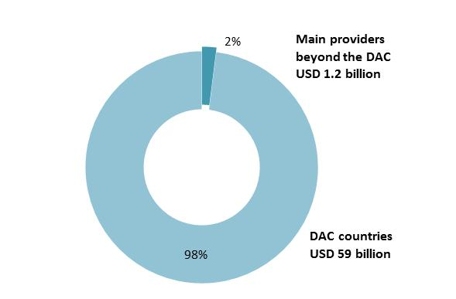
Seven* large providers beyond the DAC account for 2% of flows to multilateral organisations
Total funding to multilateral organisations by DAC members and seven* main providers beyond the DAC, 2013
*Brazil, China, India, Saudi Arabia, South Africa, Turkey, United Arab Emirates
Source: OECD DAC Multilateral Aid 2015

Slide 20
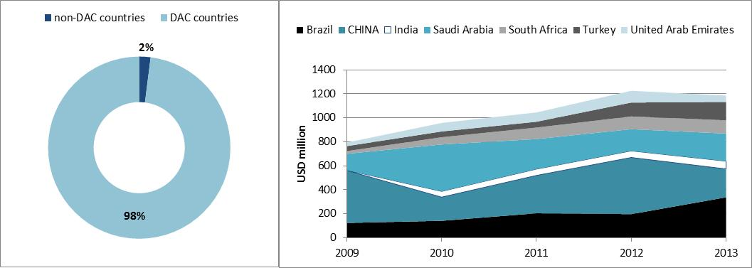
Multilateral funding increased by 51% in 2009-13
Source: OECD DAC Multilateral Aid 2015

Slide 21
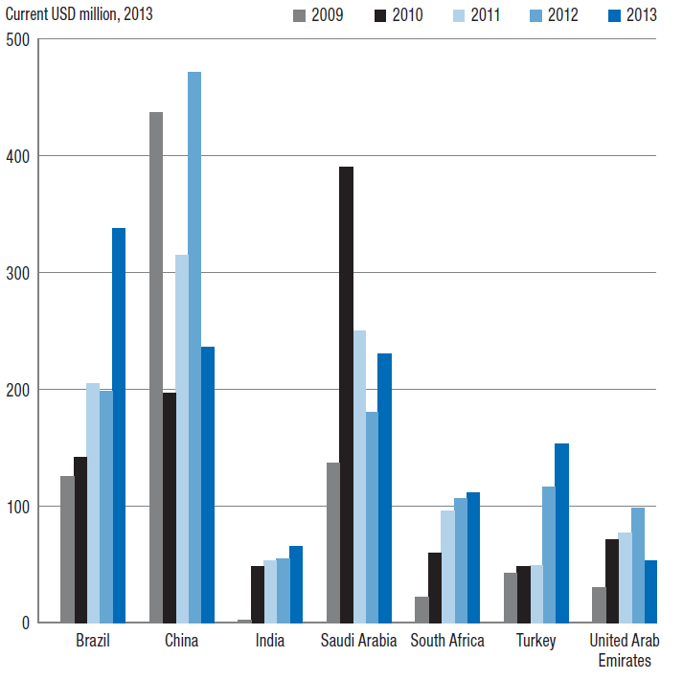
Individual countries increased multilateral funding to different extents
Funding to and through multilateral organisations
Source: OECD DAC Multilateral Aid 2015

Slide 22
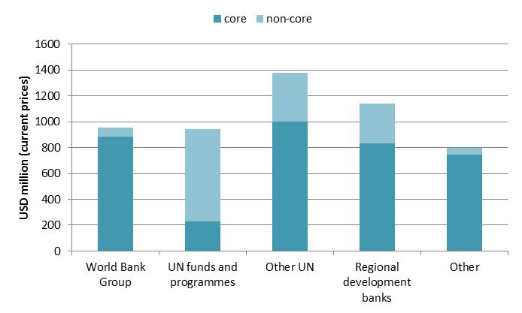
Funding across groups of multilateral organisations
Sum of funding in 2009-13, current prices
Source: OECD DAC Multilateral Aid 2015
Notes:
Almost half of all multilateral funding (core + non-core) from the focus countries was concentrated on the UN system (44%, or USD 2.3 billion), especially UN specialised agencies and other UN entities (“Other UN” in Figure 5.4), which received the largest share of 2009-13 funding (26%, or USD 1.4 billion). DAC members’ funding is instead mainly concentrated on the EU, the World Bank Group, and UN funds and programmes, each of which receives around 20% of total DAC funding.
Regional banks are the second largest recipient cluster of funding (22% of all funding, or USD 1.1 billion). This figure is largely impacted by China’s financing to regional development banks (66% of all of its multilateral funding in 2009-13), especially IaDB and AfDB (USD 531.20 million and USD 209.86 million, respectively).
The World Bank Group received 18% of all multilateral funding from the focus countries in 2009-13 (USD 953 million), mainly because of contributions to its concessional lending arm, the International Development Association (IDA). Unlike DAC members, focus countries’ contributions to trust funds are minimal (only 4% of all funding to the World Bank Group, or USD 66 million).
Almost three-quarters of non-core funding from the focus countries is directed to UN organisations (72%, or USD 1.09 billion), especially UN funds and programmes (USD 713 million). The majority of the funding from focus countries to UN funds and programmes is earmarked (76%), similar to DAC members.
. “Other UN” includes UN specialised agencies (e.g. FAO, ILO, UNESCO and WHO) and other UN entities (e.g. IFAD and UNOCHA)
. This finding is in line with Eichenauer (2015). However, it should be noted that, in line with the DAC statistical system, in this chapter contributions to large WBG trust funds like GEF and the Global Fund are accounted as core contributions.
. In line with the OECD/DAC statistical system, this figure excludes contributions to large trust funds such as many of the World Bank’s Financial Intermediary Funds (e.g. the Global Fund and CGIAR). These are included in the “Other” cluster and contributions to them are counted as core contributions.
. UN funds and programmes include UNDP, UNHCR, UNICEF and WFP.

Slide 23
Diversity of providers beyond the DAC
Importance of multilateral funding in overall concessional development finance (from less than 7% to 25% or more)
“Focus institutions” (mainly MDBs for China and South Africa, while mainly UN/WBG for the others)
Purpose and modalities of partnerships (from humanitarian aid, to own capacity development, to enhancing south-south co-operation)
Prospects of future engagement (longer versus short term/ mainly through new or old institutions)
Notes:
These seven providers differ with regards to the ways they engage with multilateral organisations for promoting development, mainly in terms of:
Importance of multilateral funding in overall concessional development finance:
Less than 7% in the case of China, India, Turkey, Saudi Arabia and the United Arab Emirates;
25% or more in the case of Brazil and South Africa;
“Focus partnerships”
MDBs: China (66% of its multilateral funding, mainly AfD and IdB) and South Africa (mainly AfD, together with other regional institutions like African Union)
UN/WBG: Brazil, India, Saudi Arabia and UAE allocated almost 50% or more to UN. The largest recipient cluster for Turkey was IBRD (38%).
Focus of their multilateral engagement and modalities
Mainly with UN entities for humanitarian purposes for Saudi Arabia and UAE;
Mainly to contribute to international humanitarian responses, to foster south-south co-operation and to improve their own institutional and implementation capacities for Brazil, China, India and Turkey;
Prospects of future engagement:
For the BRICS and Turkey there are signs of long-term stronger engagement, partly as a consequence of their growing economic power and through both new and old institutions;
Less clear prospects for Saudi Arabia and UAE, which have for long been high-income countries investing mainly in Islamic institutions (will probably continue investing in existing institutions, especially regional ones). However, UAE’s steps to become a more relevant player (e.g. record ODA/GNI share, currently elaborating a development co-operation strategy) could be an opportunity to develop a more strategic approach to its engagement with multilateral organisations.

Slide 24
Some commonalities: Need to address old and new “systemic issues”
Some factors hinder greater multilateral engagement of countries beyond the DAC:
Political (limits on voice and representation, concerns about the policy prescriptions attached to lending by international financing institutions)
Economic (reduced scope for grappling “mutual benefits”)
Organisational (embryonic development systems, including frameworks and process to provide funding to multilaterals)
These factors lead to the establishment of other “galaxies” of multilateral institutions:
Islamic or Southern institutions in the past, and
the Asia Infrastructure Investment Bank and the New Bank (“BRICS bank”) currently
Notes:
These seven providers also share some commonalities. For example, they all face some constraints limiting their engagement with existing multilateral organisations.
Constraints fall under three main categories:.
Political: for all there are limits in engagement with existing multilaterals due to limits in voice and because of concerns on the policy prescriptions attached to lending by international financing institutions which are emanation of Westerner economic and political orthodoxy;
Economic: the use of multilateral channels reduces the scope for grappling with the mutual benefits of expanding trade and investment opportunities.
Organisational: several countries are establishing or consolidating their development co-operation systems, including the legal frameworks, integrated budget processes and management and control functions that facilitate funding to multilateral organisations.
These constraints have in part led to the rise of new sets of institutions (Other galaxies):
Historically, the multilateral system has grown and become more diversified over time, mainly along geopolitical and geographic lines. The Arab and the Latin American subsystems have played important roles in mobilising and allocating finance and expertise to many countries, complementing the activities of the Bretton Woods institutions.
Going forward, it seems likely that regional and sub-regional multilateral systems largely financed by developing countries, will continue to evolve and that an additional system focused on infrastructure finance will take root in Asia.

