Slide 1
Marginalized and poor – does targeted anti-discrimination measures work?
www.eba.se Twitter: @EBACommittee
#ebaseminar
#poverty
Notes:
notes

Slide 2
Agenda 2030 – ”leave no one behind”
anti-d in the SDGs: 5 (gender equality) 10 (reduce inequality within and between countries), 16 (inclusive societies)
Sweden: human rights based approach

Slide 3
Bilateral aid to Palestine and Mozambique
≈ 25 % of contributions aim to explicitly reduce discrimination for marginalized groups
Most SE funding to social service and human rights
Conclusion: empowering the rights holders and their organisations - rather than focus on the duty bearers’ formal action against discrimination

Slide 4

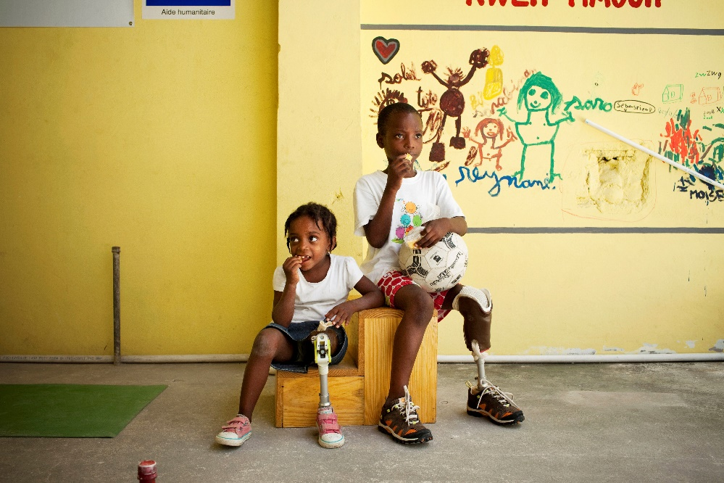




Anti-discrimination measures:
a path out of poverty?
www.chronicpovertynetwork.org

Slide 5

About CPAN
Who
What
Why
How
Network of researchers, policy makers, practitioners, hub at ODI
Focused on tackling chronic poverty & eradicating extreme poverty
Ensure that chronically poor people are not overlooked
Provide evidence to improve policies and programmes
http://www.chronicpovertynetwork.org/

Slide 6
CPAN approach and agenda
Chronic Poverty Reports and related background work
Policy database and policy monitoring 2015-20 – includes anti-discrimination and affirmative action
Policy engagement and advocacy (national Chronic Poverty Coalitions and partnerships)
Chronic Poverty Partnership (donors and advisers)
Focus on people and institutions as well as numbers via life histories and participatory methods linked to panel data analysis – poverty dynamics
Focus on growth (Chronic Poverty Report 2017-8)
Focus on inclusion wrt anti-discrimination measures (Chronic Poverty Report 2018-9)
Focus on climate change and responses, among other sources of vulnerability (Chronic Poverty Report 2019-20)

Slide 7
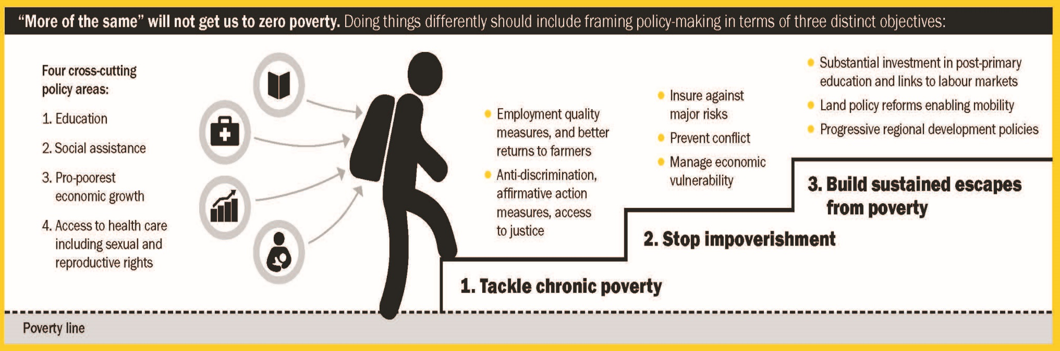
About CPAN
Eradicating extreme poverty – 2014-5 Chronic Poverty Report
Notes:
The report identified anti-discrimination and affirmative action measures as especially important in tackling chronic poverty, but it would also be important for preventing impoverishment and sustaining escapes from poverty for individuals, households and communities.

Slide 8

The project: Evaluation of Anti-discrimination measures
Phase 1
A rigorous review of evidence of anti-discrimination measures in political participation, education and labour markets in low and middle income countries
Focus on large-scale actions (implementation of laws, government or large non-governmental programmes)
Literature search identified 450 relevant studies. Evidence gaps identified and phase 2 designed.
2 reports:
focusing on sectors
Focusing on marginalised groups
Evaluation partnership – mix of experts and donors
Notes:
Slide describes phase 1 of an evaluation designed to focus on the contribution anti-discrimination and affirmative action measures make to the eradication of poverty. Phase 1 was supported by the donors listed. A narrative review – rigorous – review not classic ‘systematic review’
Phase 2 designed but not yet resourced, though some commitments have been made. We are looking for funding, so would be pleased to hear from anyone with interest in this.
The SDG context has increased the profile of such measures powerfully: read page 14 of the report.

Slide 9
The project: Evaluation of Anti-discrimination measures
Phase 2
Country studies to fill gaps in evidence on the effects of anti-discrimination measures in labour markets and related human development services including social protection
Key gaps: LICs and LMICs other than India, labour markets, health and social protection, persons with disabilities and mental health issues, disadvantaged children.
Country studies
Global analysis continued
Dissemination to countries looking to introduce anti-discrimination measures
Expanded evaluation partnership
Notes:
Phase 2 designed but not yet resourced, though some commitments have been made. We are looking for funding, so would be pleased to hear from anyone with interest in this.
The SDG context has increased the profile of such measures powerfully: read page 14 of the first report.

Slide 10
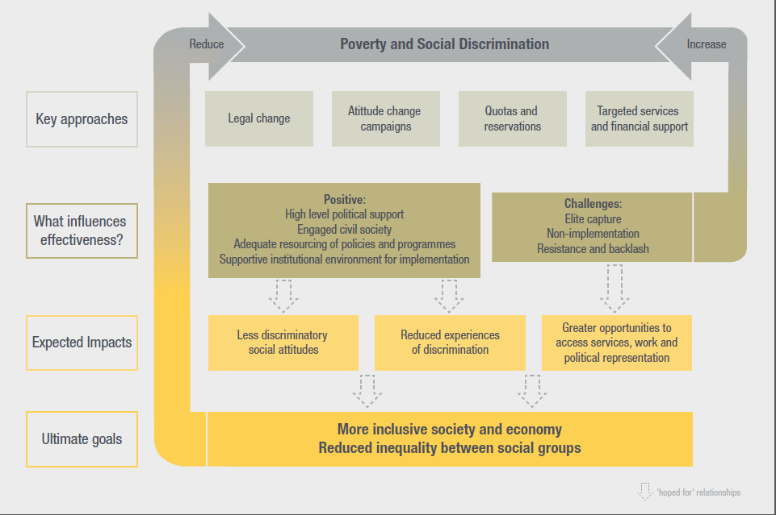
Theory of Change
Notes:
A developing ToC which outlines approaches and what influences effectiveness
What underpins effectiveness? To be effective anti-discrimination laws and policies need political support. That is most likely when they have emerged through civil and political campaigns. By their nature, anti-discrimination laws and policies aim to redress patterns of injustice, which usually means a reduction in privilege for some groups to create a fairer pattern of opportunities and entitlements for all. Affirmative action policies and laws are thus almost always controversial – especially initially – and groundwork is often needed to make a strong case for and to generate support among those who will not benefit or perceive they will lose out. Public education campaigns to change attitudes and training for front-line service providers (health workers, teachers etc) in non-discriminatory practice are key parts of this. A functioning, impartial and affordable judicial system that can uphold the law and is within citizens’ reach, and adequate financing for programmes such as targeted educational support for marginalised groups, are other vital parts of the jigsaw.

Slide 11
Evidence map – marginalised groups
Notes:
Some pretty big gaps in terms of discriminated against groups, geography and topics
Despite the universal intent of anti-discrimination laws and policies, our conclusion is that some groups are clearly under-served. The largest of these is disabled people. Other than inclusive education policies in some countries (the implementation of which is highly variable), large-scale efforts to reduce discrimination against disabled people are isolated, and typically significantly under-funded. Our review also found no evaluation evidence for large-scale initiatives to reduce discrimination against refugees, displaced people, religious minorities, people with stigmatised physical or mental health conditions or LGBTQI individuals. This suggests that some forms of discrimination are so ingrained that they are deprioritised for action.
Also even for the groups where there is ostensibly quite a lot of evidence eg children & young people, the focus is principally on measures within the school system – not how anti-discrimination policies feed through to the wellbeing of the next generation through other routes
The women-focused studies are very largely focused on political representation, much less on labour markets and moderate amunt on education

Slide 12
Evidence map- countries
Notes:
Majority of the evidence comes from a few MICs – Brazil, India, S Africa, Malaysia. Little from LICs or LMICs, a few exceptions – mostly in E Africa. 25% from India, 10% from S Africa.

Slide 13
Key Messages:
Quotas, reservations, stipends can increase the representation of people from designated groups.
Affirmative action has increased the numbers of: women in legislative bodies in many countries, in HE in East Africa; people from marginalised racial groups’ access to HE in Brazil, Malaysia and South Africa; marginalised SC/ST and racial groups’ access to employment in India and South Africa.
People with disabilities appear to have been neglected by affirmative action policies.
Not all members of a marginalised group share the same interests and group labels can become politically contested.

Slide 14
Key messages: Political representation
Quotas and reservations increase the representation of marginalised groups – in parliaments and local councils, schools, higher education, and labour markets
Does political representation impact on policy? Mixed evidence…some evidence that social movements hold representatives to account
Some evidence of improved health and nutrition outcomes and access to services in India
Quota representatives sometimes more driven by loyalty to parties/patrons than specific group
Notes:
(Bullet 2) Quantitative studies on political reservations at the local government level in India, targeted at women and Scheduled Castes and Tribes (SCs/STs) suggest they may improve outcomes or access to services in India. Examples of this include studies on the political inclusion of women leading to better access to water services, and newer research linking reservations to better nutritional outcomes for children. Qualitative evidence is more mixed.
Bullet 4 – also mixed identities – for an individual in a given context eg ethnicity or region may be more important than gender or vice versa

Slide 15
Key Messages: Education
Education
At all levels of education (primary to tertiary), there is evidence that affirmative action policies have been successful in increasing participation and learning among targeted groups.
But gains in access have not necessarily been matched with a shift to less discriminatory experience
For all social groups, reducing inequalities in access to education and reducing drop-out at all levels is key.
The most appropriate affirmative action approaches vary according to context and group.
Notes:
(bullet 2) For example, inclusive education for speakers of non-dominant languages demands curriculum change; effective inclusion for disabled children requires a combination of additional resourcing, changing pedagogical approach and, in some cases, assistive devices. For all groups, it is likely that training of teachers and school managers in inclusive attitudes and practices, as well as more specific tailored training, will be necessary, though our review found few evaluations examining the impact of such approaches.
Most children from marginalised groups – and particularly those from poor backgrounds – have very little chance of reaching higher education unless the factors that lead to drop out – poverty, poor quality teaching, and discrimination in school are addressed.
Resistance – caste – India – that better off members of lower caste groups are being prioritised; gender – with some evidence that gender-based scholarships at schools can lead to marginalisation of poor boys (Bangladesh)
Attitude change activities – positive evidence of impact from study of measures to widen participation of disabled students in Tanzanian and Ghanaian higher education; converse evidence of lack of such activities for marginalised castes in India

Slide 16
Key Messages: Labour Markets
Labour markets
Some success in India and South Africa at increasing the representation of excluded groups in the workplace, but mixed evidence of their broader impacts on incomes and well-being.
Some positive impacts of good quality skills training on marginalised youth’s employment and job quality
Labour market outcomes are also highly dependent on broader economic contexts
Notes:
Employment reservations – particularly effective for lower castes in India and Bumiputera (Malaysia) and Black population (S Africa). Results are clearer in India than South Africa.
Conversely, a lack of social networks and connections can limit the employment prospects of students who have benefited from reservations in the education system. In both contexts, there is concern about the creation of a small elite middle class who benefit disproportionately from these policies and leave the most disadvantaged behind, though this can also provide a leadership advocating the wider interests of the group. At the same time, there is some evidence from India that without the continuation of affirmative action policies some marginalised castes are at risk of sinking back into high levels of poverty.
Links to other sectors:
This relationship is evident in both affirmative action and training policies. In both India and South Africa, the quality of education available to marginalised groups is seen as limiting the quality and level of subsequent employment. The evidence shows that, for vocational skills training to lead to successful labour market outcomes – as has been the case with some groups of disadvantaged youth in Latin America - close relationships with employers, skills carefully matched to the labour market and additional ‘soft’ skills training are all effective.

Slide 17
Impacts on Economic Wellbeing
Some evidence from India of positive impact of reserved jobs and places in higher education on beneficiary individuals’ and groups’ economic wellbeing.
Inclusive services, targeted stipends and scholarships effective in schools and higher education → long-term impact on economic wellbeing unclear
Does affirmative action primarily benefit the better-off? Mixed evidence from different countries and sectors
Notes:
(Bullet 1) On who benefits – evidence from India is that reservations have been broadly pro-poor; so have higher education reservations based on race ethnicity in Brazil, Malaysia and S Africa. But disability and gender-based reservations in higher education typically benefit better off because of high levels of drop out among poorer groups.

Slide 18
Impacts on Specific Marginalised Groups

Slide 19


Key Approaches – Particular Groups
Group
Women | Political reservations Reservations in higher education
Children | Inclusive services; stipends/ scholarships (some based on gender / ethnicity) Teacher training in anti-discriminatory practice
Young People | Higher education subsidies and stipends Vocational training
Disabled People | Inclusive education in schools (but limited in practice)
Marginalised ethnic/ racial groups | Bilingual education; inclusive services; labour market reservations/ quotas; asset redistribution (S Africa)
Marginalised castes | Political, education and labour market reservations
KEY | Strong evidence of effectiveness Mixed/ weaker evidence of effectiveness
Notes:
Green – shows strong evidence, red shows weak/mixed

Slide 20
Women and girls
Focus on political representation (women), higher education (women), school education (girls)
Success in increasing numbers – though progress uneven
Less success in changing discriminatory attitudes and practices
Limited attention to gendered patterns of inequality affecting men and boys
Notes:
Numbers – in politics some rare examples of over 50% female representation but mostly around 20-30%. In higher education, inequality most acute in low income countries.
Lowering grades, catch-p courses all tried; lack of financial support has been major constraint

Slide 21
Marginalised ethnic and racial groups
Little evidence on political representation – but some concerns about effects of making ‘race’ more politically significant
Bilingual education in early grades generally positive and cost-effective
University reservations can be effective; but can marginalise other groups
Labour market reservations often resented as unfair – mixed evidence about impact on poverty and discrimination
Notes:
Bullet 2 – limited evidence re secondary
Bllet 3& 4 – S Africa and Malaysia

Slide 22
Marginalised castes (India)
Successes in increasing political representation – with some evidence of impact on services in disadvantaged areas
Positive impacts in higher education (though some displacement of women)
Also increased school participation but discrimination remains major barrier
Labour market reservations confined to public sector – positive impacts but also limitations
Notes:
Bullet 4-

Slide 23
Disabled people
Neglected and under-represented
Only one example of political reservations (local councils Uganda)
Labour market provisions rarely enforced; much evidence of discrimination
Most attention to (and political will behind) inclusive education in schools
Some impacts in higher education
Notes:
Schools – most evidence concern non-implementation of policies and challenges implementing policies rather than positive examples of impact.
Higher education – some positive efforts in E Africa and Ghana but undermined by continuing discriminatory attitudes (shunting students into subjects where they may lack interest) and sometimes lack of attention to physical barriers; finance also big issue

Slide 24
Evidence gaps (1/2)
Relative importance of broad, inclusive approaches compared with measures targeted at particular groups, and combined strategies; how this differs by context.
Length of time policies & programmes must be in place to achieve change
Role of civil society in mobilising in support of anti-discrimination policies, in developing innovative approaches and in holding governments to account.
Notes:
A couple of slides on the evidence gaps which we could discuss if there is interest.

Slide 25
Evidence gaps (2/2)
The long-term effectiveness of anti-discrimination measures in helping shift marginalised groups out of poverty. (Most evidence is from India).
Politics of implementation, resistance to and subversion of anti-discrimination policies, both at high level and ‘on the ground’.
Use and limitations of strategic litigation to enforce anti-discrimination legislation
Gaps re specific groups: disabled people refugees, migrants, displaced people, LGBTQI, men & boys
Notes:
A couple of slides on the evidence gaps which we could discuss if there is interest.

Slide 26
Conclusions/Recommendations
Great variation by group and by context - tailored solutions and regular review needed
Affirmative action policies are often controversial → hardening discriminatory attitudes
Inclusive services and economic policies should be priority with targeted measures as needed
Intervene early in life (education system)
More attention to economic constraints affecting marginalised groups esp. in education
Notes:
Bullet 1 – to ensure no misplaced impacts of policies (Eg increasing marginalisation of boys) and that plans are as needed
Bullet 2 – so donors need to tread carefully – sensitivities around ‘interference’ in these issues and unfair advantaging of one group over another
Bullet 4 – much action too late – drop out levels of marginalised groups high – action in higher education is too late
Bullet 5 – limited attention to economic barriers and how undermine efforts to expand access of marginalised groups

Slide 27
Conclusions/Recommendations
Strengthen institutions: functioning, impartial and accessible judicial system
Attitude change activities needed alongside legislation and policies/ programmes (public and service providers)
Important role for rights-based social movements - keep issues on the agenda and hold governments to account

Slide 28
Panel discussion
Pär Zetterberg, Uppsala university
Wilson De los Reyes Aragon, RFSU
Paula Engwall, Sida
Twitter: @EBACommittee
#ebaseminar
#poverty

