Slide 1
Stronger than Justice: Armed Group Impunity for Sexual Violence
Angela Muvumba Sellström
Uppsala University, Department of Peace and Conflict Research
(E: angela.muvumba-sellstrom@pcr.uu.se)
Expertgruppen För Bistandsanalys
E Development Dissertations Briefs Seminar
Conflict, Sexual Violence And Statebuilding In Sweden´s Development Cooperation
8 October 2015

Slide 2
Impunity, noun.
Exemption from punishment or freedom from the injurious consequences of an action: the impunity enjoyed by military officers implicated in civilian killings; protestors burned flags on the streets with impunity.
- From the Oxford English Dictionary, 2014.

Slide 3
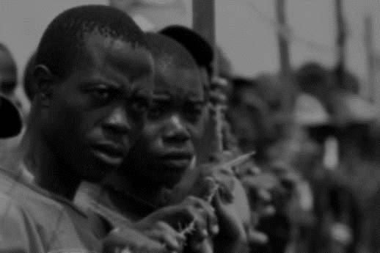
If you spend a year with no leave and you see your commander raping, you would also rape. (Former member of the Armed Forces of Burundi).
Who will make a judgment against him? A chief was a chief... (CNDD-FDD ex-combatants).
Sexual violence happened in CNDD-FDD, there were no strict laws.
(Former CNDD-FDD combatants).
...if they could see you talking to girls, that simple suspicion equalled death… (Former CNDD-FDD and FNL member).
You would be killed and they used a hoe, it was a less expensive instrument
and they used it to kill the guilty. (FNL ex-combatants).
FNL rules were written in a small notebook. We were taught the rules.
(Former FNL members).

Slide 4
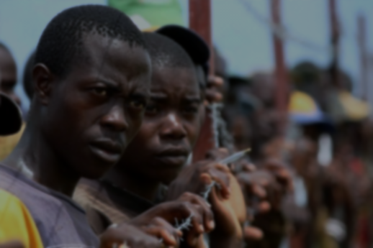
Some former combatants see wartime rape as banal.
Others describe it as a sign of weakness and indiscipline.
Some were used to their leaders and comrades committing such acts.
Others less so.
Some expect little or no consequences.
Others retribution.
This variation is under-theorized and unexplored.

Slide 5
Policy dimensions
Within Liberal Peacebuilding: 1325, Justice and Accountability
Impunity as a determinant of sexual violence, particularly in post-war: UN Security Council’s 10 resolutions on women, peace and security (between 2000 and 2014), all propose a need to counter impunity.
Amnesties are unjust, they lead to impunity and therefore, more violence: Amnesties in peace agreements are interpreted as leading to impunity (not just for sexual violence, but also for these acts). The Council excludes sexual violence from amnesty provisions in peacemaking processes (UNSC, 2008; 2009; 2010).

Slide 6
Question,Theory, Cases, Methods
Research Question: Which conditions lead to armed group impunity for sexual violence?
Outcome of interest (dependent variable):
Armed group impunity for sexual violence, defined as confidence in the absence of negative consequences for sexual violence.
Explanatory Factors: weak enforcement and pardons measured as
Flawed prohibitions
Negligent authorities
Amnesties
Methods:1) analysis of the association between amnesties and post-settlement sexual violence, based on a dataset of amnesties from negotiated settlements, and reported post-settlement sexual violence events (137) and 2) comparison of rebel groups using focus group data from ex-combatants (19 groups).
Cases: 1) 23 state and non-state armed actors in Africa’s civil wars – Burundi, DRC, Liberia, Mozambique, Sierra Leone, South Africa; and 2) rebel armed groups: CNDD-FDD (National Council for the Defence of Democracy-Forces for the Defence of Democracy) and FNL (Palipehutu-Forces for National Liberation) from Burundi.

Slide 7
Amnesties and post-settlement sexual violence
More than one type of sexual violence: 30 combinations of violence, ranging from single incidents of rape; to combinations of multiple rapes with variations on gang-rape, mass rape, sexual slavery, torture or harm to children.
Victims are grossly under-counted and un-identified: About 44 percent (61 out of 137) of post-settlement sexual violence events had an unknown number of victims.
The usual suspects are from the state: Government security agents, police and army personnel were more likely to be associated with reports of post-settlement sexual violence than were members of the rebel groups.
Only a few commit large-scale violence: A small percentage of particularly large-scale post-settlement sexual violence events was linked to just three actors, the Congolese Liberation Movement (MLC) in the DRC; Renamo of Mozambique; and the RUF in Sierra Leone, all in the first post-settlement year.
It gets better: Most of the armed actors in this study reduced their levels of sexual violence within the three years after settlement.
Amnesties are ubiquitous: All nine agreements for the actors in the dataset included some form of amnesty. The majority of actors were eligible for partial amnesty in agreements signed in Burundi, the DRC, Sierra Leone and South Africa. Only the General Peace Agreement (AGP) (1992- 10-04) for Mozambique and the Abuja II Peace Agreement (1996-08-17) of Liberia provided blanket amnesties to signatories.
Blanket amnesties co-vary with lower levels of reported post-settlement sexual violence: More events were linked to actors that received partial amnesty, than with the Mozambican and Liberian actors.

Slide 8
Comparison of CNDD-FDD and FNL
 | Background | Armed group impunity for sexual violence? | Flawed prohibition? | Past Pardon? | Negligent Enforcers?
CNDD-FDD | Diverse, divided. Strong international support. Forced recruitment. Arms & money from abroad. Higher rates of CRSV and in post-war. Force strength: approx 8,000-10,000. | Yes. Underestimated consequences. Euphemistic language. Punishment contingent. | Some punishment. Unclear. Inconstant. No peer pressure. Varied practice. | Way to peace. Not applicable to sexual violence | Commanders exempt (before and after negotiations).
FNL | Believers, ‘Born-agains’. Limited international support. Local support and refugees for recruits. Women joined. Lower rates of CRSV and in post-war. Force strength btw: 2,000 – 3,000. | No. Rape was illicit. Overwhelming expectation of punishment. Rapists weak and opportunistic. Commanders and foot-soldiers accountable. | Capital punishment. Induction. Clear. Constant. Peer pressure. | Way to peace. Not applicable to sexual violence | Commanders demoted, imprisoned or executed (before negotiations). Commanders exempt (after negotiations & systematic, rule-based).

Slide 9
Main conclusion
When armed groups
do not depend on voluntary support and recruits from the civilian population, they are likely to put in place
unclear and inconstant prohibitions of sexual violence, which,
if reinforced by authorities,
generates armed group impunity for sexual violence.

Slide 10
Policy conclusions
There is no evidence to suggest that removing amnesties deters sexual violence perpetrators. Armed groups expect some form of amnesty as a way to guarantee their safety and post-settlement political and economic power.
Focus on ensuring inclusive, transparent, equitable and credible post-war justice.
Armed groups have incentives and unique ways to control sexual violence:
Integrate these incentives into policy formulations to address sexual violence in conflict.
Focus on how armed actors/groups organize themselves, incl. ideologies, interests and internal behavior.
Offer carrots such as the opportunity to negotiate, in exchange for effective prohibitions through clear and constant codes of conduct.
Guarantee protection of civilians and bolster peace enforcement to reduce the potential for forced recruitment.
Cut-off external sources of weapons and financing.
Sequence and coordinate policies, including between international organizations, the private sector, regional organizations, popular campaigns and boycotts and local civil society.

Slide 11
Thank you !

