Slide 1
Drivers for development: advocacy, diversification, donations and endowments
Development Dissertation Briefs seminar, Jan 20, 2016
www.eba.se

Slide 2


The when and why of helping:
Individual and organizational decision making from a psychological perspective
Arvid Erlandsson (Linköping University & Lund University)
EBA Development Dissertation Briefs seminar series
20 January, 2016

Slide 3
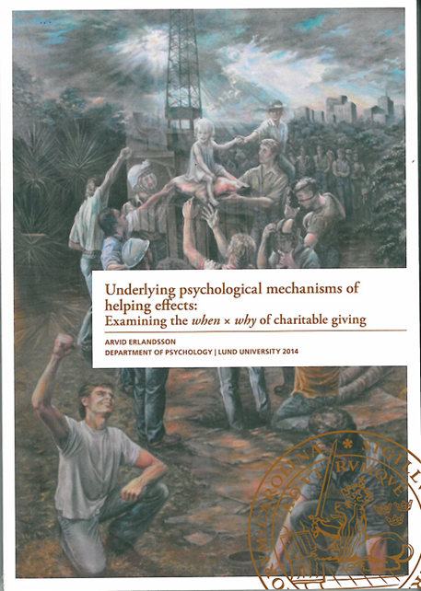
Dissertation thesis
Written in the scientific framework of experimental psychology.
Focused on basic (not applied) research.
Focus on individual (not organizational) decision making in helping situations.
Key question: Which psychological factors are making people scope-insensitive in helping situations?

Slide 4


September 2015
September 1st
September 2nd
September 3rd
When?
Which aspects of the situation increased helping?
Fund-raising campaign for fleeing refugees launched.
Why?
Which psychological mechanisms (i.e. feelings, thoughts, beliefs) can best explain the increased motivation to help?
250,000 SEK donated
250,000 SEK donated
4,000,000 SEK donated!!!

Slide 5



WHY?: Three psychological mechanisms that can influence helping.
Emotional Reactions
Perceived Effectiveness
Perceived Responsibility
”I did not really feel much before, but I felt so intense emotions after seeing the picture so i just had to do something”
”Helping used to feel like a drop in the bucket, but now I believe that I am really making a huge difference for other people”
”I used to belieive that this was someone else’s problem, but now I realize that it is my duty to try to help those worse off.”

Slide 6

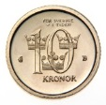


WHEN?: The identifiable victim effect

Slide 7


WHEN?: The proportion dominance effect

Slide 8



WHEN?: The in-group effect

Slide 9

Do different mechanisms primarily underlie different helping effects?

Slide 10


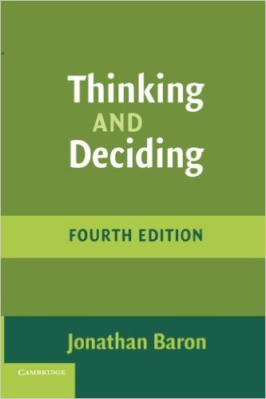
Relevance for foreign aid decision makers?
Helping decisions made by politicians and by Sida officials are much more grand-scale than individual helping decisions.
Grand-scale helping decisions can be both about the magnitude of help (0.8%, 1.0%, or 1.2% of BNI to foreign aid) and about allocation of resources (Should project A or project B recieve funding?) .
Just as individual decision making, organizational decision making can be influenced by heuristics and biases, resulting in suboptimal decisions.
Being aware of common heuristics and biases is a good first step for reducing their influence on decisions.

Slide 11
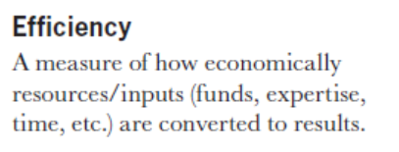
How do we define effectiveness?
Sida (2008): Glossary of Key Terms in Evaluation and Results Based Management

Slide 12
Which of these completed projects will be perceived as the most effective?
Project A which focused on the people worst of in the world and managed to help many of them.
Project B which had extremely low overhead costs meaning that hardly no money was used for unintended purposes.
Project C which focused on and succeeded in totally solving a small-scale problem.
Project D which maximized the amount of well-being per dollar spent.
A shared definition of effectiveness is necessary (but not sufficient) if we want to evaluate the effectiveness of different helping projects.
Notes:
This is an empirical question

Slide 13

Thank you!
arvid.erlandsson@liu.se

Slide 14
Essays on Child Education, Child labor and The Agricultural Economy
Elin Vimefall

Slide 15
Data
Kenya Integrated Household Budget Survey (KIHBS) 2005/2006
13430 households (66725 individuals)
Representative at national level but also at the urban/rural, provincial and district levels.

Slide 16
Ethnolinguistic background and enrollment in primary education
Setting: About 70 different languages
Question: Does the probability of being enrolled in school differ among
children with different ethnolinguistic background?
Mechanism: Culture, norms, language.
Findings: Ethnolinguistic background is important for explaining the child’s probability to be in school.
Maasai and Somali children have a lower probability of being enrolled compared with children from all other groups
Indication that gender norms are important

Slide 17
  Income diversification and working children
Question: Does the household's’ income diversification strategy influences children’s probabilities of working and going to school?
Mechanism: Income effect – less working children
Substitution effect – more working children
Findings: Children living in households that rely solely on the production from their own farm are about 3 percentage points more likely to work as their main activity and 2 percentage points less likely to be in school than other children. They also work more hours than other children.

Slide 18
Income diversification among female-headed farming households
Question: Does female headed households diversify their income in a different way compared to male headed households?
Mechanism: Female headed household have been shown to have less education, labor, and productive assets as well as less acces to credit than male-headed households. This will limit their options for diversification.
Findings: More dependent on transfers (28% compared with 14%)
Higher probability of obtaining all earned income from production on their own farm.
Less likely to diversify into non-agricultural wage work.

Slide 19
  Welfare impact of higher maize prices when allowing for price heterogeneity
Question: What are the short-term welfare impact of higher maize prizes on different regions and socioeconomic groups in Kenya
Setting: More than 90% of the farming households grow maize. However most households also buy maize in the market.
Findings: About 80% of the population would be negatively affected if the price increased. Rural landless would lose the most.
Main contribution: Relax the standard assumption that consumer and producer prices change in the same proportion and allow for heterogeneity in the marketing margin among districts.

Slide 20
Path Dependent Possibilities of Transformation:
Agricultural Change and Economic Development in North and South Vietnam
Montserrat Lopez Jerez
DDB Seminar, Stockholm, 20 January 2016

Slide 21
Disposition
Vietnam as a starting point
Motivation
Main Findings
Colonialism and Path Dependence
Concluding Remarks

Slide 22
Overarching Research Question
How can the historical processes derived from the differences in factor endowments help us understand contemporary dynamics in the two Rice Deltas in Vietnam?
Within the frame of agricultural (rice) economies
López Jerez (2014) Deltas Apart- Factor Endowments, Colonial Extraction and Pathways of Agricultural Development in Vietnam

Slide 23
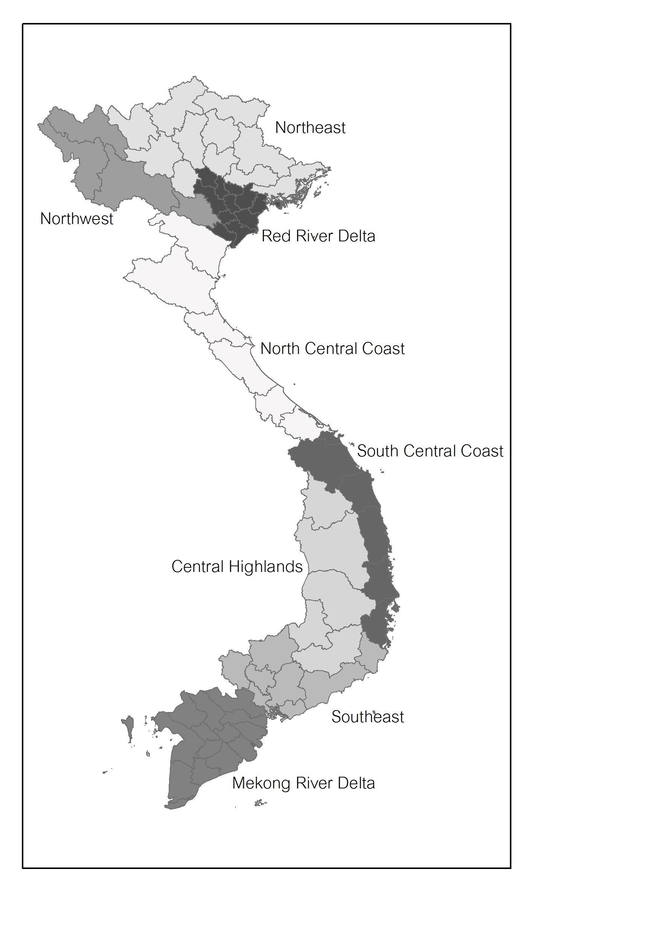
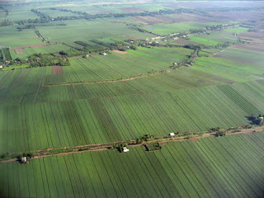
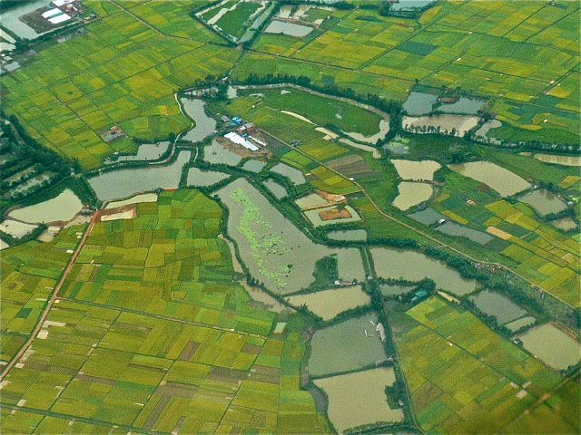
Mekong River Delta - Red River Delta

Slide 24
Vietnam Today: Miracle Economy
Agriculture-led Transformation (Timmer, 2009)
De-collectivization
  North
Land use intensification
  South: 10% Marginal Lands
Initial Conditions (Ravallion and van de Walle, 2008)
Why was the Southern farmer more able to take advantage? Why the Cochinchinese?
Source: McCaig et al (2009)
Difference South versus North:
14.3 vs 3.6% annual growth of crop income
2/3 vs 1/3 marketed output (1998)
Impact in Inequality and Poverty

Slide 25
Motivation
The dissertation:
  Questions the explanatory power of the current factor endowments-colonial literature
    Acemoglu, Johnson and Robinson (2001)
      Acemoglu and Robinson (2012)
    Engerman and Sokoloff (1997, 2002, 2005, 2012)
  Develops alternative analytical framework to include:
    Late colonisation
    Indirect rule
    Macro and micro levels
    Causally related events and processes
For the Brief:
  Which institutions are key for an inclusive economic transformation?
  How could history matter for development today?

Slide 26
Proposed Analytical Framework

Slide 27
The Land Question
Viet Cong “[T]he essence of the national problem is the farmer’s problem. The basic problem of the farmer is land. This is a strategic problem we can never neglect” (The South Vietnamese Communists and Rural Vietnam, 1966, in AID memo p 20)

Slide 28
In comparison at the end of colonial period
The Red River Delta was more extractive than the Mekong
Large landholdings in the South than in the North
But the Red River Delta in Tonkin: Asian Bimodality?
  Large concentration of ownership of land under cultivation in a small number of owners
  Cultivation done by many farmers with access too little land and too fragmented
Mekong: Large estates, absentee landlordism, but tenant had possibilities of accumulation and market access
  Vulnerability to market volatility
  Imperfect markets (not least financial)

Slide 29
The Institutional Dynamics
Colonial Institutions: are they a sufficient condition?
Village economy and its institutions
  Open versus closed village
  Moral Economy (Scott, 1976) versus Rational Peasant (Popkin, 1979)
Bringing the actors into the focus:
  Irma Adelman (1986): the distribution of assets, the institutions for asset accumulation, and the institutions for access to markets interact when new economic opportunities arise

Slide 30
Linking Past to Present
Is this story of path dependence?
  North, yes, but not due to institutions but factor endowments and the significant land fragmentation
    Currently, eight or nine non-contiguous plots often no larger than 200 to 500 square meters each (WB 1998)
    In 1938, 1938: 1,229,200 ha, divided into 13,793,000 parcels, which were less than 0.089 ha on average (1,453,400 proprietors )
    Impossibilities of economies of scale associated with new technologies
    High economic and political transaction costs
  South: more complex, but not a la E&S or AJR’s
    Are colonial “extractive” institutions a sufficient condition?

Slide 31
Thank you!
Montserrat.lopez_jerez@ekh.lu.se

Slide 32
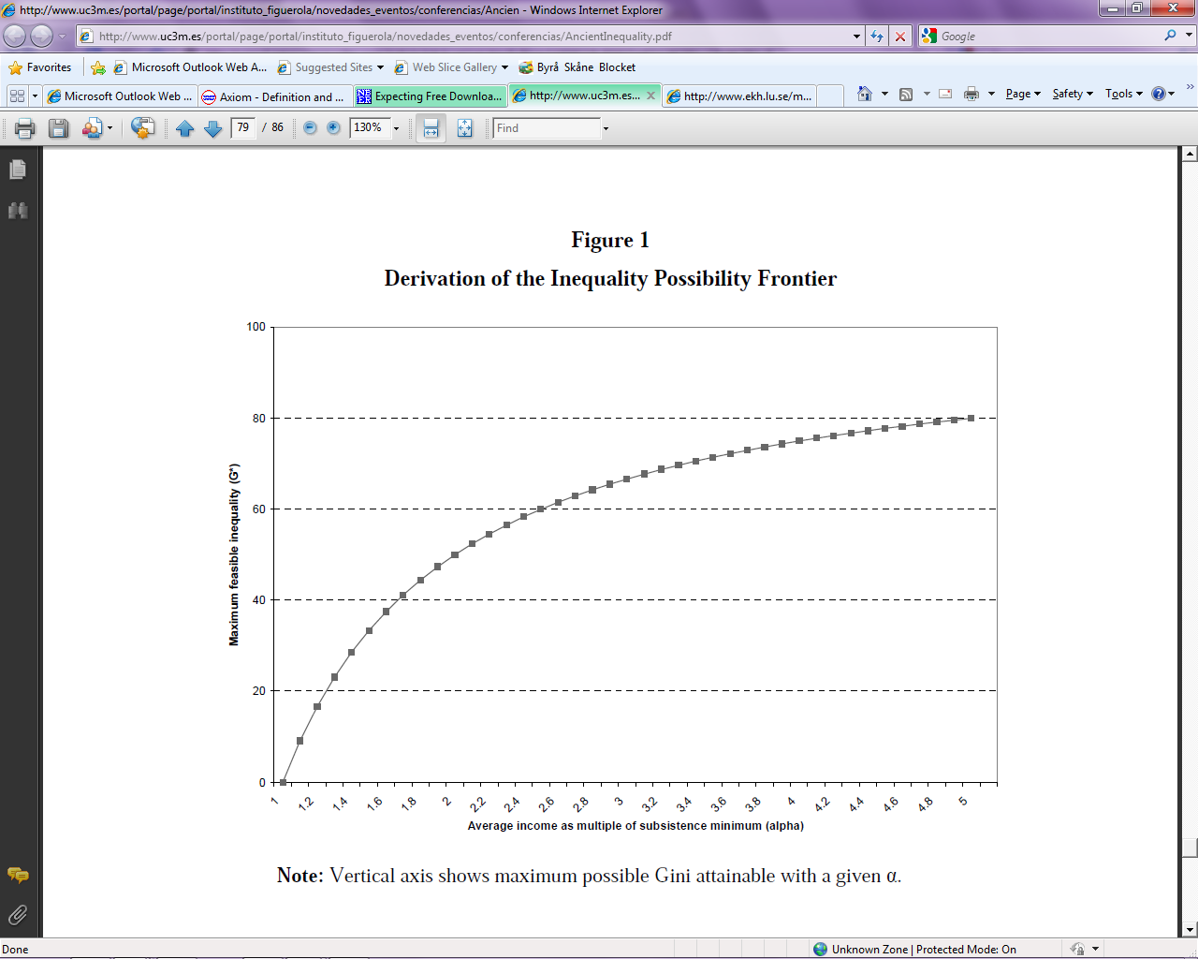
How Extractive? Inequality Possibility Frontier and Extraction Ratio
Milanovic, Lindert, and Williamson (2007) ’Measuring Ancient Inequality‘
Two groups in society
Between classes inequality (Gini)
Assumptions on income distribution:
  Guarantee subsitance minimum for the poorer classes
  Remaining = Surplus for the richer classes
Δ Average Incomes → Δ Surplus → Δ Potential Inequality (Maximum Feasible Inequality)
Extraction ratio =
Source: Milanovic et al (2007: 79)

Slide 33
GDP (1990 PPP)
Figure Appendix GPD per Capita in Tonkin and Cochinchina
Source: Author’s based on Bassino (2000)

Slide 34
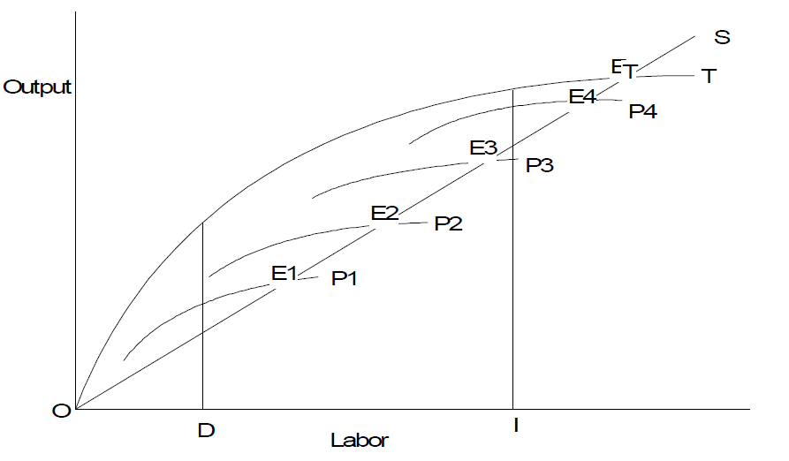
Tonkin
HLET
Production Possibility Frontier
Tonkin
Rice
Surplus
Involution
IPF and ER
Other Produce
* Tonkin 1936
* Tonkin 1931

Slide 35
Cochinchina
Production Possibility Frontier
IPF and ER
Rice
Cochinchina up to 1930s
* Cochinchina 1930
* Cochinchina 1936
Other Produce
Processes:
  A formation of a (Viet) landed elite
  Under labour shortage and a mobile land factor
  Improvements in stratification and more inclusive growth
  Incentives and Opportunities to access and accumulation
  Debt crisis – polarization and subsistence

Slide 36
Lorenzt Curve – Initial Land reforms
Source: Data for land owners taken from Bredo et al (1968), estimates of landless in Callison, (1974, table A-1 and table A-2, pp. 359-360).

Slide 37
Colonial Debate – AJR
1500
XIX C
1995
Low Pop. Density = Relative Poorer
European Settlement
Prop. Rights for Broad Cross Section
Better Economic Performance
High Pop. Density = Relative Richer
No European Settlement
Extractive Institutions (Reversal)
Worse Economic Performance

Slide 38
Colonial Debate – Engerman & Sokoloff
Factor Endowments
Colonial Institutions
Equality of Opportunities
Economic Performance
High Man to Land Ratios
Plantation Economies
Inequality of Opportunities
Institutional Development Paths

Slide 39
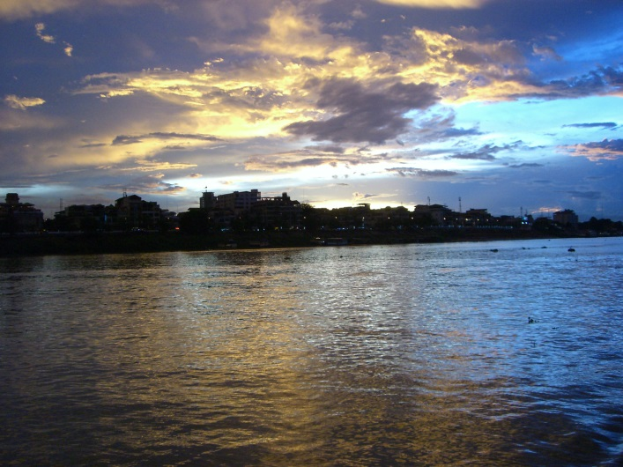
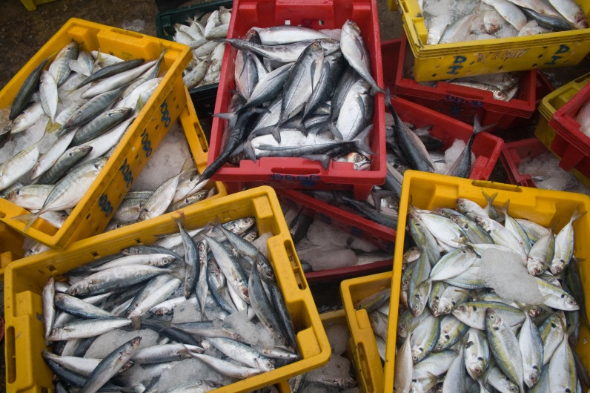
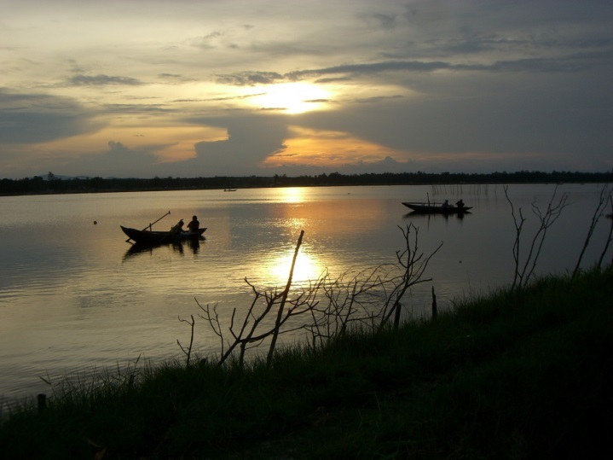
Civil society engagement in the governance of transboundary rivers
Formal rules, informal norms and NGO advocacy strategies
A case from the Mekong river
Yumiko Yasuda (PhD)
20 January 2016 EBA Seminar

Slide 40
Research background and objectives
Background
  Civil society actors are key agency in water governance
  Many studies focusing on Roles, strategies, approaches, actions of civil society actors in their attempt to influence rules and norms. But limited studies analyzing how norms and rules influence NGOs’ strategies.
Objectives
  Understand how formal rules and informal norms affect advocacy strategies of civil society actors.
  Identify opportunities and barriers civil society actors face in the context of transboundary water governance.

Slide 41
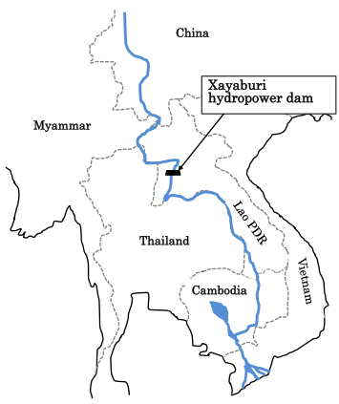
Research methodology: Comparative case studies of 2 NGO coalitions in the Mekong
Advocacy strategies associated with the Xayaburi hydropower dam, on the Mekong River.
Study period: September 2010-August 2012. Procedure for Notification and Prior Consultation and Agreement(PNPCA) process.
Comparative cases:
  Rivers Coalition in Cambodia (RCC)
  Vietnam Rivers Network (VRN)

Slide 42
The Xayaburi dam PNPCA process
Year/Moth | Key Events
2010/Sept | Lao PDR expressed its intension to build the Xayaburi dam.
2010/Oct | Strategic Environmental Assessment of 12 mainstream hydropower dams
2011/Feb&March | Public consultation in Cambodia, Vietnam and Thailand (not in Lao PDR). EIA was not publicly available at the time of consultation
2011/April | No agreement reached at the MRC Joint Committee after 6 months consultation period. The decision was deferred to the Council level.
2011/Dec | MRC Council meeting suggests to conduct further transboundary impact assessent
Concession agreement signed (2011/3)
Electricity purchase agreement signed (2011/10)
Xayaburi official launch (2012/11)

Slide 43
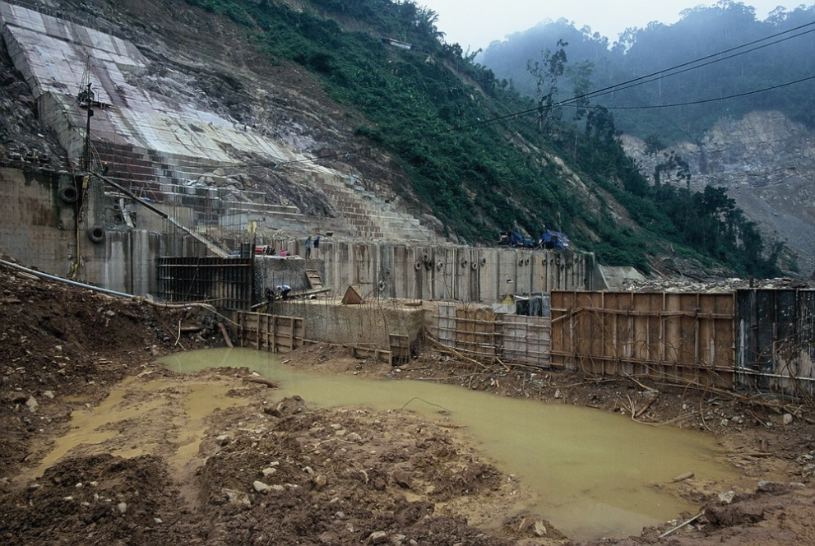
Key findings
4 types of advocacy strategies were identified, depending on target audiences
  Targeting Mekong regional decision-makers
  Targeting national decision-makers
  Targeting stakeholders in affected areas
  Targeting general public

Slide 44
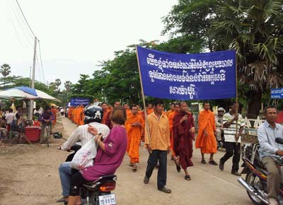
Cambodia: RCC’s Key strategies
Strategy targeting regional decision-makers: participating to activities initiated by regional coalitions of NGOs.
Many activities targeting stakeholders in affected areas. Awareness raising events and thumb prints petitions.
Photo: RCC 2012

Slide 45
Influence of rules and norms on RCC’s strategy targeting stakeholders in affected areas
Biophysical & Material conditions:
Cambodia’s plans for hydropower dams on the mainstream of the Mekong River.
.
Interactions:
Informal pressure not to speak up against authorities and development.
NGOs’ needs for maintaining positive relationship with local authorities.
Actors:
CPP.
Local authorities.
RCC member NGOs (mix of advocacy and development-focused organizations).
Formal rules:
Policies and laws on decentralization.
Informal rules and norms:
Taboo in criticising people who gained higher social status (Theravada Buddhism)
Neo-patrimonialism.
Fear of authorities.
Strategies:
RCC’s cautious approach in raising the issue of hydropower dams.
Modification of planned activities. Some RCC/community members did not take part in thumb print activities.

Slide 46
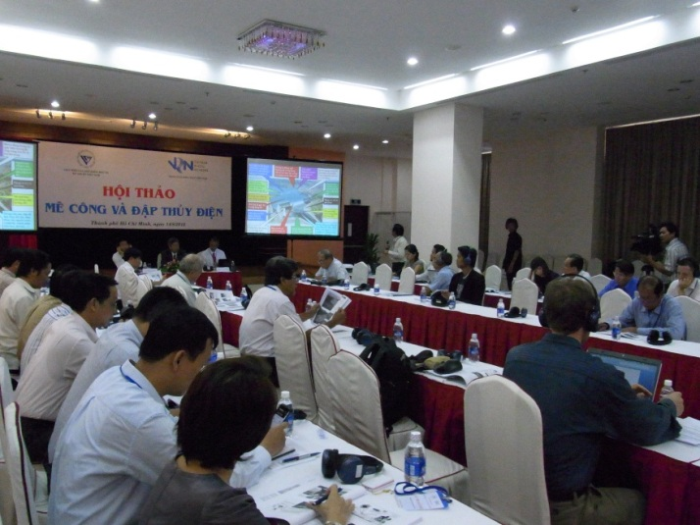
Vietnam: VRN’s key strategies
Primarily targeting national decision-makers, scientists and media
Close collaboration with government, conducting joint workshops
Use of informal meetings
Use of media

Slide 47
Influence of rules and norms on VRN’s media strategy targeting general public
Biophysical &Material conditions: Territorial disputes between Vietnam and China.
Actors:
CPV.
Ministry of Culture and Information.
Journalists.
Competition between Vietnam and China over influence in Laos.
Formal rules:
Law on Media.
Penal code.
Constitution.
Interaction:
Media embargo on the Xayaburi dam
Informal rules and norms:
Informal guidance from CPV and the Ministry of Culture and Information on what can be in the media.
Strategies:
VRN faced restrictions in media strategy

Slide 48
Conclusion
  Formal and informal rules and norms influenced advocacy strategies through interacting complementary at times, and competing at other times.
  Actors played important roles in determining types of interactions.
  Analytical framework developed for this research could serve as a useful tool for future analysis of and by NGOs and civil society actors on influence of formal and informal rules and norms.
  Lack of pathways for civil society engagement in decision-making in the context of transboundary water.

Slide 49
Existing legal tools for public participation in the governance of transboundary rivers
Aarhus Convention：Rights of citizens to participate to environmental decision-making regardless of the nationality
ESPOO Convention: Requires parties to allow citizens to participate to transboundary Environmental Impact Assessment
UN Watercourses Convention: Individual right to claim compensation for significant harm, regardless of nationality.

Slide 50
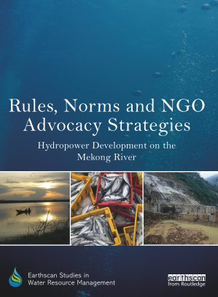
Thank you and more information
Summary of the research is published as EBA dissertation brief in 2016.
Full research published in 2015: ‘Rules, Norms and NGO Advocacy Strategies: Hydropower Development on the Mekong River.’ (Earthscan Studies in Water Resources Management Series by Routledge Taylor/Francis group)
For more information, please contact yumikoyasuda@gmail.com

