Slide 1
The African Development Bank:
Ready to Face the Challenges of a Changing Africa?
EBA Seminar
Stockholm
23 March 2015
Notes:
1

Slide 2
Overview of Presentation
Context: Africa Rising?
AfDB Overview
Key Challenge: Non-Concessional Lending
    Business Practices
    Financial Policies
Conclusions
Notes:
Will try to cover the main themes of the paper, but not be exhaustive
My expertise is in MDBs as a type of institution – especially the pressures they face in the current global economic context.

Slide 3
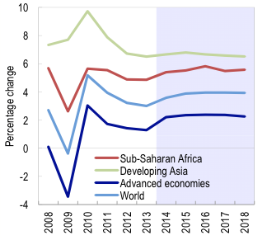
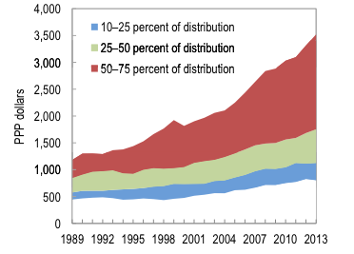
Africa Rising?
Real GDP Growth
GDP Per Capita (PPP) (SSA)
Notes:
There’s no question that Africa as a whole – which is a big generalization – has strengthened in macro-economic terms in past decade or so.
Investment, access to finance, public finances all trending in the right direction. Some data in my paper, much more available. Won’t bore you with the details.
Both from IMF African Economic Outlook, 2014

Slide 4
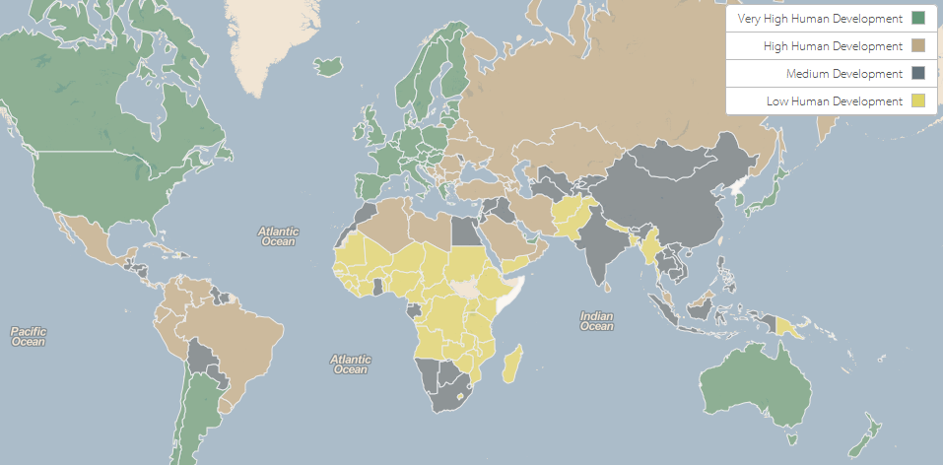
Africa Stagnating?
Notes:
Social indicators and opportunities for individual Africans has not kept pace.
This is HDI, which combines indicators on education, life expectancy and income in a single measure – Africa is by far the weakest region of the world. 36 of bottom 46 countries in the 2013 list.
Tremendous gaps in access to basic services, health outcomes, economic and physical security.
SSA accounts for one-third of the world’s extreme poor, and over 40% of the population (400 million) live on less than US$1.25 a day.

Slide 5
Africa Changing
Growth is accelerating – how will it play out?
Population boom – how will it be channeled?
New External Finance Players
New Attitudes
Notes:
Reality is that Africa is both rising and falling – but above all it is changing quickly and in new ways.
Growth is accelerating, but not clear the direction it will take. Inclusive and equitable, or to the benefit of a few and exclusion of most?
Population boom – 20 million new workers per year for next 40 years. Will be a great catalyst, but for what?
Drivers of growth and employment are not clear. Commodities up to now – but that’s not sufficient nor sustainable
For more broad-based growth capable of employing, need huge new investments, especially in infrastructure
Farmer products to market
Good production
Regional trade networks
Access to external finance growing: New bilaterals, new MDBs, bond markets
New attitudes: Seen development in Asia and Lat Am, and that’s what they want: growth.

Slide 6
AfDB vs. Other MDBs
2013 Lending Commitments
Notes:
Here explain concessional vs. non-concessional

Slide 7
AfDB vs. Other MDBs in Africa
2013 Lending Commitments

Slide 8
Non-Concessional Lending: Falling Short
Project vs. Actual Lending Commitments, 2010-2013
 | 2010 (Proj) | 2010 | 2011 (Proj) | 2011 | 2012 (Proj) | 2012 | 2013 (Proj) | 2013
Sovereign | 1.88 | 2.40 | 3.82 | 4.39 | 3.57 | 2.24 | 3.44 | 1.22
Non-Sovereign | 1.86 | 1.57 | 1.70 | 1.26 | 1.97 | 0.95 | 2.04 | 1.60
Total | 3.74 | 3.97 | 5.53 | 5.67 | 5.53 | 3.20 | 5.47 | 2.82
Notes:
This paper focuses on non-concessional window in particular.
Shareholders increased the bank’s capital in 2010, but performance has not kept up

Slide 9
ADB Capital is Not Being Put to Use
Equity as % of Outstanding Loan Portfolio
Notes:
This is capital sitting idle, even though Africa has such massive development needs. That seems borderline criminal.

Slide 10
Why Does Non-Concessional Window Matter?
Not serving its members
  Some can borrow but don’t want to
  Others want to, but can’t
Link between ADB and ADF
  Finance
  Knowledge
Future of AfDB and Africa
  Financial strength of MDB model
  Decline in concessional donations
Notes:
My argument is that non-concessional window is critical for AfDB
Sometimes overlooked by external actors in Africa – focus on aid, poverty, etc.

Slide 11
Business Practices: Bureaucracy
Average Sovereign Loan Approval Times
Notes:
Amazing array of processes, requirements, review levels
20 review gates at AfDB, plus 4-5 missions, translations, circulating two weeks prior to many reviews, etc.
This does not include the extensive procedures required after loan approval – AfDB reputedly very poor here also.
Can easily be 2.5 years or more before any money moves. Unacceptable for many borrowers, private and public
Ensure quality, rather than cover every possible base.
Development is difficult – have to take risks to promote it successfully. Allow failure, and learn from it – in project design, not new rules!

Slide 12
Business Practices: Instruments and Knowledge
Public sector loan mentality; minimal financial innovation
Knowledge value-added is insufficient
Notes:
Still stuck in an old-style public sector long-term loan mindset – not been effective at leveraging external resources or using more innovative financial instruments
Needs to start seeing itself as more a packager instead of straight forward lender.
Give comfort to investors (especially institutional investors) that would like to find opportunities in Africa, but are unable to manage the risks
Some incipient efforts at syndication
Knowledge is essential, especially for MICs. My experiences in Lat Am, also the Chinese still borrowing from WB.
Close links to operations, not just detached studies for their own sake. Timely, concise, policy-relevant. More exchanges with other regional MDBs, and develop focused in-house expertise on specific and practical issues.

Slide 13
Financial Policies: Credit Policy
Recent Sovereign Bond Issues, Concessional Countries
Country | Issue Year | Yield (%) | US$ Amount | Maturity
Zambia | 2012 | 5.625 | 750 mln | 10 yr
Ghana | 2013 | 7.875 | 750 mln | 10 yr
Nigeria | 2013 | 6.625 | 500 mln | 10 yr
Rwanda | 2013 | 6.875 | 400 mln | 10 yr
Tanzania | 2013 | 6.46 | 600 mln | 7 yr
Kenya | 2014 | 6.875/5.875 | 1.5 bln/500 mln | 10 yr/5 yr
Ghana | 2014 | 8.25 | 1 bln | 12 yr
Senegal | 2014 | 6.25 | 500 mln | 10 yr
Ivory Coast | 2014 | 5.625 | 750 mln | 10 yr
Zambia | 2014 | 8.625 | 1 bln | 10 yr
Notes:
Out of Africa’s 54 countries, only 14 straight ADB borrowing
40 received ADF resources
But many of these clearly would like to receive ADB lending – compare to their private sector borrowing costs. Much higher, and shorter maturities ADB is about 1% and 20 years.
Credit policy put in place by non-borrowers after downgrade in 1990s, but no longer makes sense.
Modification was approved in May 2014, but not clear how effective it will be – depends on subjective judgment of AfDB treasury/risk departments – perception of rating agencies.
Can make ADB loans in ADF countries to private sector, under certain conditions

Slide 14
Financial Policies: Credit Rating
Is AAA necessary?
Limits flexibility
  Portfolio and Country Risk
  Opening to ADF borrowers
  Private sector lending
Consider 1 or 2 step downgrade as part of strategy to expand operational relevance
  Would increase spread, but not huge
  CAF: AA-, and business is booming in LatAm
Notes:
Currently rated aa stand alone by SP, which means one more step down and the bank would lose overall AAA rating.
Could also mention other options to deal with concentration risk – portfolio swap, and Sweden’s operation with AsDB

Slide 15
Adapt for the Future
To have an impact on Africa’s future, AfDB needs to develop a culture of:
  Risk-taking
  Financial innovation
  Demand-driven
Underneath everything: GOVERNANCE

Slide 16
Thank You!
Chris Humphrey
christopher.humphrey@pw.uzh.ch

