Slide 1
Poverty focus in 12 Swedish bilateral aid programs
Mats Hårsmar
Notes:
Good morning,
Present a study of how poverty reduction is undertaken in Swedish aid programs in 12 partner countries
The paper is written in preparation for this seminar
Not been scrutinized or discussed by the expert group, so the responsibility is mine, even though I work at the EBA secretariat

Slide 2
Why these countries?
Poverty focus within countries;
Four categories of Swedish partner countries;
Poverty focus most likely in long term collaboration
Notes:
Bob Baulch has just shown and discussed how targeted Swedish aid is at the country level. But what is the picture within countries? If now Sweden is targeting poor countries fairly well - is it also doing the right things and reaching the right kinds of groups within the poor countries?
Bob showed that most Swedish bilateral aid is targeted at 33 countries. When these were selected in 2007 they were also classified into four separate categories:
Reform collaboration with countries in central and Eastern Europe aspiring to become EU members;
Countries with specific democratic needs (authoritarian states);
Conflict ridden and post-conflict countries; and
Countries for long term development collaboration
also a fifth category for countries that were meant to graduate out of Swedish development cooperation
This forth category chosen for this study. The argument is that in the 12 countries belonging to that group it would be more feasible to build up strategic work aimed at poverty reduction than it would in any of the other categories. This would be our best chance to find poverty focused aid portfolios. And on the other hand – should we not find a good poverty focus in these countries it is not likely that it would be there in the other categories.

Slide 3
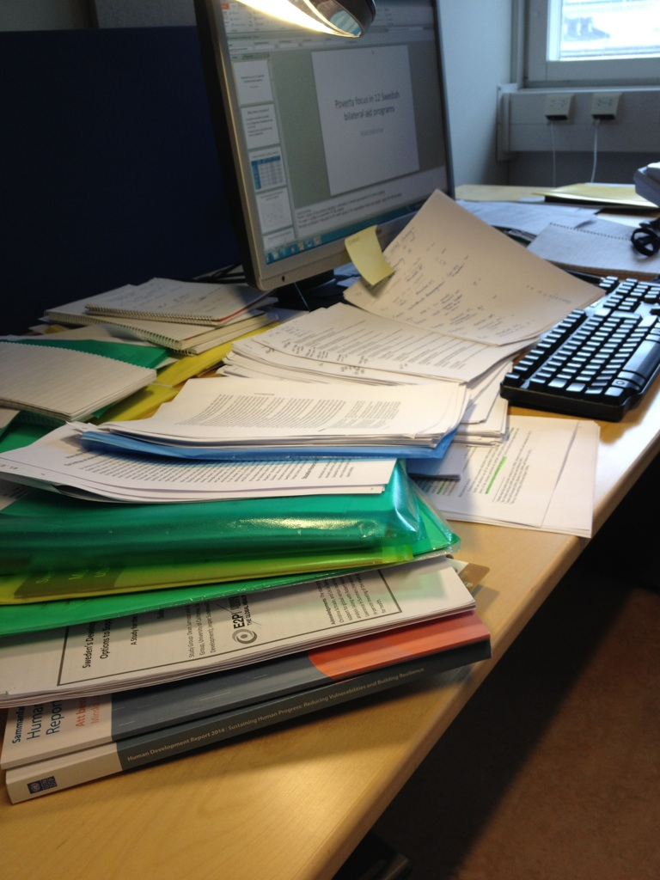
Documents scrutinzed
Notes:
I have read and analysed documents and websites and that way scrutinized all projects and programmes over 100 000 SEK for these 12 countries during the years 12-13.
I have assessed them against a scheme which I’ve build by borrowing from the CPR 2014-2015. Interventions have been assessed as contributing or not to the processes that CPR holds as key to reducing poverty.
I have NOT judged the effectiveness of Swedish bilateral aid. I have just assessed whether the activities belong to categories of interventions that are found to be effective.
To what extent are money being allocated to the kinds of interventions that research hold to be effective?

Slide 4
Poverty indicators, partner countries
 | % Headcount poverty USD 1.25/day (PPP) | % Poverty gap, 1,25 USD/day (PPP) | Poverty trend over last decade | % Swedish ODA to poverty reduction
Zambia | 74 | 42 | On the rise | 70
Tanzania | 68 | 28 | Mild decrease | 50
Rwanda | 63 | 27 | Mild decrease | 20 - 25
Mocambique | 60 | 25 | Sharp decrease | 60
Mali | 50 | 16 | Mild decrease | 20 - 30
Burkina Faso | 45 | 15 | Continuous (?) | 25 - 30
Kenya | 43 | 17 | On the rise (?) | 20 - 25
Bangladesh | 43 | 11 | Steady decrease | 80
Uganda | 38 | 12 | Steady decrease | 35
Ethiopia | 31 | 8,2 | Sharp decrease | 40 - 45
Cambodia | 19 | 3,5 | Sharp decrease | 20
Bolivia | 16 | 8,6 | Mild decrease | 35
Notes:
Don’t be angry if you cannot see all the figures on this table. I’ll tell you the essence of it.
In this table the 12 countries are listed. They have been ranked according to the poverty incidence in each country. We have used the share of each countries’ population that live under the poverty threshold of 1,25 US dollars a day, calculated in purchasing power parities. Source is World Development Indicators, which in turn is based on national household surveys. Done with 5 years interval. Hence, these figures come from different years – should be dealt with carefully! Indications, nothing more.
The poverty gap – second column – indicate how deeply below the poverty line the average poor person finds her/himself. Test to see if the ranking is reasonable.
I’ve also added the trend in poverty evolution – over the last three measure points.
In the forth column I’ve put figures for how much of the Swedish aid portfolios to these countries that can be seen as effective at reducing poverty, following the model that Andrew described from the Chronic Poverty Report earlier.

Slide 5
Share SE poverty reducing aid vs. poverty incidence
Notes:
When put this on scatterplot – obvious that Swedish support to poverty reduction varies a lot.
On the x-axis – poverty incidence in countries – between 15 and 75 percent of populations below poverty threshold
On the Y-axis – share of Swedish aid portfolios that are allocated to interventions that we here assess to be effective at reducing poverty
So with these glasses can see that it varies massively
take 40 percent poverty – may get from 25 to 80 percent of the Swedish aid in effective poverty reducing interventions
Take 25-35 percent span of poverty reducing Swedish aid – countries may have from 40 to 65 percent of populations below 1,25 USD/day
Conclusion? Well, there must be a host of factors other than the poverty incidence that decide where Swedish aid is allocated in these countries. Something else must be going on.

Slide 6
What works in poverty reduction?
Poverty status
3.Sustain
poverty
escapes
Poverty line
2. Stop
impoverishment
1.Tackle chronic
poverty
Time
Notes:
OK. How do we know what works in poverty reduction?
I’ve shamelessly stolen from the CPR . This time-line should be known to you by now.
A key point is that these three processes are happening simultanuously. This is what we mean when we say that poverty is a dynamic phenomenon.
People live below the poverty line, some move up above it, others fall down below, while others still manage to move further away from the poverty line. The numbers I showed earlier are the net results of these changes.

Slide 7
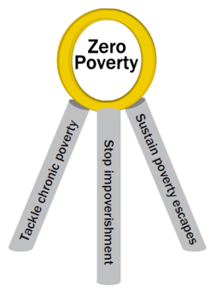
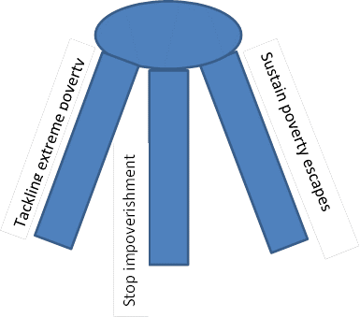
Poverty tripod
Notes:
Also this is a pirate copy of the CPR argument and illustration

Slide 8
Poverty interventions, SE partners
 | Tackling extreme poverty |  |  |  | Stopping impoverishment |  |  |  | Sustaining poverty escapes
2012-2013 | Better quality basic educ | Social assist. | Pro-poorest econ. growth | Affirm. action, anti-discrim. | Universal health care | savings & insur. | disaster risk mgmt | Prevent conflict | Assets, land policies, mobility | Skills training labor market links | social protect | Universal SRHR
Zambia
Tanzan.
Rwanda
Mocam.
Mali**
Burkina F
Kenya
Bangla.
Uganda
Ethiopia
Cambod
Bolivia
Notes:
Here you should try to get the whole picture, rather than losing yourselves in details – which you cannot read anyway.
On top – the three legs in the tripod. Each of them contains four kinds of interventions, which we will look at more in detail later.
Countries at the left, coulored boxes are places where interventions are done.
Yellow – related to education
Red – related to social protection mechanisms
Blue – related to pro-poor growth, market development and management of productive resources
Lilac – socio-political relations
Green – health related interventions.
SE fairly strong on pro-poor growth, health
weaker on education and social protection

Slide 9
Poverty interventions, SE partners
 | Tackling extreme poverty |  |  |  | Stopping impoverishment |  |  |  | Sustaining poverty escapes
2012-2013 | Better quality basic educ | Social assist. | Pro-poorest econ. growth | Affirm. action, anti-discrim. | Universal health care | savings & insur. | disaster risk mgmt | Prevent conflict | Assets, land policies, mobility | Skills training labor market links | social protect | Universal SRHR
Zambia |  |  |  | + |  | + |  |  |  |  |  | +
Tanzan. |  |  | +* | + |  | +* |  |  | +* | +
Rwanda |  | + |  |  |  | + |  |  | + |  | +
Mocam. | +* |  |  |  | +* | +* | +
Mali** |  |  |  | + | + |  | + | + | +
Burkina F
Kenya | + |  |  | + | + | + |  | + |  | + | + | +
Bangla. |  |  |  | + |  |  | + |  |  | +
Uganda |  |  |  |  |  | + | + | +
Ethiopia | + |  | + | + |  |  |  |  | + |  |  | +
Cambod |  |  |  |  |  |  |  |  | + |  |  | +
Bolivia |  |  |  | + |  |  |  |  |  |  | + | +
Notes:
Marked plusses,
one plus: intervention below 10 MSEK, or thematically marginal intervention
Total of 78 boxes are filled, 45 of these have only one plus – interventions are thus fairly thinly spread

Slide 10
Poverty interventions, SE partners
 | Tackling extreme poverty |  |  |  | Stopping impoverishment |  |  |  | Sustaining poverty escapes
2012-2013 | Better quality basic educ | Social assist. | Pro-poorest econ. growth | Affirm. action, anti-discrim. | Universal health care | savings & insur. | disaster risk mgmt | Prevent conflict | Assets, land policies, mobility | Skills training labor market links | social protect | Universal SRHR
Zambia |  |  |  | + |  | + |  |  | ++ |  |  | +
Tanzan. | ++ |  | +* | + | ++* | +* |  |  | +* | + |  | ++
Rwanda |  | + |  |  |  | + |  | ++ | + |  | +
Mocam. | +* | ++ | ++ |  | +* | +* | +
Mali** |  |  | ++ | + | + |  | + | + | +
Burkina F |  |  | (++*) |  | ++*
Kenya | + | ++ |  | + | + | + |  | + | ++ | + | + | +
Bangla. |  |  |  | + |  |  | + |  |  | + |  | ++
Uganda |  |  | ++ |  |  | + | + | +
Ethiopia | + |  | + | + |  |  | ++ |  | + |  |  | +
Cambod |  |  |  |  |  |  |  |  | + |  |  | +
Bolivia |  |  | ++ | + | ++ |  |  |  | ++ | ++ | + | +
Notes:
WE add the two plusses – interventions between 10-30 MSEK and with fairly broad coverage thematically
19 boxes have 2 plusses

Slide 11
Poverty interventions, SE partners
 | Tackling extreme poverty |  |  |  | Stopping impoverishment |  |  |  | Sustaining poverty escapes
2012-2013 | Better quality basic educ | Social assist. | Pro-poorest econ. growth | Affirm. action, anti-discrim. | Universal health care | savings & insur. | disaster risk mgmt | Prevent conflict | Assets, land policies, mobility | Skills training labor market links | social protect | Universal SRHR
Zambia |  |  | +++ | + | +++ | + |  |  | ++ |  |  | +
Tanzan. | ++ |  | +* | + | ++* | +* |  |  | +* | + |  | ++
Rwanda |  | + |  |  |  | + |  | ++ | + |  | +
Mocam. | +* | ++ | ++ |  | +* | +* | + |  | +++* |  | +++*
Mali** |  | +++ | ++ | + | + |  | + | + | +
Burkina F |  |  | (++*) |  | ++* |  |  |  | +++
Kenya | + | ++ | +++ | + | + | + |  | + | ++ | + | + | +
Bangla. | +++ |  |  | + | +++ |  | + |  |  | + |  | ++
Uganda |  |  | ++ |  | +++ | + | + | + |  |  |  | +++
Ethiopia | + | +++ | + | + |  |  | ++ |  | + |  |  | +
Cambod | +++ |  |  |  |  |  |  |  | + |  |  | +
Bolivia | +++ |  | ++ | + | ++ |  |  |  | ++ | ++ | + | +
Notes:
What remains are 14 boxes with three plusses – interventions above 30 MSEK and with broad thematic coverage. If more than one intervention is relevant for the policy area, I’ve added them together.
What we learn from this is that those interventions that are relevant for poverty reduction are neither very concentrated or focused OR very comprehensive.
Only in Bolivia, Kenya, tanzania and Mocambique we can talk about comprehensive programs. Two of these Moc and Tz are the result of general budget support (marked with asterix)

Slide 12
Tackling extreme poverty
2012-13 | Better quality basic education | Social assistance | Pro-poorest econ. growth | Affirmative action, anti-discriminat.
Zambia |  |  | +++ | +
Tanzania | ++ |  | +* | +
Rwanda |  | +
Mocambique | +* | ++ | ++
Mali |  | +++ | ++ | +
Burkina Faso |  |  | (++*)
Kenya | + | ++ | +++ | +
Bangladesh | +++ |  |  | +
Uganda |  |  | ++
Ethiopia | + | +++ | + | +
Cambodia | +++
Bolivia | +++ |  | ++ | +
Notes:
Now a more detailed look at one of the legs in the tripod – tackling extreme poverty.
It is about helping people to get capabilities and platforms to master the risks they face and to be able to be more productive in what they do for a living.
Better quality basic education – The three Asian and Latin American countries – strong interventions. In Africa it is Tanzania where education is strong part, otherwise very thin.
Social assistance – here taken in humanitarian interventions in Mali and Ethiopia, Mozambique and Kenya. In Rwanda this was part of a market development intervention
Pro-poor growth – quite a lot of interventions in most countries: market development geared towards poor people, job creation of various sorts/ agriculture
Here, I’d like to make some additional comments that may help you understand what I’ve done, and what I’ve not done.
There are since many years back a critical discussion on the role of agriculture in Swedish aid. It is often said that there is way too little focus on this key sector for poverty reduction. Based on other work that I’ve done earlier, I would agree with such a critique. However, in this study, I’ve not gone into detail about this. I’ve not separated interventions between economic sectors in that way. I have rather noted whether interventions in this category of policies are done or not. So, based on this work I cannot say whether there is too little or enough focus on agriculture. That has to be discussed elsewhere, since I don’t have any basis for that kind of discussion here. My material doesn’t say anything about it.
Affirmative action – well, represented, but very thin interventions to support marginalized groups.

Slide 13
Stopping impoverishment
2012-13 | Universal health care | Savings & insurance | Disaster risk mgmt | Prevent conflict
Zambia | +++ | +
Tanzania | ++* | +*
Rwanda |  | + |  | ++
Mocamb | +* | +* | +
Mali | + |  | + | +
Burkina F | ++*
Kenya | + | + |  | +
Bangladesh | +++ |  | +
Uganda | +++ | + | + | +
Ethiopia |  |  | ++
Cambodia
Bolivia | ++
Notes:
To stop impoverishment is about helping people to deal with risks and shocks that may push them back into poverty
UHC key – poverty may very often be just one illness away – costs for curing too high, away from earning money or working on your field. SE strong on this, almost everywhere, and with focus.
Savings & insurance in credit schemes/ financial sector development. Well, to some extent, but very thinly. Much more could be done here!
Same with disaster risk mgmt – is this relevant everywhere, yes increasingly. Even Burkina Faso and Kenya face climate change effects; so SE is thin on this
Prevent conflict – well, here better focused on where the needs are. Possibly Mozambique coming up, Ethiopia more difficult for political reasons, otherwise reasonable.

Slide 14
Sustain poverty escapes
2012-13 | Assets, land policies, mobility | Skills training, labor mkt links | social protection | Universal SRHR
Zambia | ++ |  |  | +
Tanzania | +* | + |  | ++
Rwanda | + |  | +
Mocambique | +++* |  | +++*
Mali | +
Burkina F | +++
Kenya | ++ | + | + | +
Banglades |  | + |  | ++
Uganda |  |  |  | +++
Ethiopia | + |  |  | +
Cambodia | + |  |  | +
Bolivia | ++ | ++ | + | +
Notes:
Sustain poverty escapes is about helping people to build and reinforce their resilence, as individuals. To be able to find new ways forward when the ones tried fail
Access to productive assets, such as land, water, forest, fair tenure systems and land policies, mobility to be able to diversify and utilise these resources productively. Here Sweden is quite strong. Some of this is called environmental projects. But people are in focus in these interventions, so they are effective at poverty reduction;
Skills training – what? Why has this been forgotten?
Social protection – schemes for child allowances, old age pension, conditional cash transfers. This is an area were it is argued that donors probably should keep hands off for systems to be viable and sustainable. Much is also happening in this area driven by governments themselves. However, there is much more room for supporting such programs in various ways with pilots, studies, help building systems etc. In the Swedish aid policy framework this area is presented as a sub-objective and described as important – however without any committments made.
Universal SRHR – Swedish profile issue, however, not that well reflected in interventions, missing in some countries, focusing on information and awarenessbuilding in others.

Slide 15
Summary
Poverty severity doesn’t guide allocations;
Broad education & social protection very thinly supported;
Interventions thinly spread;
SE somewhat stronger at tackling extreme poverty;
Stronger at pro-poor growth and health;
Tripod is unbalanced.

Slide 16
Conclusions
Glass is half full
Either more comprehensive programs…
…Or more focus on specific areas – coordinated with others
Strengthen education and skills training, social protection
Notes:
I ticked 78 out of 144 boxes, which is slightly more than half. Is the glass then half full?
Well, there is a choice to make, given that many interventions were quite small. Either specialize further, make more out of what is done, or move towards more comprehensive programs.
I immediately hear the objection that everyone should not do everything. Yes. But here it is essential that all those policies are present together if poverty is to be reduced. So if SWE does not support it, someone else has to do it. Other donors need to support, or fundamentally – the partner country government should do it.
However, when I wen through the result reports for these 12 countries, I did not find references to what others are doing, and surprisingly little talk about what ther government does.
Hence, these documents do not tell us much about what coordination that is taking place.
It might be that this coordination is happening anyway. But these documents are not good instruments for a strategic discussion about what to support.
My preliminary conclusion is that there seems to be room for more strategic selection of interventions.
Another conclusion I draw is that education and social protection needs to be stronger in Swedish bilateral aid. This is basically because these areas are helpful across-the-board in supporting all three legs of the tripod.

Slide 17
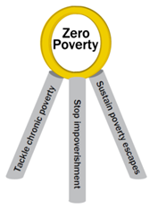
Make the tripod stronger!

