Slide 1

Swedish Policy Options in Support of Global Health 2035 Goals
Gavin Yamey MD MPH
Lead, Evidence to Policy Initiative, Global Health Group
University of California San Francisco
Jesper Sundewall PhD
Program Manager, Expert Group for Aid Studies (EBA)
EBA Seminar, Rosenbads Conference Center
7th November, 2014

Slide 2



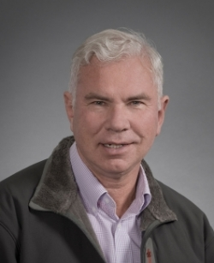

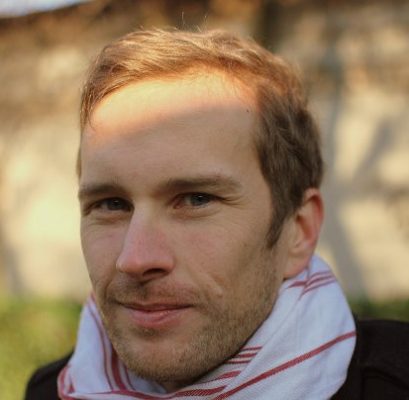
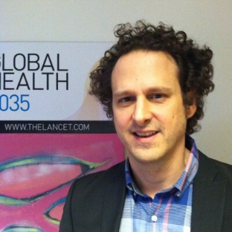

Our Team
Dean Jamison
Helen Saxenian
Jesper Sundewall
Research assistance from R4D and SEEK
Gavin Yamey
Robert Hecht

Slide 3

Key Framing Questions
How could Swedish development assistance for health (DAH) evolve over the next 20 years to help achieve Global Health 2035 goals?
Are there new areas for DAH where Sweden might act as a pioneer?

Slide 4
Our Approach
1. Summarize GH2035 goals and implications for DAH
2. Lay out key post-2015 global health challenges and opportunities
3. Develop new classification of DAH by function
5. Assess Sweden’s strengths & impacts in global health
6. Policy options for Swedish DAH to support GH2035 goals—based on strengths and neglected functions
4. Analyze Swedish DAH by function

Slide 5
Our Approach
1. Summarize GH2035 goals and implications for DAH
2. Lay out key post-2015 global health challenges and opportunities
3. Develop new classification of DAH by function
5. Assess Sweden’s strengths & impacts in global health
6. Policy options for Swedish DAH to support GH2035 goals—based on strengths and neglected functions
4. Analyze Swedish DAH by function

Slide 6
Global Health 2035: WDR 1993 @20 Years
The World Bank’s World Development Report 1993
Evidence-based health expenditures are an investment not only in health, but in economic prosperity
The Lancet Commission on Investing in Health (chaired by Lawrence Summers, co-chaired by Dean Jamison)
Re-examines the case for investing in health
Additional resources should be spent on cost-effective interventions to address high-burden diseases
Provides a roadmap to achieving dramatic gains in global health by 2035
Proposes a health investment framework for low- and lower-middle-income countries

Slide 7
Global Health 2035: Key Findings
For infectious, maternal & child deaths, a grand convergence is possible by 2035
The returns from investing in convergence are impressive
DAH is likely to shift away from supportive towards core functions
Fiscal policies are a powerful, underused lever for curbing non-communicable diseases and injuries
Pro-poor pathways to UHC could efficiently achieve health & financial protection

Slide 8
Global Health 2035: Key Findings
For infectious, maternal & child deaths, a grand convergence is possible by 2035
The returns from investing in convergence are impressive
DAH is likely to shift away from supportive towards core functions
Fiscal policies are a powerful, underused lever for curbing non-communicable diseases and injuries
Pro-poor pathways to UHC could efficiently achieve health & financial protection

Slide 9
Two Centuries of Divergence; ‘4C Countries’ Then Converged

Slide 10
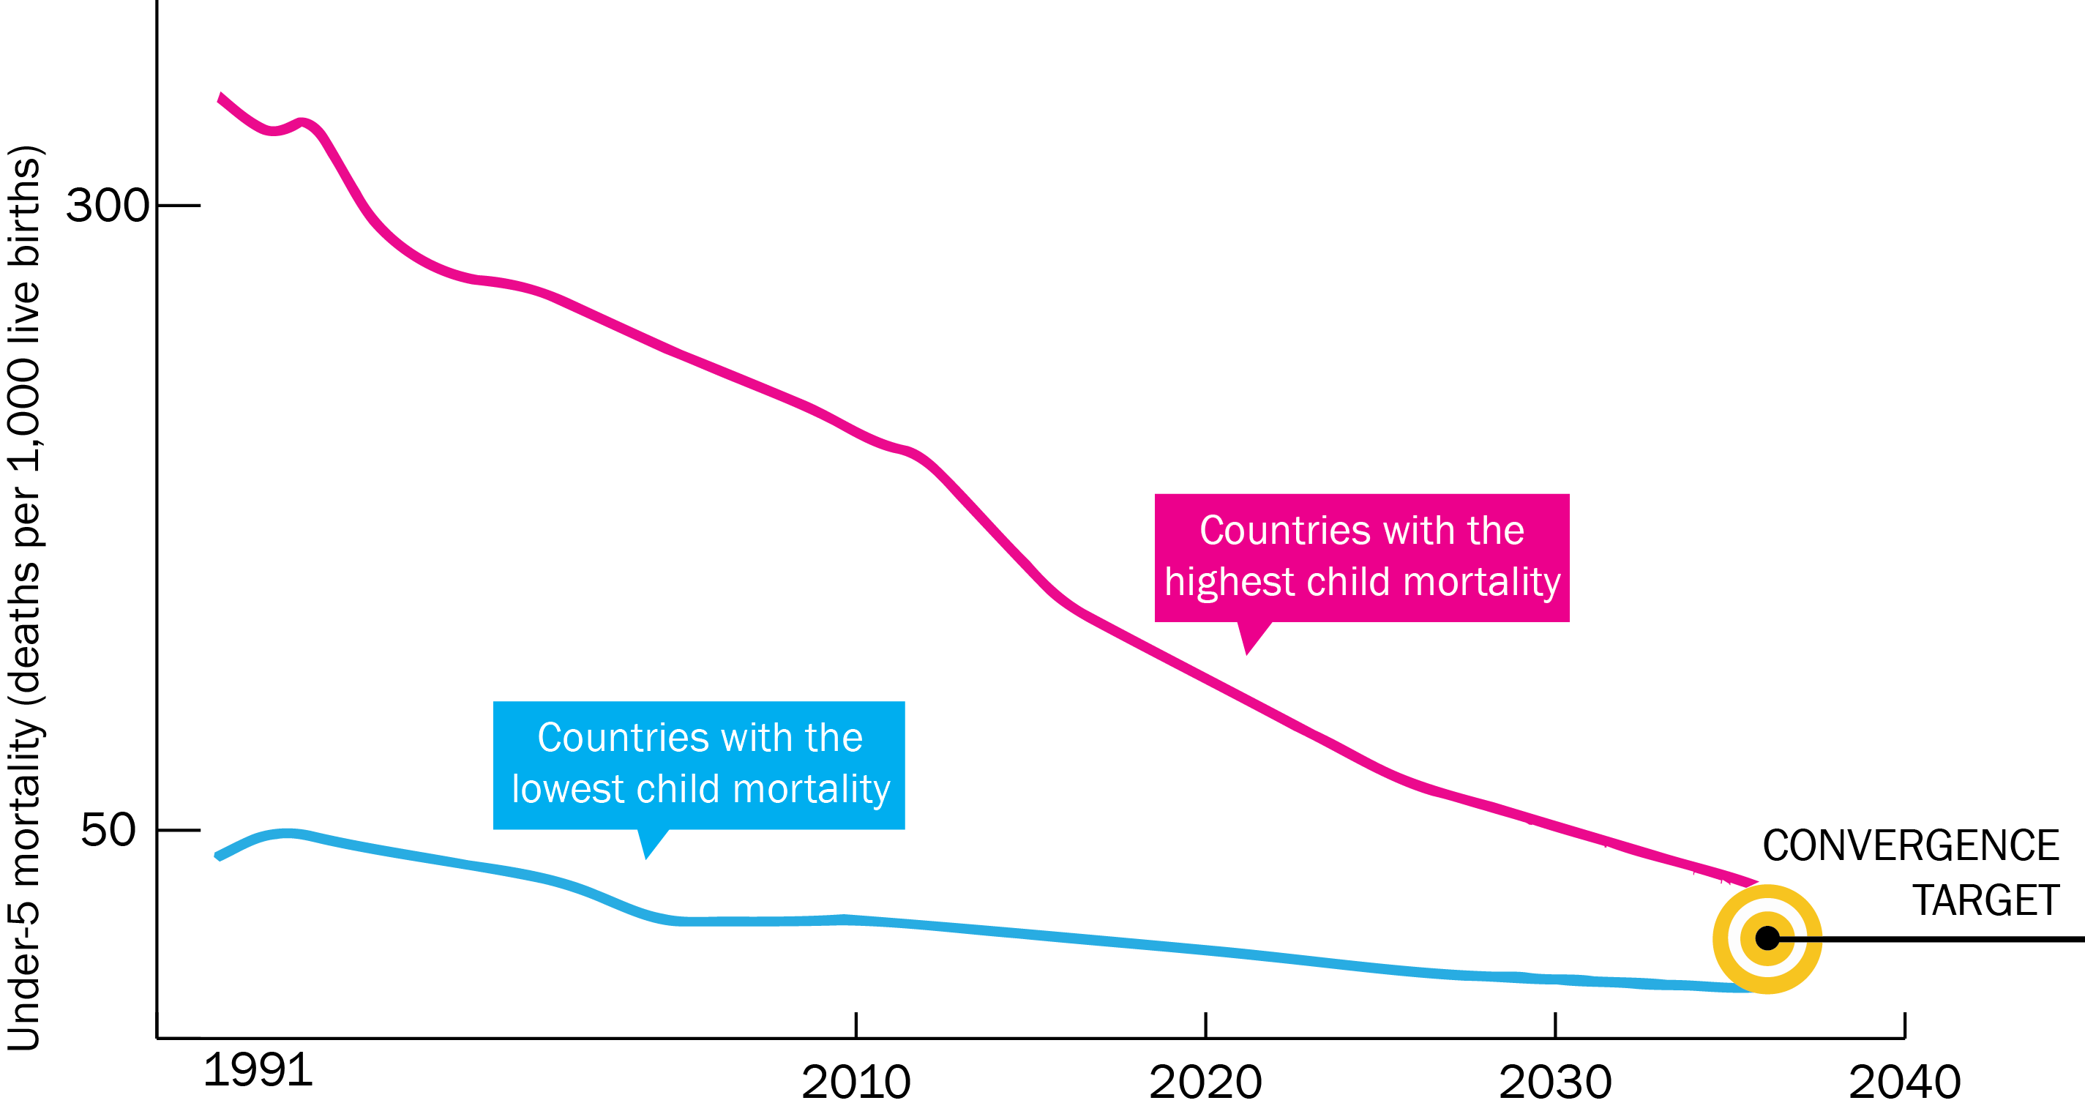
Now on Cusp of a Historical Achievement:
Nearly All Countries Could Converge by 2035

Slide 11
Impact and Cost of Convergence
Low-income countries | Lower middle-income countries
Annual deaths averted from 2035 onwards
4.5 million | 5.8 million
Approximate incremental cost per year, 2016-2035
$25 billion (a doubling of current spending) | $45 billion (a 20% increase over current spending)
Proportion of costs devoted to structural investments in health system
60-70% | 30-40%
Proportion of health gap closed by existing tools (rest closed by R&D)
2/3 | 4/5

Slide 12
Caveats & Challenges
Inherent uncertainties in any modeling exercise
Assumes aggressive coverage levels (typically 90-95% by 2035)—would all countries have the institutional capacity?
Model does not account for role of other development sectors (e.g. climate, water ) or social determinants of health
May over-play or under-play role of R&D

Slide 13
Sources of Income to Fund Convergence
Economic growth
CIH projections: annual GDP growth of 4.5% for LICs, 4.3% for LMICs, 2011-2035
Mobilization of domestic resources
Taxation of tobacco, alcohol, sugar, extractive industries
Inter-sectoral reallocations and efficiency gains
Development assistance for health
Removal of fossil fuel subsidies, health sector efficiency
Subsidies account for an 3.5% of GDP on a post-tax basis
Will still be crucial for achieving convergence
USD 10 trillion would be added to GDP
About 1% of this growth would fund annual cost in 2035

Slide 14
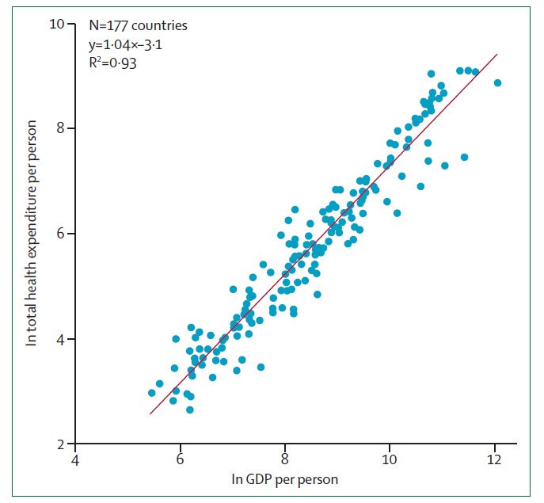
First Law of Health Economics

Slide 15
Global Health 2035: Key Findings
For infectious, maternal & child deaths, a grand convergence is possible by 2035
The returns from investing in convergence are impressive
DAH is likely to shift away from supportive towards core functions
Fiscal policies are a powerful, underused lever for curbing non-communicable diseases and injuries
Pro-poor pathways to UHC could efficiently achieve health & financial protection

Slide 16
Global Health 2035: Key Findings
For infectious, maternal & child deaths, a grand convergence is possible by 2035
The returns from investing in convergence are impressive
DAH is likely to shift away from supportive towards core functions
Fiscal policies are a powerful, underused lever for curbing non-communicable diseases and injuries
Pro-poor pathways to UHC could efficiently achieve health & financial protection

Slide 17
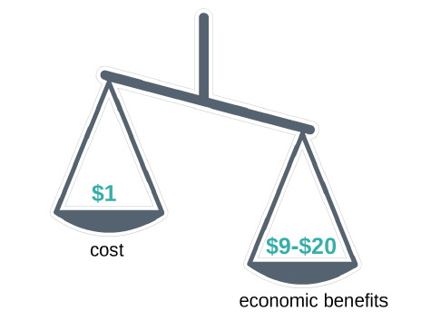
Benefit: Cost Ratio for Achieving Convergence

Slide 18
Global Health 2035: Key Findings
For infectious, maternal & child deaths, a grand convergence is possible by 2035
The returns from investing in convergence are impressive
DAH is likely to shift away from supportive towards core functions
Fiscal policies are a powerful, underused lever for curbing non-communicable diseases and injuries
Pro-poor pathways to UHC could efficiently achieve health & financial protection

Slide 19
Global Health 2035: Key Findings
For infectious, maternal & child deaths, a grand convergence is possible by 2035
The returns from investing in convergence are impressive
DAH is likely to shift away from supportive towards core functions
Fiscal policies are a powerful, underused lever for curbing non-communicable diseases and injuries
Pro-poor pathways to UHC could efficiently achieve health & financial protection

Slide 20
Key Functions of International Collective Action
Function | Key examples
Core: Providing global public goods | ▪ R&D for health tools ▪ Guidelines, norms, standards ▪ Knowledge generation and sharing ▪ Intellectual property and market shaping activities
Core: Controlling cross-border externalities | ▪ Surveillance, information sharing, regulatory regimes e.g. to tackle cross-border outbreaks, counterfeit drugs, antibiotic resistance, tobacco marketing
Core: Leadership and stewardship | ▪ Global health advocacy, priority setting, aid effectiveness
Supportive: Direct country assistance | ▪ Financial and technical assistance
Jamison DT, Frenk J, Knaul F. International collective action in health: objectives, functions, and rationale. Lancet 1998; 351: 514–17.

Slide 21
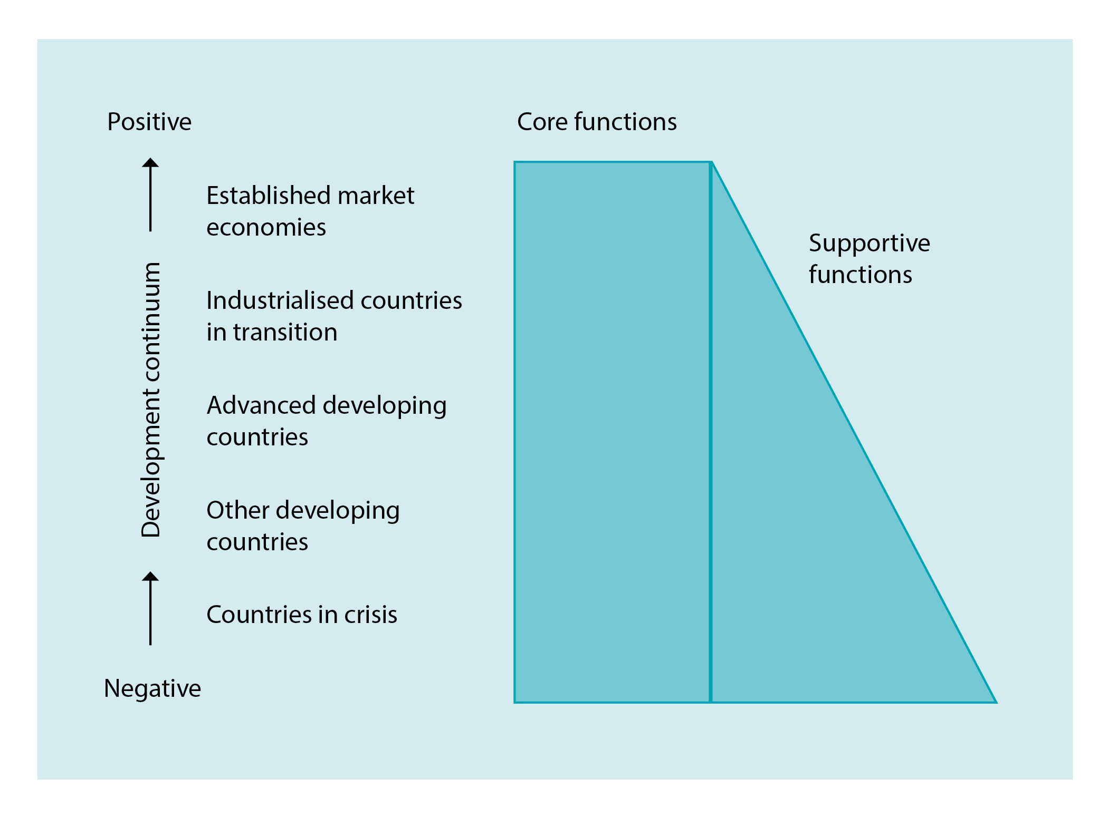
Core Vs. Supportive Along the Economic Continuum

Slide 22
Core Functions Have Been Neglected
Prominent DAH actors channel most resources to supportive functions
Trend is contrary to expectations over time
Global Health 2035 argues that international collective action should focus on R&D, externalities
The report calls for a doubling of R&D for neglected conditions, from $US 3 billion to $US 6 billion per year
Blanchet N, Thomas M, Atun R, Jamison DT, Knaul F, Hecht R. Global collective action in health: the WDR+20 landscape of core and supportive functions, 2013

Slide 23
Global Health 2035: Key Findings
For infectious, maternal & child deaths, a grand convergence is possible by 2035
The returns from investing in convergence are impressive
DAH is likely to shift away from supportive towards core functions
Fiscal policies are a powerful, underused lever for curbing non-communicable diseases and injuries
Pro-poor pathways to UHC could efficiently achieve health & financial protection

Slide 24
Global Health 2035: Key Findings
For infectious, maternal & child deaths, a grand convergence is possible by 2035
The returns from investing in convergence are impressive
DAH is likely to shift away from supportive towards core functions
Fiscal policies are a powerful, underused lever for curbing non-communicable diseases and injuries
Pro-poor pathways to UHC could efficiently achieve health & financial protection

Slide 25

Single Greatest Opportunity To Curb NCDs is Tobacco Taxation
50% rise in tobacco price from tax increases in China
  prevents 20 million deaths + generates extra $20 billion/y in next 50 y
  additional tax revenue would fall over time but would be higher than current levels even after 50 y
  largest share of life-years gained is in bottom income quintile

Slide 26
Global Health 2035: Key Findings
For infectious, maternal & child deaths, a grand convergence is possible by 2035
The returns from investing in convergence are impressive
DAH is likely to shift away from supportive towards core functions
Fiscal policies are a powerful, underused lever for curbing non-communicable diseases and injuries
Pro-poor pathways to UHC could efficiently achieve health & financial protection

Slide 27
Global Health 2035: Key Findings
For infectious, maternal & child deaths, a grand convergence is possible by 2035
The returns from investing in convergence are impressive
DAH is likely to shift away from supportive towards core functions
Fiscal policies are a powerful, underused lever for curbing non-communicable diseases and injuries
Pro-poor pathways to UHC could efficiently achieve health & financial protection

Slide 28
Example of Pro-poor Pathway to UHC
Insurance covers whole population
Targets poor by insuring highly cost-effective health interventions for diseases disproportionately affecting poor
Interventions are funded through tax revenues, payroll taxes, or combination
No OOP expenses for defined benefit package of publicly financed services
As resource envelope grows, so does package (as seen in Mexico), e.g. add wider range of interventions for NCDs

Slide 29
Our Approach
1. Summarize GH2035 goals and implications for DAH
2. Lay out key post-2015 global health challenges and opportunities
3. Develop new classification of DAH by function
5. Assess Sweden’s strengths & impacts in global health
6. Policy options for Swedish DAH to support GH2035 goals—based on strengths and neglected functions
4. Analyze Swedish DAH by function

Slide 30
Our Approach
1. Summarize GH2035 goals and implications for DAH
2. Lay out key post-2015 global health challenges and opportunities
3. Develop new classification of DAH by function
5. Assess Sweden’s strengths & impacts in global health
6. Policy options for Swedish DAH to support GH2035 goals—based on strengths and neglected functions
4. Analyze Swedish DAH by function

Slide 31
Post-2015 Challenges & Opportunities
Unfinished MDGs agenda
Microbial evolution
For infectious, maternal & child deaths, a grand convergence is possible by 2035
The returns from investing in convergence are impressive
DAH is likely to shift away from supportive towards core functions
Fiscal policies are powerful, underused lever for curbing NCDs & injuries
Pro-poor UHC could efficiently achieve health & financial protection
Crisis of NCDs and injuries
Medical impoverishment

Slide 32
Post-2015 Challenges & Opportunities
International collective action arrangements and financing are not “fit for purpose”
For infectious, maternal & child deaths, a grand convergence is possible by 2035
The returns from investing in convergence are impressive
DAH is likely to shift away from supportive towards core functions
Fiscal policies are powerful, underused lever for curbing NCDs & injuries
Pro-poor UHC could efficiently achieve health & financial protection

Slide 33
Our Approach
1. Summarize GH2035 goals and implications for DAH
2. Lay out key post-2015 global health challenges and opportunities
3. Develop new classification of DAH by function
5. Assess Sweden’s strengths & impacts in global health
6. Policy options for Swedish DAH to support GH2035 goals—based on strengths and neglected functions
4. Analyze Swedish DAH by function

Slide 34
Our Approach
1. Summarize GH2035 goals and implications for DAH
2. Lay out key post-2015 global health challenges and opportunities
3. Develop new classification of DAH by function
5. Assess Sweden’s strengths & impacts in global health
6. Policy options for Swedish DAH to support GH2035 goals—based on strengths and neglected functions
4. Analyze Swedish DAH by function

Slide 35
Classifying Aid by Function
Role for DAH | Definition | Example
Global | Aid to address global, transnational issues | R&D of new health tools
Local | Fungible aid to LICs/LMICs that could be easily replaced with domestic financing as countries get richer | DAH to support the purchase of health commodities (e.g. vaccines, ARVs) or to pay health workers to deliver maternal and child health services
“Glocal” | DAH that is less fungible and is used to -tackle supranational (regional, international) health concerns, or -overcome constraints resulting from unwillingness/inability of governments to deal with certain subpopulations or health issues | DAH to governments for malaria control to reduce cross-border, regional spread; DAH to governments to tackle health problems of refugees or to provide reproductive health and abortion services

Slide 36
Our Approach
1. Summarize GH2035 goals and implications for DAH
2. Lay out key post-2015 global health challenges and opportunities
3. Develop new classification of DAH by function
5. Assess Sweden’s strengths & impacts in global health
6. Policy options for Swedish DAH to support GH2035 goals—based on strengths and neglected functions
4. Analyze Swedish DAH by function

Slide 37
Our Approach
1. Summarize GH2035 goals and implications for DAH
2. Lay out key post-2015 global health challenges and opportunities
3. Develop new classification of DAH by function
5. Assess Sweden’s strengths & impacts in global health
6. Policy options for Swedish DAH to support GH2035 goals—based on strengths and neglected functions
4. Analyze Swedish DAH by function

Slide 38
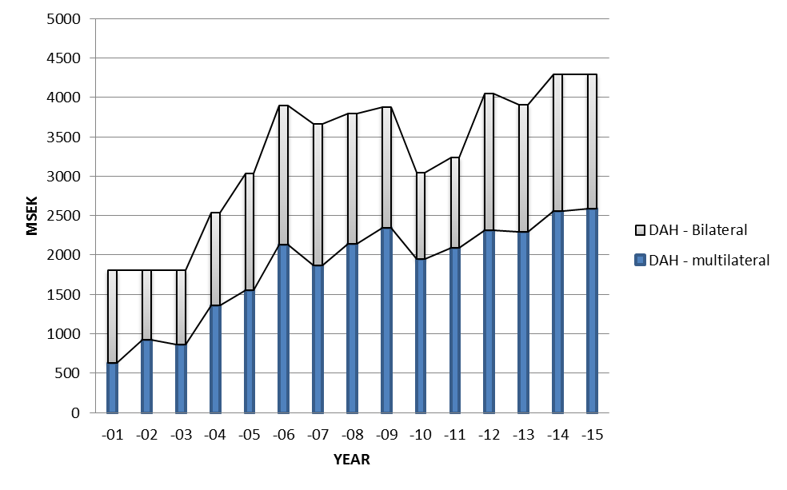
Swedish DAH reached about 4 billion SEK in 2013
1.6 billion SEK in 2013
2.3 billion SEK in 2013
GFATM | 0.7
UNFPA | 0.43
GAVI | 0.37

Slide 39
Multilaterals’ Support for Global vs. Local Functions
Multilateral recipient of Swedish DAH | Proportion of multilateral agency spending that is global | Proportion of multilateral agency spending that is local
Global Fund | 20-25% | 75-80%
UNFPA | 10-15% | 85-90%
GAVI Alliance | 20-25% | 75-80%
UNICEF | 3-8% | 92-97%
UNAIDS | 35-40% | 55-60%
WHO | 62% | 38%
Only about 1/5 of Sweden’s DAH to multilaterals supports global functions
2.3-3 billion SEK out of 13.8 billion SEK over period 2010-2015

Slide 40
Sweden’s Bilateral DAH: 54% is Direct Country Cooperation

Slide 41
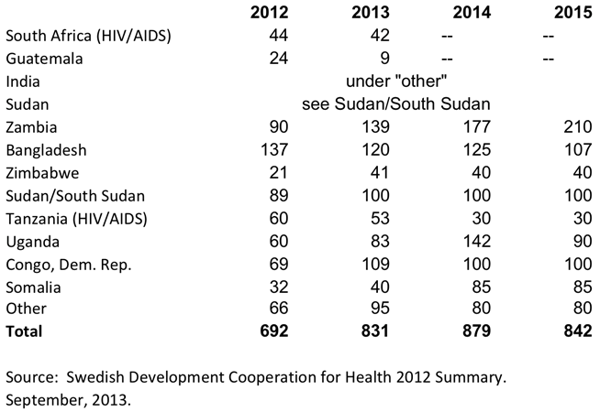
Direct Country Support: Largest Programs

Slide 42
Focus Areas for Bilateral Assistance
Reproductive health care (36%), basic health care (23%) and control of STIs including HIV/AIDS (21%)
Four fragile/conflict/post-conflict countries: DRC, South Sudan, Somalia, Guatemala
Phasing out support for the highest income countries (South Africa, Guatemala)
Phasing in support for Myanmar (2014) → increasingly targets bilateral resources on poorer countries with greater health needs
Broadly supportive of convergence agenda

Slide 43
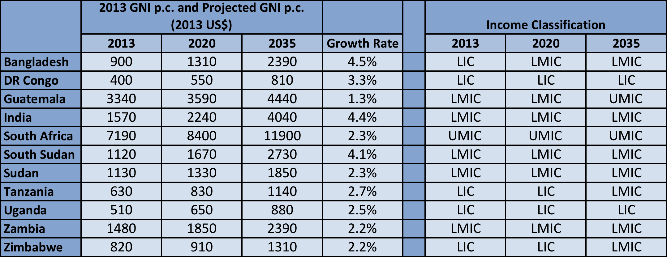
Economic Growth Means Some Countries May Graduate from Swedish DAH by 2035
Example: applying GAVI graduation cut-off of $1570 p.c., only 4 countries would be eligible for Swedish support

Slide 44
Assessing Bilateral DAH for Global Versus Local Functions
Step 1
Step 2
Geographic focus
Further categorization of global functions
Country projects (“local functions”)
Unspecified bilateral ODA, for global and multi-regional projects (“global functions”)
3 categories
Providing global public goods
Managing cross-border externalities
Leadership and stewardship
Sweden’s 2012 disbursements as recorded in the OECD creditor reporting system database
Output: division of Sweden’s bilateral DAH into local versus global (and global is further sub-divided)

Slide 45
Examples of Bilateral Donors Supporting Global Functions
Category | Examples
Providing global public goods | International Partnership for Microbicides
 | WHO Special Programme of Research and Training in Tropical Diseases
Managing cross-border externalities | DFID contribution Towards the Global Polio Eradication Initiative
 | ReAct network (taking action on antibiotic resistance)
Leadership and stewardship | Support to PMNCH
 | Support to IHP+

Slide 46
Most Swedish Bilateral Support is for Local Functions
Global Public Goods | 63%
Externalities | 14%
Leadership/Stewardship | 23%

Slide 47
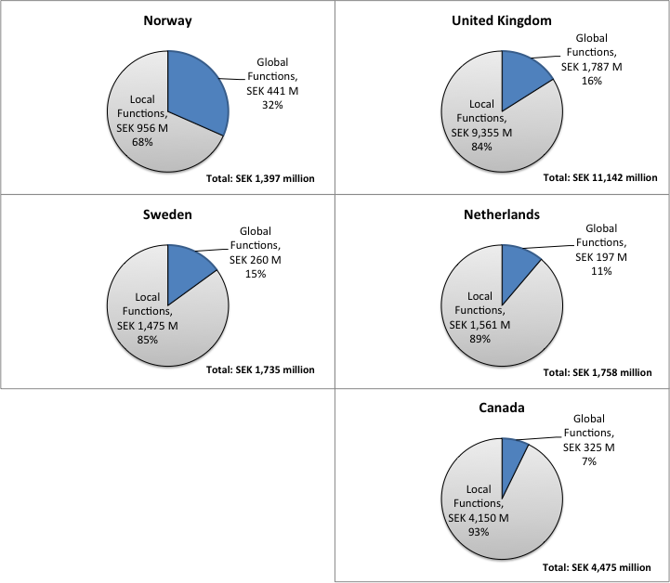
Cross-Country Comparison

Slide 48
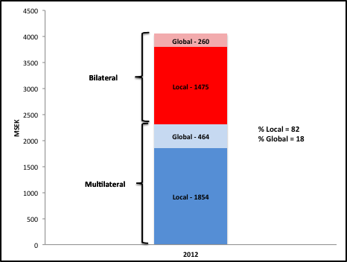
Overall Breakdown of Swedish DAH

Slide 49
Our Approach
1. Summarize GH2035 goals and implications for DAH
2. Lay out key post-2015 global health challenges and opportunities
3. Develop new classification of DAH by function
5. Assess Sweden’s strengths & impacts in global health
6. Policy options for Swedish DAH to support GH2035 goals—based on strengths and neglected functions
4. Analyze Swedish DAH by function

Slide 50
Our Approach
1. Summarize GH2035 goals and implications for DAH
2. Lay out key post-2015 global health challenges and opportunities
3. Develop new classification of DAH by function
5. Assess Sweden’s strengths & impacts in global health
6. Policy options for Swedish DAH to support GH2035 goals—based on strengths and neglected functions
4. Analyze Swedish DAH by function

Slide 51
Global Health is a Core Priority for Swedish Aid:
Active, Visible, Influential Health Donor
Sexual and reproductive health and rights, including family planning and safe abortion
Midwifery, e.g. major support to UNFPA for midwifery programs
Growing reputation and expertise on NCDs and injuries, including road traffic safety
Antibiotic resistance; research on infections of poverty (only about 200 million SEK per yr)

Slide 52
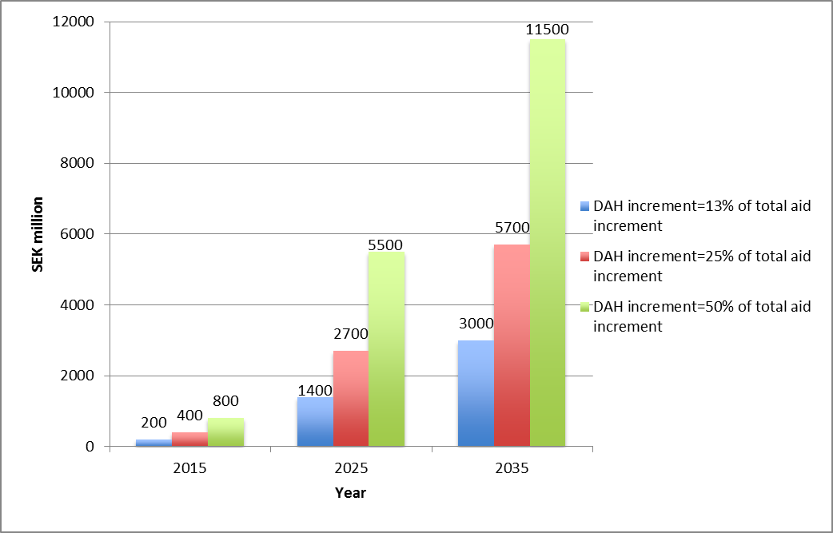
Growth in Swedish DAH by 2035
Notes:
We argue that a greater % of ODA should go to health. Why? First, health aid has a strong record of exceptional implementation success, as shown for example by the robust association between development assistance for health for scaling up HIV and malaria control tools and reduced mortality from these infections. Second, the returns to investing in the health sector have historically been very large—benefit-cost analyses can be around 5-10 or even higher

Slide 53
Our Approach
1. Summarize GH2035 goals and implications for DAH
2. Lay out key post-2015 global health challenges and opportunities
3. Develop new classification of DAH by function
5. Assess Sweden’s strengths & impacts in global health
6. Policy options for Swedish DAH to support GH2035 goals—based on strengths and neglected functions
4. Analyze Swedish DAH by function

Slide 54
Our Approach
1. Summarize GH2035 goals and implications for DAH
2. Lay out key post-2015 global health challenges and opportunities
3. Develop new classification of DAH by function
5. Assess Sweden’s strengths & impacts in global health
6. Policy options for Swedish DAH to support GH2035 goals—based on strengths and neglected functions
4. Analyze Swedish DAH by function

Slide 55
Overarching Policy Considerations
Invest in high priority global functions, while avoiding sudden disruptive shifts
Build on strengths, complement existing portfolio
Synergize financing with other sectors
In supporting “glocal” functions, assess fungibility as criterion for external financing (if function can be funded domestically, less likely to warrant DAH)
In supporting “local” functions, direct funding to countries below agreed eligibility threshold (e.g. based on IDA eligibility)
For both “glocal” and local, couple funding with dialogue to influence policy change

Slide 56
Reminder: Five Major Post-2015 Challenges/Opportunities
1. Unfinished MDGs agenda
2. Microbial evolution
For infectious, maternal & child deaths, a grand convergence is possible by 2035
The returns from investing in convergence are impressive
DAH is likely to shift away from supportive towards core functions
Fiscal policies are powerful, underused lever for curbing NCDs & injuries
Pro-poor UHC could efficiently achieve health & financial protection
3. Crisis of NCDs and injuries
4. Medical impoverishment
5. International collective action arrangements and financing are not “fit for purpose”

Slide 57
1. Unfinished MDGs/Convergence
Post-2015 Challenge
Sweden’s strengths
Opportunities
1a. Low coverage of evidence-based health interventions and services
1b. Under-funding of R&D for infections and RMNCH conditions that have greatest burden in LICs/MICs
1c. Under-investment in health by national governments of LICs and MICs
1a. Scaling up SRH, family planning, midwifery, and abortion services ; strong human rights based approach & advocacy
1b. Support for infectious disease research, including HIV vaccine and microbicide development
1c. Strong performance in fostering national priority-setting
1a. Global: invest in global functions of multilaterals e.g. pooled procurement, market shaping
1b. Glocal: Build national capacity to conduct research of global value (e.g. scale-up methods)
1c. Local: Dialogue to promote increased domestic spending on infections/RMNCH

Slide 58
2. Microbial Evolution
Post-2015 Challenge
Sweden’s strengths
Opportunities
Global
Fund coalition of international universities, implementers, private actors to ramp up global surveillance & control of antibiotic resistance
“Glocal”
Build national capacity on infectious disease surveillance (regional/global benefits)
Global leader in controlling antibiotic resistance at home and internationally (e.g. through ReAct ); pandemic preparedness is specific priority in Sweden’s global development policy
Antimicrobial resistance
Threat of global pandemics

Slide 59
3. Crisis of NCDs and Injuries
Post-2015 Challenge
Sweden’s strengths
Opportunities
Global
Fund program of adaptive R&D & pre-qualification
“Glocal”
Build national capacity in conducting NCD research with global value, e.g. population policy, and delivery research on scaling up NCD intervention
Spends increasing political capital in highlighting crisis of NCDs; international leader in curbing deaths from road injuries
Global burden of disease is shifting towards NCDs and injuries

Slide 60
4. Medical Impoverishment
Post-2015 Challenge
Sweden’s strengths
Opportunities
“Glocal”
Build national capacity to conduct research on UHC with global value, e.g. on evaluating equity, health impacts
Local
Support national institutions to develop mechanism for revenue mobilization, pooling & designing benefits package
Sweden co-chaired Thematic Consultation on Health in the Post 2015 Development Agenda, which advocates strongly for UHC
150 million people suffer financial catastrophe each year due to medical expenses

Slide 61
5. International collective action arrangements
Post-2015 Challenge
Sweden’s strengths
Opportunities
Global
Fund UN Inter-agency Groups for Child Mortality and Maternal Mortality Estimation
Fund high quality, competitive work by multilateral bodies on RMNCH, infectious disease, and NCD norms, knowledge generation, and advocacy
Strong global health metrics research agenda
Historically, deep backing for WHO, UNAIDS, and other multilateral institutions focused on norms, knowledge, and advocacy
Relative neglect of crucial
global functions: setting technical norms, standards, and
guidelines; international health metrics; and
providing leadership and stewardship of global health

Slide 62

Agenda for Future Research
Refine the DAH classification, especially “glocal” functions
Global health priority setting for the post-2015 era
Costing of convergence

Slide 63

Classifying DAH by functions helps articulate roles of health aid in the post-2015 era
Swedish DAH mostly target local functions
Economic growth means some countries may graduate from Swedish DAH by 2035
Five key global health challenges for post-2015 era
Sweden can play a key role in tackling these challenges, given its impacts and strengths in global health
Significant additional Swedish DAH is likely to be available from 2015 to 2035
Investing this additional Swedish DAH in specific global, local and “glocal” functions could help reach the Global Health 2035 goals

Slide 64

Keely Jordan (UCSF)
Marco Schäferhoff, Christina Schrade, and Cécile Deleye (SEEK)
Milan Thomas and Nathan Blanchet (R4D)
Lawrence H Summers (Harvard University)
GlobalHealth2035.org

