Slide 1
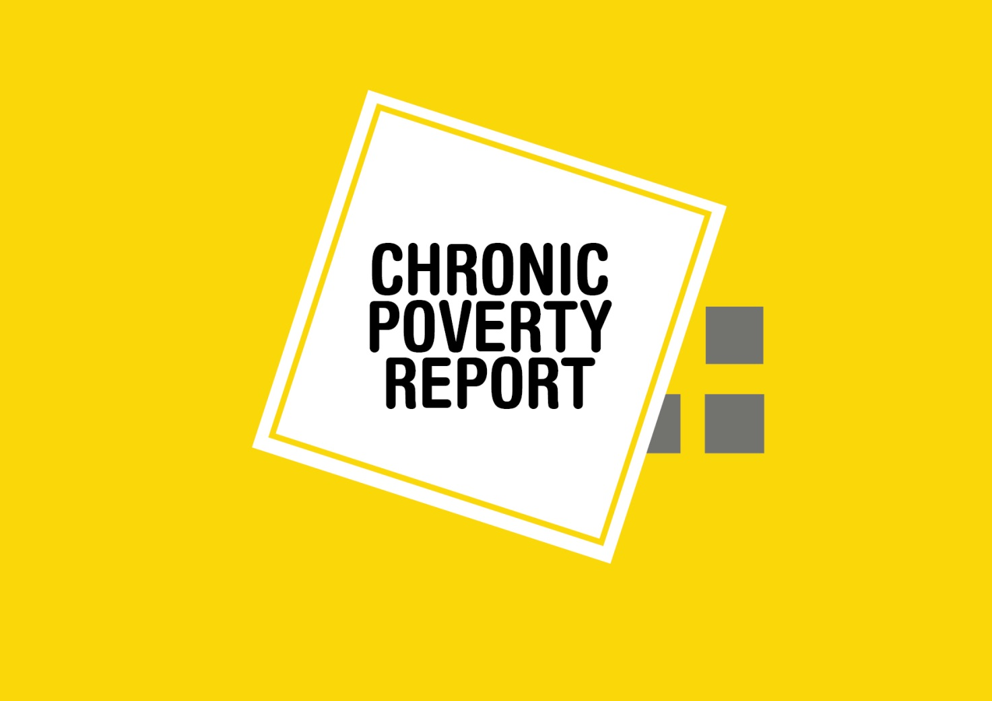

Slide 2
THE ROAD TO ZERO: THE CHRONIC POVERTY REPORT
Andrew Shepherd – Director of the Chronic Poverty Network at ODI
Notes:
Previous Chronic Poverty Reports have focused on identifying and tackling chronic poverty - working out who and where they were and what policies and programmes have worked for them. This report broadens the agenda, in the context of the current international discussions on a post-2015 development framework to replace and finish the job of the MDGs, to the question of what will work to get close to zero extreme poverty. Of course this will not be the last word on the eradication of extreme poverty, but it offers an intellectual framework and a comprehensive analysis of what is needed.
Although this is the context, the report is still aimed at the key public policy decision makers in developing countries – an international framework can only support their efforts.
Sweden has recently produced its excellent Aid Policy Framework, which aims at long-term, concrete improvements for individual people, especially women and girls, living in poverty and under oppression. This presentation will set the Report next to the Policy Framework, and ask the question: of Sweden implements the framework, will it be contributing strongly to the eradication of extreme poverty?

Slide 3
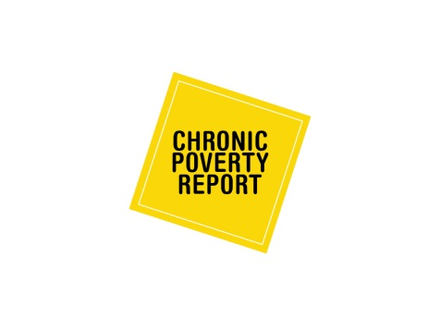
The Zero Poverty Tripod
Notes:
The key message of the report is that getting to zero extreme poverty requires a new public policy approach to understanding and acting on poverty – focused on tackling chronic poverty, stopping impoverishment and sustaining the escapes people make out of extreme poverty.
Extreme poverty, by the way, is defined conventionally and here as living with less than the equivalent of $1.25 a person a day (or sometimes less than the national poverty line) – there is a slide of definitions if anyone wants to go into this [not for presentation]. One could develop the same dynamic framework using multi-dimensional poverty if one wanted, though it would be more complicated.

Slide 4
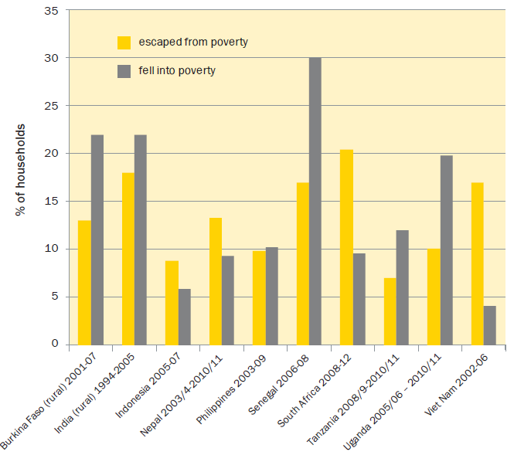
STOPPING IMPOVERISHMENT
Poverty transitions – escapes and descents into poverty
Notes:
This graph illustrates why it is important to talk about poverty dynamics rather than simply the eradication or reduction of poverty. We now understand that the same overall net result or statistic (poverty status) can be achieved with different balances between impoverishment, escaping poverty and chronic poverty. So any national strategy worth the name now needs to make sure that it addresses all three, in an appropriate, context-specific balance, which will probably also change over time.
Stopping impoverishment is the second leg of the poverty tripod. Analysis based on panel data for 10 countries has revealed that descents into poverty can be nearly as great as (or greater than) escapes from poverty over particular periods.

Slide 5
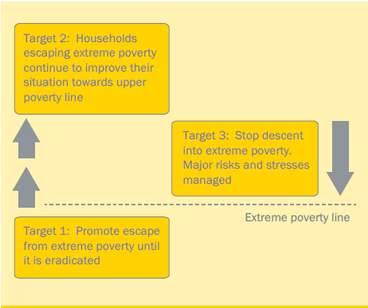
A dynamic post-2015 goal to eradicate extreme poverty
Notes:
All three objectives need to be met in order to get close to zero, so the report proposes a post 2015 poverty eradication goal framed in terms of the three legs of the tripod:
The three targets correspond to the three legs of the tripod. How do we know whether these targets have been met? A raft of indicators is also suggested:
Target 1: % and numbers crossing the extreme poverty line; % and numbers of chronically poor; % of the poor children, women, older women and men, and poor persons with disabilities crossing the extreme poverty line.
Target 2: % and numbers who have crossed the extreme poverty line who reach an upper poverty line (e.g. $2 a day) and a country-specific resilience threshold, beyond which slipping back into poverty is unlikely.
Target 3: % and numbers becoming poor; reported impoverishment due to conflict, natural disasters or ill-health
Many of the indicators proposed require panel data – surveys tracking households over time – which only a few countries have at present – so this would be one significant addition, among others, to the data required for monitoring. To get a decent panel survey up and running in all countries in 2015/6 would not be financially impossible, though it would be a challenge. Countries already doing it would have to assist those who have yet to start. The cost might be $150 million.
The OWG has 19 focus areas; some consolidation is needed. Some goal areas, especially those which are more context specific, can feature as indicators under a poverty eradication goal. Governance, for example. Natural disasters. Employment. Progress to universal health coverage. This idea was presented at an UNGA meeting in May.

Slide 6
Definitions of poverty concepts used in the report
Extreme poverty = $1.25 per person per day (or below national poverty lines in some cases). This basic statistical measure is based on consumption or expenditure as recorded by household surveys.
Severe poverty = $0.70 per person per day, based on the average consumption of the poor in sub-Saharan Africa (or in some cases consumption below national food or severe poverty lines).
Chronic poverty = extreme poverty that persists over years or a lifetime, and that is often transmitted intergenerationally.
Impoverishment = descent into extreme poverty.
Sustained escapes from extreme poverty = staying out of poverty and progressing towards a higher threshold (such as $2 per person per day).
Panel household survey = a survey that tracks the same households over several years, enabling the tracking of movements in and out of poverty.
Multidimensional deprivation/poverty = the Oxford Poverty and Human Development Initiative defines this as being ‘deprived in 3 of 10 assets and capabilities’; and severe deprivation as being deprived in half of these indicators
Notes:
This is an annex – not for presentation.

Slide 7
Notes:
The main focus of the report is on the policies to get to zero.
There are three sets of policies which we think work for all three legs of the tripod:
social assistance (cash transfers, employment guarantees and schemes) which helps the poorest get closer to the poverty line, and provides a safety net against impoverishment;
massive investment in education; so children can eventually contribute to lifting their families out of poverty, staying out and further improving their standard of living; and education is also a portable asset, which survives well in a crisis.
And then a bundle of policies to support pro-poorest growth – the social assistance and education policies already mentioned, but also inclusion in minimum wages provisions, health and safety, and strong support for smallholder agriculture. Of the three the pro-poorest growth measures will be the most contentious in many countries. These will be top priorities in almost all circumstances.
Fragile states – there will be choices to make on priorities around which to build a legitimate state.
Of these three areas of work, Sweden emphasises basic education, especially for girls, and pro-poorest growth (more and better jobs, more inclusive markets, and structural change, more productive agriculture and greater food security), but appears to give less weight to social protection, though its effects are mentioned positively.

Slide 8
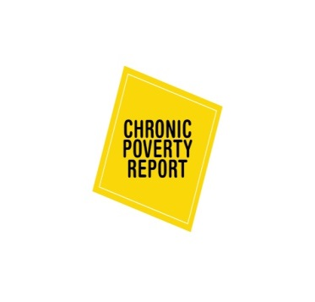
Policies for the zero poverty tripod
Notes:
In addition to these three areas of work, each leg of the tripod also requires its own set of policies, the importance of which may be more context-specific. For example, stopping impoverishment may require heavy emphasis on disaster risk management, where natural disasters are a strong cause of impoverishment. Tackling chronic poverty may require implementing anti-discrimination measures in case chronically poor people are poor for long periods or poor for a life time because they are discriminated against. Or measures to stimulate transformative social change that eliminates or reforms social norms that impoverish certain categories of people – social norms that regulate key life events of women are the most obvious example (dowry, inheritance, child marriage).
Less context specific is the need to universalise access to decent health care – the major cause of impoverishment in many societies.

Slide 9
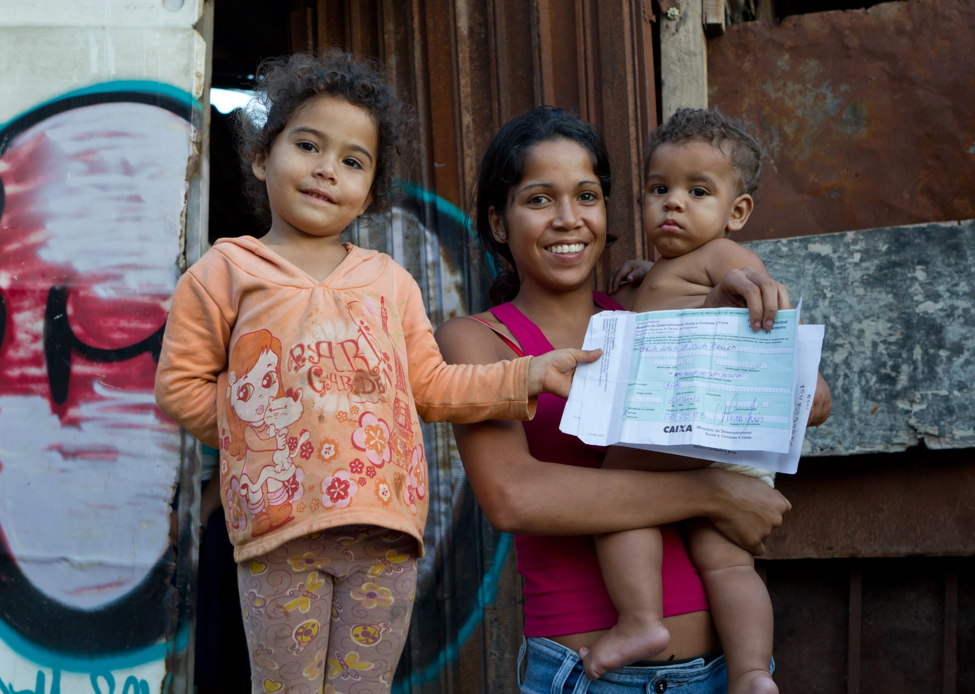
Bolsa Família contributed to Brazil’s success in reducing extreme poverty, which more than halved, from 17.5% to 8.4%, between 2003 and 2009. In 2011 it expanded into a large multi-programme initiative called Brasil Sem Miséria, built around two key principles: economic inclusion and intermediation
Notes:
So, tackling chronic poverty, the first leg of the tripod.
It is worth spending a few moments to restate the importance of social assistance in tackling chronic poverty. Brasil is an obvious example with a spectacular reduction in extreme poverty, at least partly thanks to Bolsa Familia. In 2011 Bolsa Familia has been upgraded to a more integrated programme, that focuses more explicitly on economic inclusion and intermediation/active search).
What Brasil’s experience tells us however is that social assistance leads to sustainable graduation from poverty only if it’s integrated with or at least alongside other anti-poverty interventions, if it’s provided in a systematic way and not as a stand-alone project. The Latin American cash transfers and South Asian employment guarantees are beginning to look like systems, and cross party political commitment can be strong. The main challenge is now in African countries, where Ethiopia’s Productive Safety Nets Programme is leading the way.
Beneficiaries of Bolsa Família, Brazil. Photo: Ana Nascimento/MDS

Slide 10
Changes in land assets among the poor, poorest and median quintiles 1990s-2000s
Source: Analysis of DHS data
Notes:
One of the reasons for chronic poverty is that the poorest may be losing access to land – the accumulation of which remains a critical pathway in most countries for escaping extreme poverty. So policies on land – secure land tenure, opportunities to access more land (eg through renting), and to build the other complementary assets (tools, equipment, land and water conservation) and access to decent markets which will increase the returns to labour.
The overall picture on land trends is worrying. Little good data on changing access to land over time. Where there is (DHS survey results) Except B/desh poorest all categories of household from median down losing access to land, poorest most. Even with the DHS in countries where they ask the question twice, we had to reduce the number of countries we could analysis because of problems with the data. There is a crying need for better data on this issue. And research to explain what is going on. Hypothesis: this is more often due to operations of local land markets and inheritance dynamics than large scale land acquisition. And opportunities to rent in are not growing to compensate for loss of land owned. So the poorest farm households are becoming more reliant on farm and non farm wage labour.
[The graph shows that land ownership is in decline across the poorest, poor and median income groups. For a sample of five countries, in all but one (Bangladesh) land ownership fell dramatically between the 1990s and the late 2000s, with the most marked decline seen among the poorest wealth quintile.
There are many drivers of land loss among the poor, with their relative importance varying from country to country. They include: the effect of population growth (with land divided into ever smaller parcels among heirs); the privatisation of common property (land and water bodies) as a result of mounting resource extraction and commercial interests; and the normal effects of market transactions; as well as a recent, pervasive and global land grab, which has sparked struggles to secure common and traditional land rights.]

Slide 11
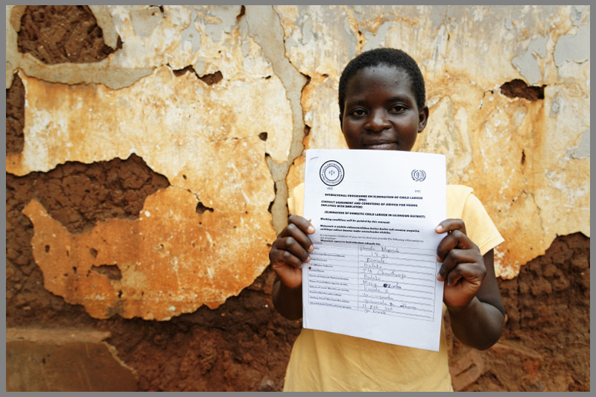
Pamela is a domestic worker in the morning and a carpenter in the afternoon. For her carpenter job, she obtained a special contract signed by the responsible village chief, the district level officer and her employer.
Notes:
Loss of land and lack of employment opportunities mean that to be pro-poor, economic growth certainly needs to focus on creating jobs and self-employment, but they also need to be decent jobs, even in the informal sector.
Written contracts are often a first step towards more decent work. China is a country with a rapidly formalising economy which has vastly increased the proportion of informally employed workers who have written contracts. In Tanzania, by contrast it can be difficult to get government to accept this.
The photo shows Pamela who is an 18 years old girl from Malawi. Pamela obtained the carpenter job after taking part to a vocational training project implemented by ILO. Through this project she also managed to obtain the contract that she shows in the picture. This is a special contract signed by the responsible village chief, the child worker, district level officer and the employer. The contract allows working children like Pamela to go to school and/or train their professional skills. Can these kinds of initiatives be scaled up?
Sweden has emphasised decent work, but we all need to think through strategies on how to support it without undermining job creation. Appropriate and gradual reforms may be the key. This is an area many governments are wary of, so politically difficult.
Improving the operation of value chains is another area Sweden is committed to, which could help indirectly improve the conditions under which informal firms and self-employed operate. However, this is a complex area of work.
Pamela : Domestic worker in the morning, carpenter in the afternoon.
Photos Marcel Crozet/ILO
Perhaps here we can say something on the importance of formalisation to implement all other social policies – UHC and social insurance

Slide 12
Targeted services for migrant workers: the case of the Aajevika Bureau in Rajasthan, India
Services provided
Registration and photo ID
Training and placement
Legal counselling, arbitration services and legal literacy
Financial inclusion and linkages with social security schemes
Family Support Programme and empowerment
Notes:
Things can also be done to improve the situation of migrant labourers, who are often employed through exploitative labour arrangements. An example is provided by the Aajevika Bureau – this provides support to migrants from Southern Rajasthan who head to Gujarat and Maharashtra to seek part-time, seasonal work at construction sites, brick kilns, in factories, markets and in a vast range of services. Mostly very young males, unskilled and from lower castes, migrants face many problems at their destination that are related to identity, stable employment and access to basic services. The specific services offered by the Bureau aim to tackle such problems.
Registration and photo ID through a network of walk-in resource centres at source and the destination areas.
Training and placement: vocational skill training and placement services to help rural youth.
Legal counselling, arbitration services and legal literacy offered in the walk-in centres and through a phone-based help line are also available for workers in Udaipur.
Financial inclusion and linkages with social security schemes: a specialised agency called Rajasthan Shram Sarathi Association (RSSA) provides support in accessing micro-credit, insurance and pensions.
Family Support Programme and empowerment at source areas.
Again, the challenge is to replicate or scale up such programmes, and begin to get government agencies (police, justice, social services) to work for rather than against migrants.
Sweden emphasises human rights – migrant labour would be a strong candidate group – it’s often critical to improve their participation in growth. So far the thinking on migration seems more tuned to making use of migrants’ expertise when they return home rather than focusing on the migrants’ experience (and that of those who remain behind often women and girls)…and apparently does not make the important distinction between international and national migrants. Within-country migration is usually more accessible and therefore more directly relevant for the extreme poor.

Slide 13
Inheritance-based destitution in Bangladesh: Halima.
Widow; married at 13 to a poor man.
Cared for ill grandfather and father, promised land in return for doing so – land that she never received.
Brother retains the 0.4 acres of land and the 200 betel nut and coconut trees on it.
Denied a document to prove ownership of 3 decimals of land to rebuild her house post-cyclone, by brother
Eldest sons migrated; looks after her younger children with no support.
Notes:
There are two other aspects of chronic poverty on which the report focuses – these are social norms and intersecting inequalities. It is well known that certain social practices (especially those which concern women, e.g. separated, divorced or widowed women) can be highly impoverishing, as in the case of Halima, who is denied access to the land she would have lawfully inherited.
Inheritance reform is a complex business – even when progressive legislation is on the books, implementation can be difficult. The reform of inheritance systems in favour of women (and their children) is a contested political issue in several countries, and one that requires significant social and political mobilisation to push through. And, as is so often the case, having legislation may be only the first step – land issues are often deeply cultural and embedded in local institutions that may (or may not) implement any laws on the ground. Governments have to work with local opinion leaders, law courts and civil society organisations in a broad coalition, or the latter have to pressure unwilling governments.
Sweden is most highly committed to gender equality, which is critical for tackling chronic poverty, so these issues must be ‘bread and butter’. Perhaps what is required in the context of the new framework which seeks to establish a hierarchy of objectives, is to work out which aspects of gender equality (a cross cutting theme for Sweden) will help people in poverty and living in oppression most in particular contexts. This is perhaps an area for stretching the current thinking.

Slide 14
Addressing intersecting inequalities
Notes:
The report highlights the most intractable forms of poverty, where marginalised people experience multiple disadvantages which reinforce each other, and
This analysis draws on Naila Kabeer’s work on this issue, as well as an as yet unpublished ODI report on how to address these intersecting inequalities.
What emerges from this analysis is that countries that have managed to reduce inequalities, have done so through context specific variations of the model illustrated here.
Examples are Brazil, Ecuador, Ethiopia, Nepal. India’s implementation of a panoply of rights is also promising.
May be difficult to replicate such experiences – they are very dependent on the political settlement, political leadership and institutions.
Sweden has been and remains committed to a human rights approach to development, political rights, right to organise, vibrant civil society, which are elements of the above. This would be a strong area to focus Sweden’s work, and one which other donors are not covering adequately.

Slide 15
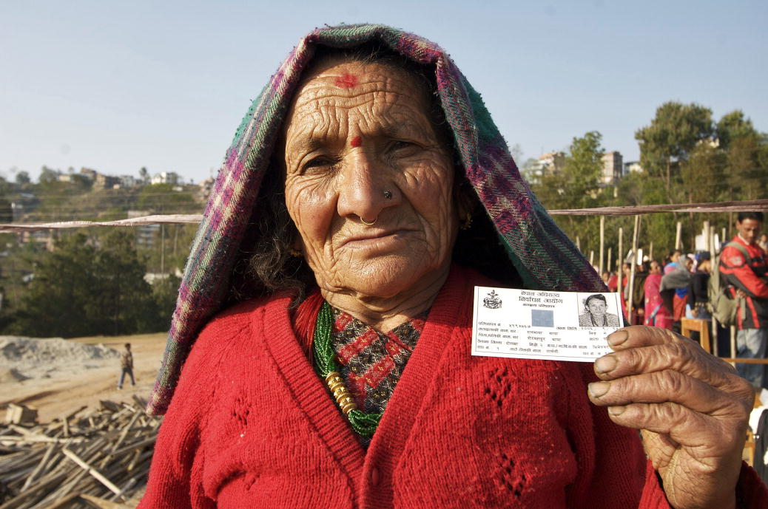
Towards progressive political settlements
Notes:
Nepal did have a universal pension scheme since the early 1990s, but few other policies benefiting the most marginalised people.
Progressive political settlements, of the sort seen in Nepal since the end of conflict involve new bargains between elites and citizens, typically centred on economic growth, jobs and their distribution, educational equality, and possibly also equalising access to land or other critical resources. Regional (or inter-group) equalisation may also be a central issue, as in Nepal.
New political settlements are generated by – (i) processes of resolving conflict and preventing its recurrence; (ii) other political crises; processes of social mobilisation leading to elite alliances with the poor, for the purposes of winning elections; (iii) the maturing of electoral democracies such that parties actively compete for the votes of poor people; and (iv) visionary political leadership. These drivers lead to the creation of the fiscal space and institutional capacity to address the issues which keep people poor.
In case no new political settlement is possible in the short to medium term are there things which will nevertheless help tackle chronic poverty? Definitely – there is a set of intermediate political and governance factors which will promote better service delivery for all. These are: (i) politicians making credible political commitments; (ii) the development of strong oversight systems, with clear roles and responsibilities for delivery and good performance monitoring and sanctioning; (iii) strengthening the capacity for local problem solving (eg via local governance) and (iv) for collective action including the poor – associations, selfhelp groups, CSOs etc.
In all cases, the result is greater demand for progressive policies.
Sweden has developed an analysis of power, but this will perhaps be brought into play more strongly as the framework is implemented.

Slide 16
STOPPING IMPOVERISHMENT
Poverty transitions – escapes and descents into poverty
Notes:
The report recommends that far more attention be given by national policy makers to the different causes of impoverishment than has been the case in the past. In particular this requires a specific set of policies which aim at preventing different types of risks, or helping families to cope with them when the negative shocks do occur. Social assistance is a good start, but does not deal fully with the major risks which push people into poverty in the first place.
The extent of impoverishment compared with escaping poverty, and understanding what causes these dynamics, provides a basis for prioritising policies in specific contexts. The report created a simple Impoverishment Index to measure this (proportion impoverished: proportion escaping). This will of course not be static over time – there is a need for ongoing investment in panel data to track this.
Reasons for not prioritising this leg of the tripod include: it’s politically less attractive to focus on stopping a negative than achieving a positive; the pre-occupation of elites with growth takes education along with it, but tends to leave health and social protection behind – a strong finding from a forthcoming study of successful MICs.

Slide 17
Risks of impoverishment and policy responses
Type of risk | Impoverishment channel | Policies to mitigate risk and reduce vulnerability
Individual | Production-related risks (inherent in farming and in entrepreneurial activity) and unemployment. Credit-debit spirals. Health shocks. Life-cycle turning points. | Tailor-made financial services, especially savings and insurance products. Universal Health Coverage. Social assistance for the extreme poor and social insurance in countries where the economy is formalising. Pre-school educational vouchers and targeted support to young families.
Systemic | Macro-economic and financial shocks. Conflicts. Natural disasters and climate change. Price spikes and inflation. | Macro-economic policies. Conflict prevention. Disaster risk-management. Wage policies.
Notes:
There is a raft of policy measures that can be used to prevent impoverishment, according to the type of shock. For negative shocks that operate at the individual and family level, the most relevant policies are: [select one of each eg:
Ill health is the most frequent and universal impoverishing risk – taking steps towards universal coverage by good quality services is essential in all circumstances. What those steps are depends on the national situation. Universal health insurance may work (as in Thailand), making certain services free where there have previously been charges is also a step in the right direction (as in Burundi). Sweden is committed to improving basic health services: this is a good start, but may not be quite enough to prevent impoverishment, which occurs when breadwinning adults fall sick, have accidents and need treatment, especially over long periods.
The quality of Disaster Risk Management is enormously varied across countries, and probably within countries too, with lots of scope to improve capacities to predict, and respond. DRM typically focuses on saving lives and loss of property; preventing impoverishment remains a neglected issue. Finding the turning point to take DRM more seriously is not easy.
Sweden has a strong focus on preventing impoverishment through sub-objectives on (3) A better environment, limited climate impact and greater resilience to
environmental impact, climate change and natural disasters; adaptation and disaster risk management; (5) the conflict prevention work looks very serious and thought out; this objective (preventing impoverishment) could be brought out more strongly in humanitarian work, alongside saving lives and alleviating suffering. A stronger focus on preventing impoverishment within humanitarian work would make it easier to link humanitarian and long term development aid.
Building resilience is mentioned several times in the Aid Policy Framework. Researched the idea of a resilience threshold for this report: income expenditure increases reduce likelihood of slipping back into extreme poverty, but no threshold as such in the panel data sets explored. More work can be done. Combining qual and quant evidence leads to the hypothesis that resilience in rural SSA may be a product of 8 years + of education, being above the poverty line and diversifying income sources (identified strongly in life history work). Education is very important – but massive hikes in education levels for most people needed to achieve resilience.
Resilience is linked to the quality of escapes from extreme poverty – how far are people progressing? Education is again a strong contributor to the ability to move far from the poverty line.

Slide 18
Notes:
Sustaining escapes from poverty is the third leg of the tripod.
Getting to close zero can only be achieved if families which manage to escape poverty, sustain this over time – and progressively move away from the poverty line.

Slide 19
What happens to households which escape extreme poverty?
Notes:
The analysis that we run for the report found that many people slip back into poverty having once escaped. Some of this may be small or short term movements, but the graph is also capturing at least some bigger movements.
The graph shows what happened at time period 3 to the households that had managed to escape poverty between time 1 and 2. Even in the Southeast Asian development ‘successes’, slipping back into poverty can affect around a fifth of households surveyed. In rural Ethiopia over 60% fell back into poverty after escaping it between 1999 and 2009.
This is a further illustration of how panel data can get under the usual picture of the proportion or number of people in poverty.

Slide 20
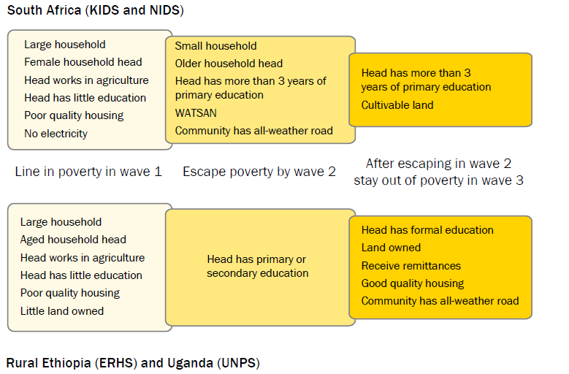
The factors associated with living in poverty, escaping poverty and sustained poverty escapes
Notes:
Looking at the characteristics of the households that managed to stay out of poverty provides an indication of what policies are needed to support people in their poverty escapes.
For example, In South Africa and Uganda, these are above all education, and to a lesser extent land policy and agriculture, but then also remittances, improved housing and local infrastructure feature in the story. + progressive regional development (although this is not evident from the figure)
What does Sweden support which is of relevance? Education support stops at basic education – not enough? Land policy focuses on equal land rights for women – critical, but not the whole story? Agriculture – not clear what will be supported. Sustainable cities stop at the boundaries, do not encompass regional development – ‘strategic urbanisation’ a missing element.
Sources: for South Africa: National Income Dynamics Study and Kwa-Zulu Natal Income Dynamics Study. For Ethiopia: Ethiopian Rural Household Survey; Uganda: Uganda National Panel Survey.

Slide 21
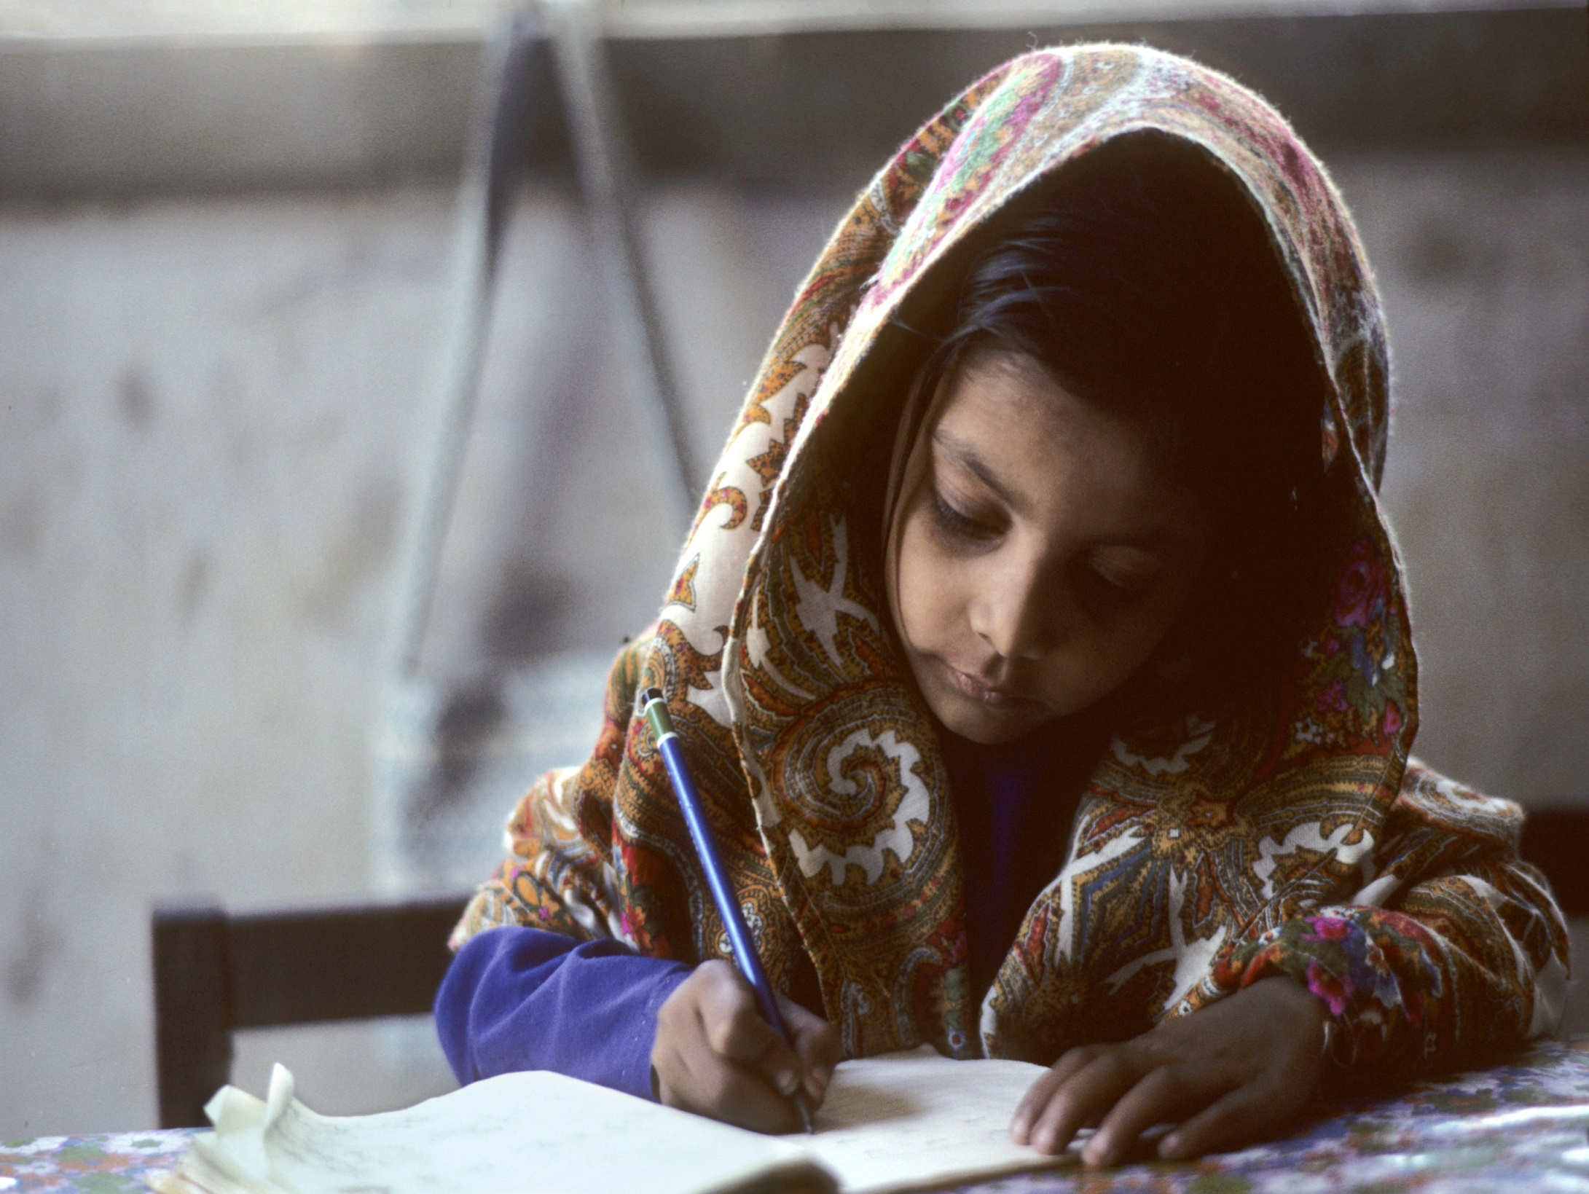
Notes:
Education, education, education: photo of girl studying (Karachi). It’s not just basic education which gets families out of poverty – in most societies children need more than this, and the poorest children need to be seen through school with the help of scholarships, cash transfers, school feeding programmes, appropriate and quality education, and wherever possible parental involvement. This would be greatly helped if the links between education and the labour market could be dramatically improved – through upgraded apprenticeship schemes, and curriculum design which takes into account the requirements of employers at different levels. TVET has proved an expensive and largely exclusive sub-sector, but modern communications must surely offer some solutions here. There is a need for great policy creativity to create these links, especially for poor children.
These issues are covered in more detail in the CPAN Education Policy Guide.

Slide 22
 | East Asia and Pacific | Europe and Central Asia | Latin America & Caribbean | Middle East & North Africa | South Asia | Sub-Saharan Africa | Global
$0.70/day Optimistic | 6.9 | 0.2 | 8.8 | 2.2 | 27.5 | 84.5 | 130.1
$0.70/day Baseline | 10.3 | 0.4 | 11.6 | 4.1 | 47.8 | 124.8 | 199.0
$0.70/day Pessimistic | 15.2 | 0.6 | 14.4 | 6.3 | 92.8 | 172.1 | 301.4
$1.25/day Optimistic | 33.1 | 1.9 | 21.4 | 9.1 | 143.4 | 218.7 | 427.5
$1.25/day Baseline | 46.6 | 3.0 | 27.8 | 14.2 | 228.0 | 304.5 | 624.1
$1.25/day Pessimistic | 68.3 | 4.4 | 35.3 | 20.3 | 409.1 | 417.5 | 954.9
Notes:
The report then asks can it be done? The answer is based on an analysis of relative success in tackling chronic poverty… which shows that even poor countries can address some of the difficult challenges mentioned so far.
We’ve also done projections to 2030, using the International Futures model. The best projection from the calculations we have done to date gives 624 million people still in extreme poverty in 2030. The range (optimistic to pessimistic) is 427-954 million, not too far away from other projections which have been done, and which are compared in the report, though this one is on the pessimistic. The details are work in progress – the IFs is about to go to another version once the World Bank updates its PPP figures this month, and we should rerun the model at that point. However, the message is clear, even if the figures may need updating continuously – it’s a dauntingly difficult road that lies ahead.

Slide 23
Projected poverty headcount in 2030 by country income category
Notes:
Two of the controversial issues are the degree to which poverty will be concentrated in LICs vs MICs, and fragile versus non-fragile states.
We looked at the geography of severe poverty as well as $1.25 poverty and found a fairly even division between LICs and MICs, with severe poverty not surprisingly more prevalent in LICs.

Slide 24
Projected poverty headcount by 2030 in fragile and non-fragile states
Notes:
And significant poverty in fragile states. Widespread agreement about this.
CPRC definition of fragile state (2008-9 Chronic Poverty Report) was a state which increased the vulnerability of its citizens. Impoverishment likely to be a prevalent process, so a focus on policies against impoverishment is logical.

Slide 25
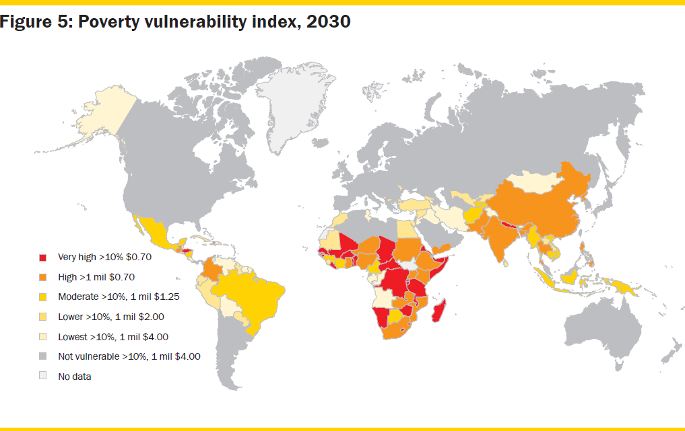
Notes:
This is a map showing countries which are vulnerable to significant levels of severe and extreme poverty in 2030, taking into account the proportions and the numbers in poverty. This will be updated with the new data, but in the mean time, it is clear that the best prediction is that many countries will still be struggling with significant poverty problems.
It is often the same countries which will struggle to collect enough revenue and spend enough: we projected that 19 countries would still have less than $500 total public expenditure per capita in 2030, 16 of which in SSA; 44 countries spend less than that amount now. Financial aid will necessarily continue to play an extremely important role in helping these countries eradicate extreme poverty.
In conclusion: we think this report presents a realistic picture of the road towards zero extreme poverty. There are both grounds for pessimism – the widespread severe poverty in Africa, the structural inequalities in South Asia, and state fragility cutting across these two.
The report has made the case for a new approach which gets away from the expectations that growth, human development or democracy (or social assistance for that matter) by themselves will do the job, and gets under the bare statistics of progress to focus on what happens to people over time.

Slide 26
Summary comments on Sweden’s Aid Policy Framework
Long menu - use goal to screen: what makes the biggest difference?
Tackling chronic poverty √
Preventing impoverishment √
Sustaining escapes from poverty x
Politics, taxation, social contract, remember ‘power analysis’

Slide 27
Future plans
Pro-poorest growth (PP²G)
Anti-discrimination measures
Political economy of policy change needed to eradicate poverty: what needs to change by 2020?
Disability and poverty dynamics: policy evaluation
Climate finance and poverty eradication
Notes:
PP²G: Further policy guides
International Conference 2015
Chronic Poverty Report 2016
Discrimination: Multi-country evaluation 2015-6, leading to a
Chronic Poverty Report 2017

